Slide 1
StreamNet Steering Committee Meeting Monday, September 19, 2022 9:30 AM – 3:30 PM (PDT) Microsoft Teams meeting: Click here to join the meeting Or call in (audio only): +1 207-387-0436,,771668135# Phone Conference ID: 771 668 135#

Slide 2
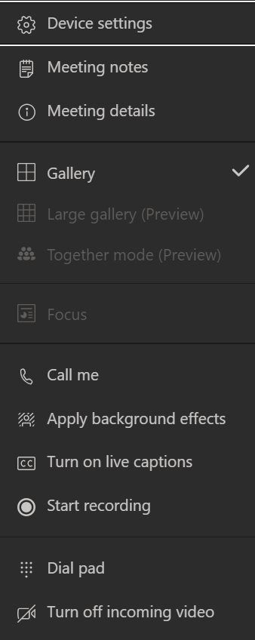
Welcome and Introductions Please leave web cameras on to facilitate discussion
Please mute yourself when not speaking.
Use *6 to mute phone audio.
Use the microphone icon on the control bar to mute computer audio.
All participants,
please use the chat to introduce yourself (name and affiliation)
Check device settings
if you are having problems with audio/video

Slide 3
Agenda (times are approximate, Pacific time zone)
9:30 | Welcome and introductions
9:45 | Updates, Announcement and Partner Spotlights
11:00 | Discussion on CAP QA/QC pilot and next steps
11:30 | Check in on SN Tech Team/DDT and CAP DDT
11:45 | Lunch Break
1:00 | Discuss draft changes to the CAP Fish HLIs user interface for display groups of population, adding data status for populations without HLIs
1:30 | CAP 5-year plan - propose and discuss CY23
2:00 | Stretch Break
2:15 | 2023 CAP Workshop Discussion
2:45 | Update November ETIS 2022
3:00 | FY23 Budget and February 2023 SC meeting
3:30 | Adjourn

Slide 4
Spotlights, Updates, and Announcements
Spotlight
ODFW: Cedric Cooney and Spotlight
Colville Tribes: John Arterburn, George Batten and Ryan Klett for Spotlight
MFWP: Dawn Anderson and Spotlight
Shoshone-Bannock Tribes: Kurt Tardy
IDFG: Angie Schmidt
CRITFC: Sheryn Olson and Denise Kelsey
NPCC: Kris Homel
BPA: Russell Scranton, Matthew Schwartz, Tom Pansky
CRITFC Library: Tami Wilkerson
USFWS: Todd Gilmore
WDFW: Brodie Cox
NOAA: Mari Williams
PNAMP: Jen Bayer
StreamNet: Nancy, Greg, Mike, Van

Slide 5
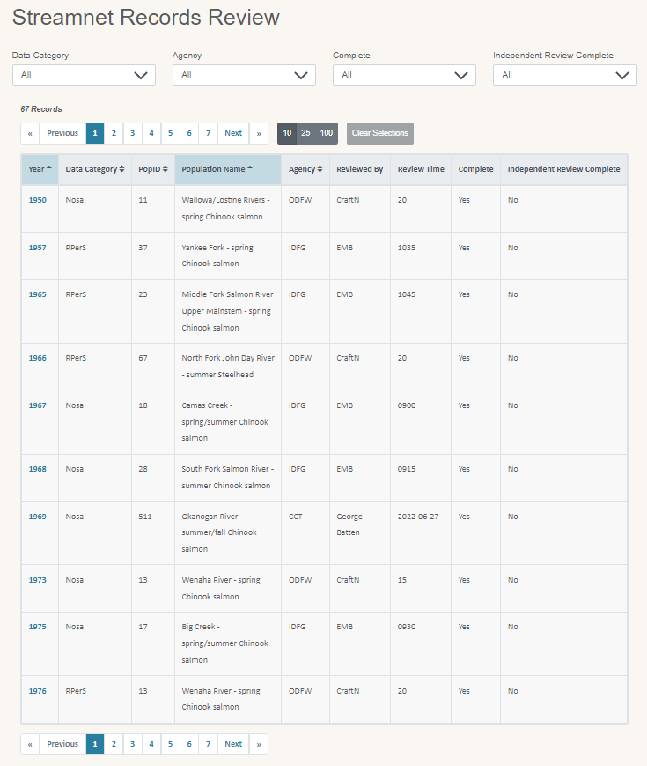
Discuss CAP QA/QC pilot and next steps
Notes:
https://app.streamnet.org/app/datareview/?index=1&perpage=10&datacategory=All&agency=All&complete=All&complete_2=All&sort=year%3Easc*population_name%3Easc

Slide 6
CAP Manual/Visual QA/QC pilot discussion
Summary of Pilot Tasks
Review assigned records using QA/QC web app
Data Stewards focus on accuracy
Independent focus on comprehension
Provide input on process and the review tool
QA/QC plan & pilot implementation plan are posted on website
Summary of Pilot Outcome
Time range of record reviews 5min to 3:30 hrs
Most took about 7 minutes
Review identified
broken links,
some questionable data entry, and
potential validation rules that could be added

Slide 7
CAP QA/QC Questions & Next Steps
Questions
Was this value added?
Data steward perspective
Independent reviewer perspective
If value added how can we improve documentation?
Capture in web-app via comment box?
Is timestamp of updated field in CAX enough?
Add separate fields/assignments in web-app for independent reviewer
If value added, how many records should we aim to complete per year or per quarter?
Other?

Slide 8
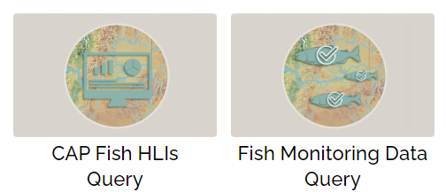
Check in on SN Tech Team/DDT and CAP
Notes:
https://app.streamnet.org/app/datareview/?index=1&perpage=10&datacategory=All&agency=All&complete=All&complete_2=All&sort=year%3Easc*population_name%3Easc

Slide 9
Check in on SN Tech Team/DDT and CAP
Update connecting StreamNet and monitoringresources.org
February 2022: SN Technical Team discussed concepts for connecting MR Study Plans to SN Fish Monitoring Data (FMD; aka “trends”) and CAP HLIs
April 2022: agreement on data connections to pursue in 2022-2023 for FMD only and SN DES changes.
July 2022: MR developed a plan and resources to facilitate connecting BPA Project & study plan to FMD and StreamNet implemented DES modifications.
Sept 27th: Kick-off meeting to begin collecting data starting with IDFG & ODFW data compilers
Fish Monitoring Data ("trends")
Summary of DES refinements
Age data query (next 3 slides)
CAP Populations table cleanup
Removal of MPG & ESU from non-listed populations (done)
We will suggest to CA DDT to standardize population names
Notes:
Update on connecting StreamNet and MonitoringResources.org
February 2022 -- SN Technical Team discussed concepts for connecting MR Study Plans to SN Fish Monitoring Data (FMD; aka “Trends”) and CAP.
April 2022 -- Agreement on data connections to pursue in 2022-2023. FMD only -> not HLIs due to time/resource limitations. Also identified necessary StreamNet DES modifications.
July 2022 -- MR developed a plan & resources to facilitate connecting BPA project numbers & study plans to FMD data. StreamNet has implemented DES modifications:
Adding 2 fields (BPAprojNum and MRstudyPlanID) to Trend table. First one is more of a tool to help find the second one. Both fields allow multiple entries, comma-delimited. Query system will make calls to MR.org based on study plan IDs. Each study plan can link to multiple protocols.
Sept 27th -- Kick-off meeting to begin collecting data starting with IDFG & ODFW data compilers as first testers. Plan is for them to provide data by March 2023. Greg will implement a query system mod we will design to display/provide these links. Actual work to do at PSMFC is not huge; data providers will have more to do, as usual.
Fish Monitoring Data
Significant DES changes to be adopted in next version:
Add BPAprojNum and MRstudyPlanID to Trend table.
TrendID will not change and will not be reused if deleted. We will need to create validation rules to be sure species, run, location, etc. do not change for a TrendID.
Some new rules for the Reference table, mostly associated with using databases as references.
Hatchery names must be unique.
Next version to be published ..... soon.
STILL TO DO: Ongoing need to create format for handling trend locations as a feature class rather than as events.
Age data query system
Next 3 slides

Slide 10
Age data query
Fish Monitoring Data - Age Data
Age data can be displayed in two ways: as age distribution of a sample of fish, or as age distribution of a brood year. The data shown here are derived from our Fish Monitoring Data. (Not from HLI data.)
Present Data As ...
Species
Run
Rearing Type
Sampling Year
i
Age distribution by sampling year
Age distribution by brood year
All, Chinook,
Steelhead, etc.
All, Spring,
Summer, etc.
All, Natural, Hatchery, Mixed, Unknown
All, 1958, ... 2016
Population Name
Compiled By
i
All,
etc.
All, CDFG, CRITFC, etc.
3541 Age Data Sets
<<
Previous
1
2
3
4
5
6
7
8
9
10
Next
>>
10
25
100
Download
Clear Selections
Link
STREAM | RIVER MILE | HATCHERY / DAM | SPECIES | RUN | SUBRUN | PRODUCTION | LIFE HISTORY | DATA SOURCE | SAMPLING YEAR
StreamAndTribNames | RiverMiles | HatcheryOrDam | Species | Run | SubRun | Production | LifeHistory | SourceDataCategory | SampleYear
StreamAndTribNames | RiverMiles | HatcheryOrDam | Species | Run | SubRun | Production | LifeHistory | SourceDataCategory | SampleYear
Notes:
Age data query
A separate query system will be made for age data. A mock-up is shown here. Under 1% of our trends have age data, so finding the age data needles in that haystack would be impossible.
Age data will be presented in a way that shows age distribution, based on either sampling year or brood year. The user chooses which.
Age data are complex. They come from the Trend, EscData, HatchRetMain, and HatchRetDetail tables. Data that go together are not always in the same trend, or same year, or same ASNID, and the numbers to report vary based on total age or ocean age, along with other fields. So I created a view that provides a 2-D table for the query system to pull from.
Here the user selected "Age distribution by sampling year", and the results are shown on the next slide.

Slide 11
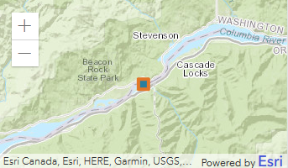
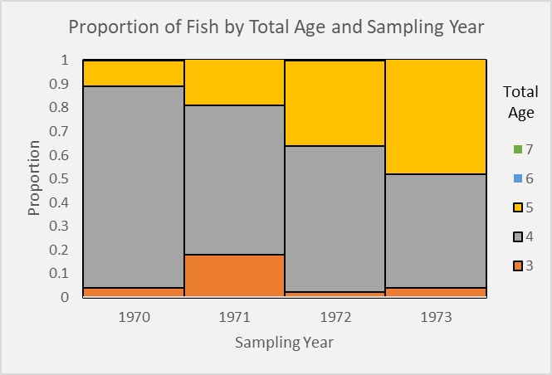
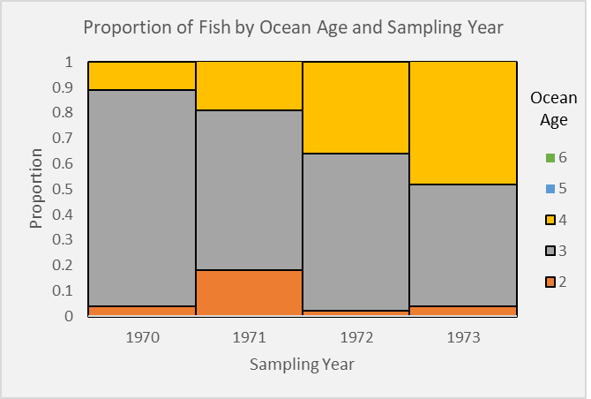
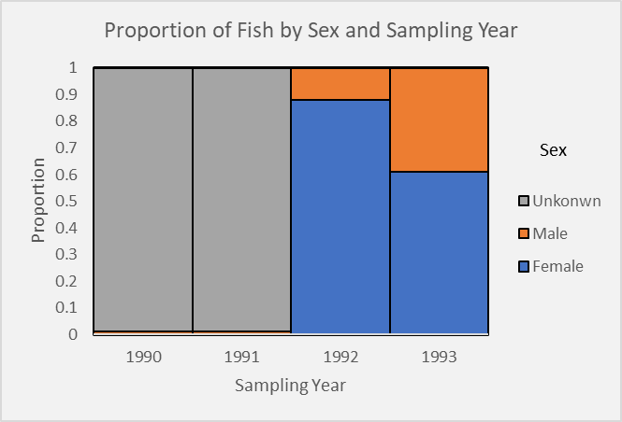
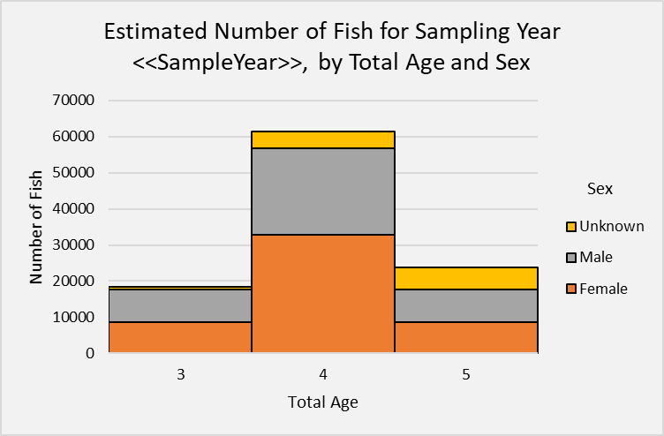
Age Data – Age Distribution By Sampling Year
Download
Link
Species: Chinook salmon
Run: Spring
Subrun: N/A
Production: Mixed
Life History: Anadromous
Population Name: Not assigned
Stream: Columbia River, trib to Pacific Ocean
River Mile: from RM 143.87 to RM 143.87
Hatchery / Dam: N/A
Age data from Dam / Weir Counts | Compiler: CRITFC
All years →
Year selected in table →
SAMPLE YEAR | NULL RECORD | BROOD YEAR | TOTAL AGE | OCEAN AGE | SEX | TOTAL FISH | AGED FISH | LENGTH TYPE | MEAN LENGTH (mm) | MEAN WEIGHT (g)
SampleYear | NullFlag | BroodYear | TotalAge | OceanAge | Sex | TotalPerAS | ActualPerAS | LengthType | LengthMean | WeightMean
SampleYear | NullFlag | BroodYear | TotalAge | OceanAge | Sex | TotalPerAS | ActualPerAS | LengthType | LengthMean | WeightMean
Show Field Definitions
Notes:
Graphs show age distribution for each sampling year.

Slide 12
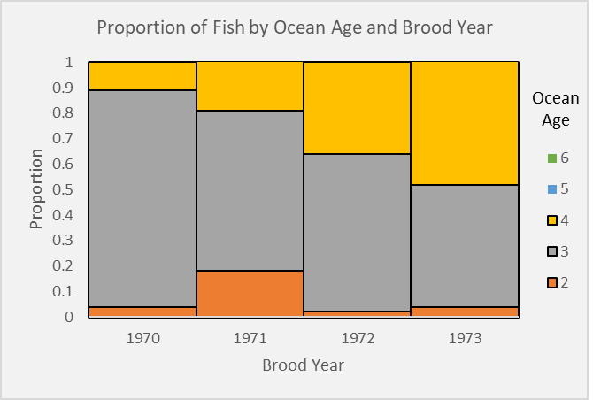
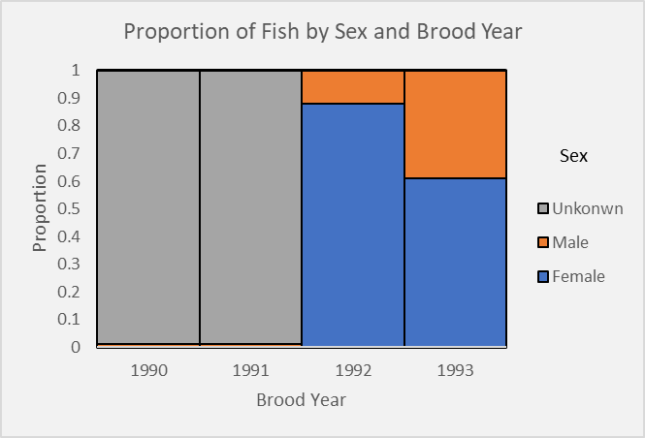
Age Data – Age Distribution By Brood Year
Download
Link
Species: Chinook salmon
Run: Spring
Subrun: N/A
Production: Mixed
Life History: Anadromous
Population Name: Not assigned
Stream: Columbia River, trib to Pacific Ocean
River Mile: from RM 143.87 to RM 143.87
Hatchery / Dam: N/A
Age data from Dam / Weir Counts | Compiler: CRITFC
All years →
Year selected in table →
BROOD YEAR | NULL RECORD | SAMPLE YEAR | TOTAL AGE | OCEAN AGE | SEX | TOTAL FISH | AGED FISH | LENGTH TYPE | MEAN LENGTH (mm) | MEAN WEIGHT (g)
BroodYear | NullFlag | SampleYear | TotalAge | OceanAge | Sex | TotalPerAS | ActualPerAS | LengthType | LengthMean | WeightMean
BroodYear | NullFlag | SampleYear | TotalAge | OceanAge | Sex | TotalPerAS | ActualPerAS | LengthType | LengthMean | WeightMean
Show Field Definitions
Notes:
Graphs show age distribution for each brood year.
This page looks almost the same as age distribution by sampling year.

Slide 13
Check in on SN Tech Team/DDT and CAP
Update connecting StreamNet and monitoringresources.org
February 2022: SN Technical Team discussed concepts for connecting MR Study Plans to SN Fish Monitoring Data (FMD; aka “trends”) and CAP HLIs
April 2022: agreement on data connections to pursue in 2022-2023 for FMD only and SN DES changes.
July 2022: MR developed a plan and resources to facilitate connecting BPA Project & study plan to FMD and StreamNet implemented DES modifications.
Sept 27th: Kick-off meeting to begin collecting data starting with IDFG & ODFW data compilers
Fish Monitoring Data ("trends")
Summary of DES refinements
Age data query
CAP Populations table cleanup
Removal of MPG & ESU from non-listed populations (done)
We will suggest to CA DDT to standardize population names
For HCAX we want a list of stock names in a standard format. We looked to the natural populations as a guide, but ...
Notes:
CAP populations table cleanup
Populations list clean up: Mike and Mari reviewed the ESU and MPG entries in the populations table. We set ESU and MPG to "N/A" for non-listed populations.
Populations list clean up: Impending creation of hatchery stock names for HCAX prompted us to look to the existing natural population names for a naming convention. But we found the natural populations don't use a consistent format. For example, 80% use a hyphen in the name, 20% don't. We want to make all names consistent and, because these are names we made ourselves for the query systems, we think it's ok to make changes. We will propose to the CA DDT changing our natural population names, as needed, to a single convention. The full list of all proposed changes is available if anyone wants to see it.
Here are the new rules if anyone asks:
All natural populations and hatchery stocks have names in the form <location(s)> <run(s)> <species>. For example, "Big Creek winter Steelhead".
Include specifiers such as "River" and "Creek" and "Hatchery" in the name.
Do not use hyphens unless necessary, such as for "mid-Columbia".
Use "and" for multiple locations; use ampersand for multiple runs. (I found using the same thing for both caused the names to be hard to read.)
Do the best possible when those rules cannot apply perfectly. For example, "John Day Basin wild summer Steelhead".
Clarifying information goes in parentheses; information in addition to the name goes in square brackets.
Capitalization: The first word, and proper nouns, are capitalized; other words are not. AFS considers official common names to be proper nouns, e.g. "Bull Trout". We will follow AFS's lead.

Slide 14
Lunch Break back at 1pm (PT)
Northern Pike removal, Lake Roosevelt

Slide 15
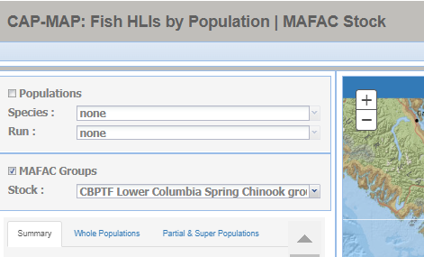
Discuss draft changes to the CAP Fish HLIs user interface

Slide 16
Status of the CAP Fish HLIs user interface
Status of SN ExCom Sept 2022 decisions on CAP Fish HLIs
Task | CAP Fish HLIs map query | Draft CAP Fish HLIs tabular query
Provide additional filters (e.g. population name, HLI, pop fit, methods, compiled by) | ---- | Done
Remove ‘non-trt’ from pop names | Done | Done
Display partial population estimates (subpop) with whole population estimates; place whole estimate at top and differentiate clearly from partial | Pending changes to MAFAC/Superpop | Done displayed on separate rows
Provide info on data availability for all populations without CAP Fish HLIs/related trend | FMWG Data Display reviewed data and provided input on display Mock up display for map query ready for input Next step: SN SC input and SN ExCom review then finalize
Separate out HLIs for different groupings (e.g. Multiple pop; MAFAC-NPCC groups) | Same as previous row | Done via filter Whole, Multiple, Partial. New groupings will be added

Slide 17
View proposed changes to the CAP Fish HLIs user interface
Go to online map demo
Notes:
https://capmap.streamnet.org/

Slide 18
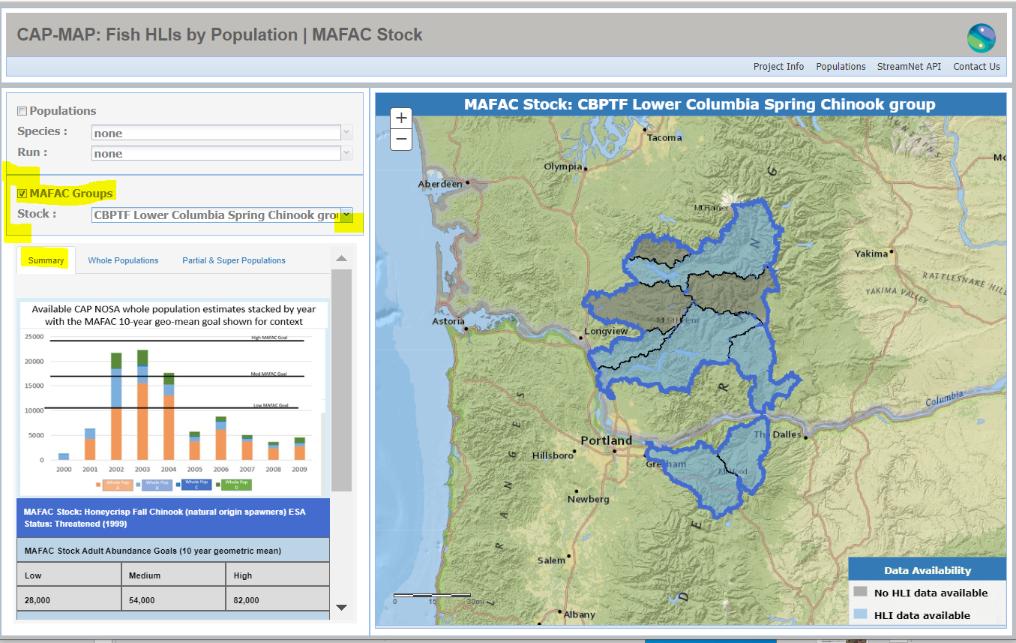
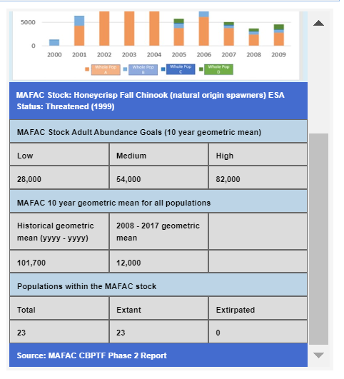

Slide 19
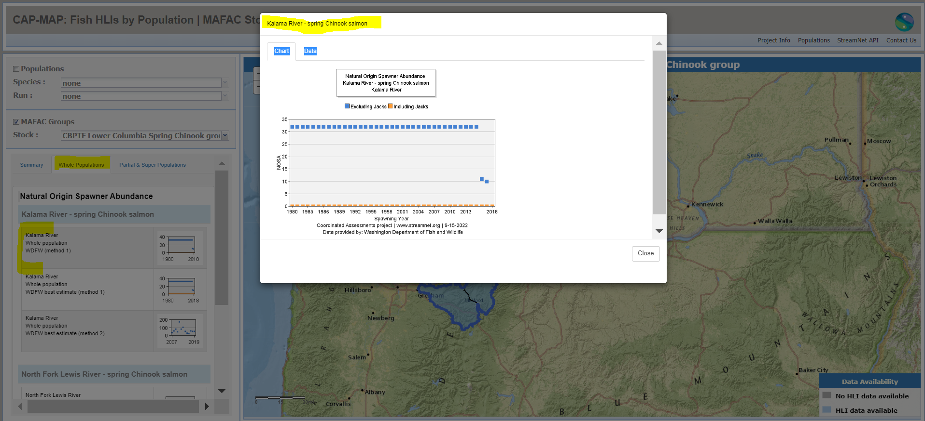

Slide 20
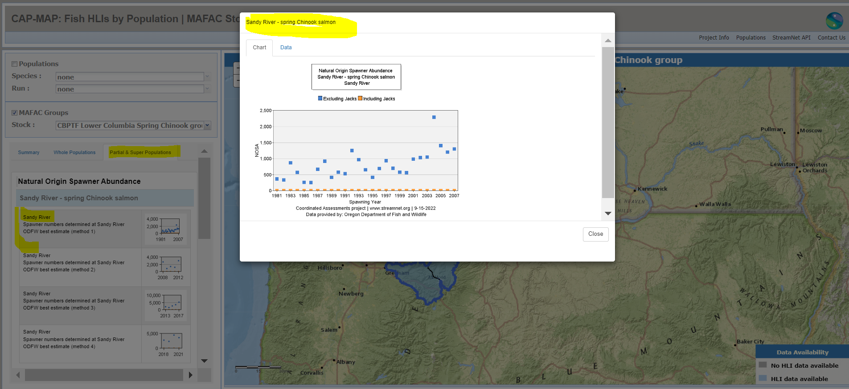

Slide 21
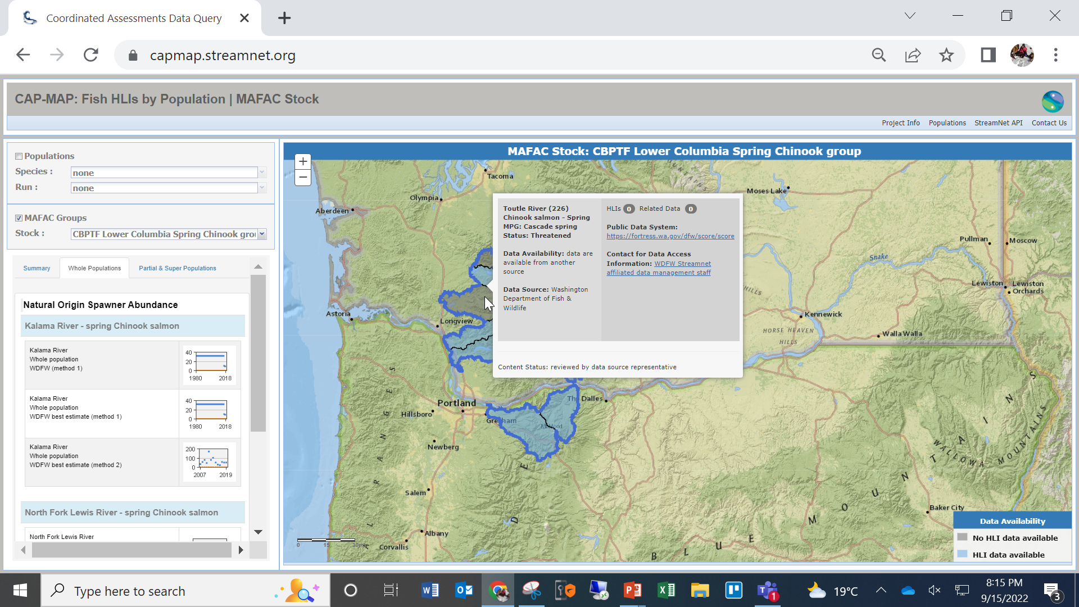

Slide 22
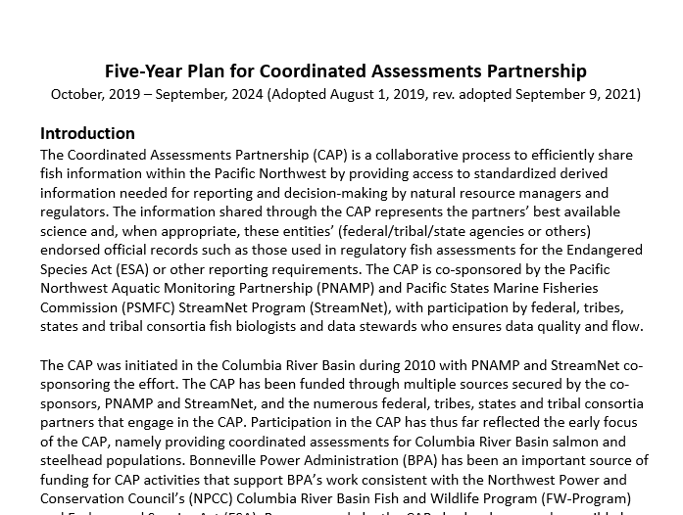
CAP 5-year plan - propose and discuss CY23

Slide 23
CAP 5-year plan - propose and discuss CY23
Summary of proposed changes thus far:
Correct old URLs, typos, remove obsolete info (e.g. priority populations, StreamNet trends)
Clarify and update CAP/StreamNet specific target text (e.g., Fish Monitoring Data etc.)
Add Bull Trout DES development steps in anticipation of regional support for development
Clarify white sturgeon DES text and steps
Update HCAX hatchery indicator content
Completed 2021, 2022 tasks; and postponed harvest indicator task
Meeting document:
Five-Year-Plan-for-Coordinated-Assessments-20190731 (proposed revisions Sept2022)

Slide 24
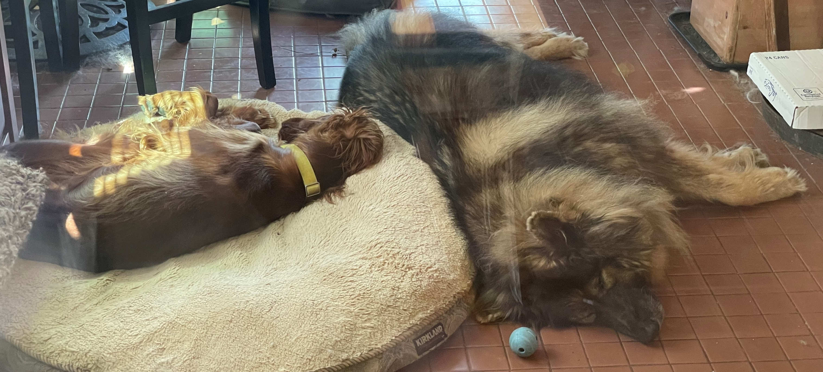
Break back at 2:15pm (PT)

Slide 25
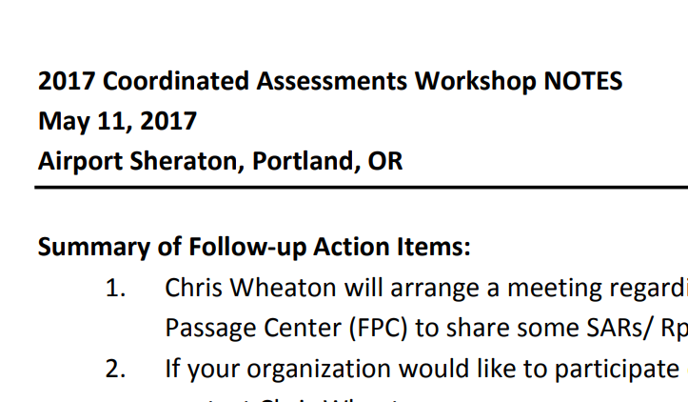
2023 CAP Workshop Discussion
Upcoming Workshop: 2023
Last Workshop: 2017

Slide 26
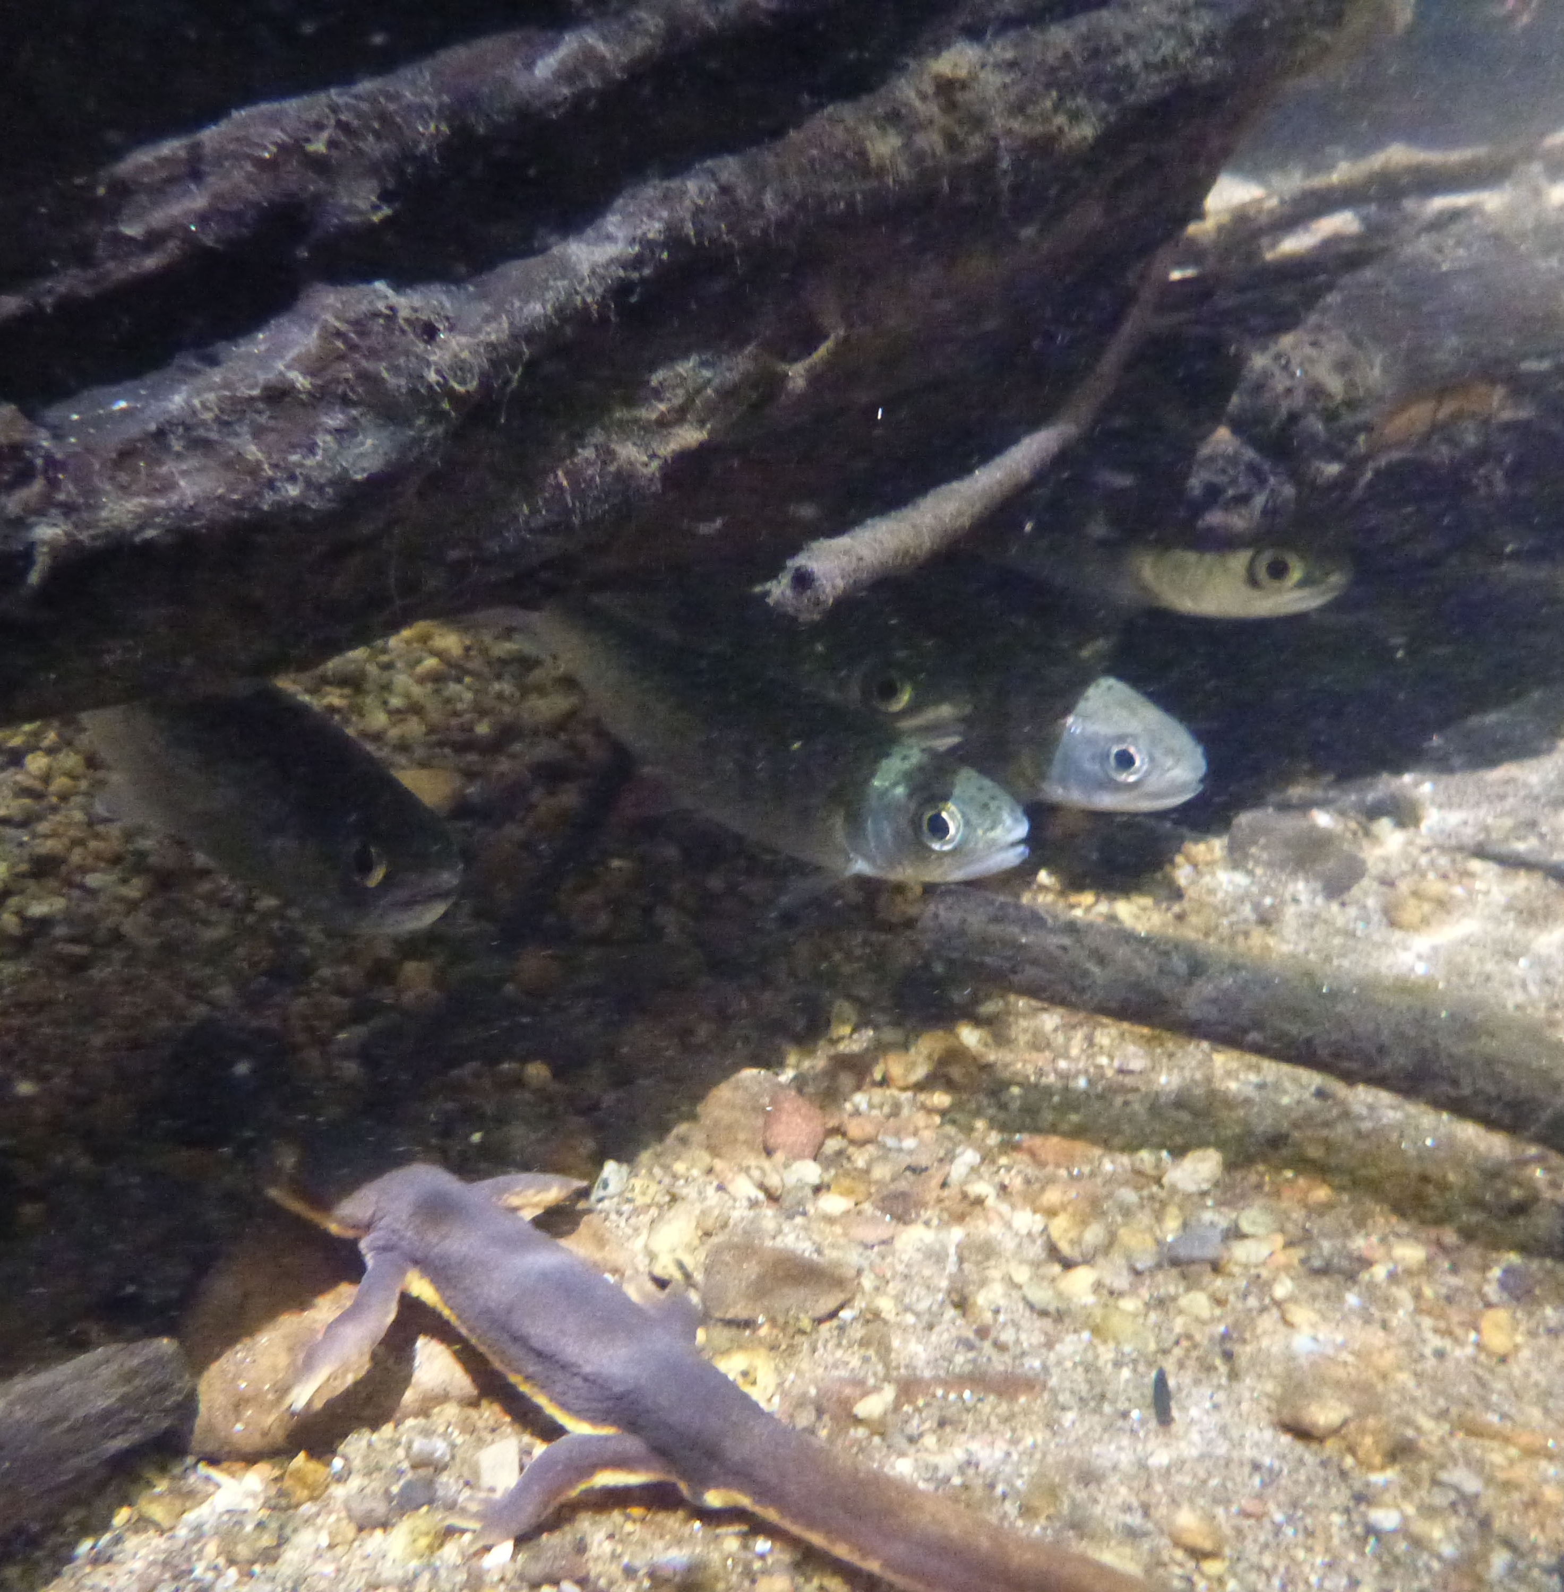
Coordinated Assessments Partnership (CAP) 2023 Workshop
Why: support CAP community of practice to collaboratively agree on important metrics and indicators benefiting from a standardized and efficient exchange process to inform regional assessments and reporting
Expected outcomes:
Identify current and future data access challenges (provider/user perspectives) and propose solutions
Confirm data that inform regional assessments (research, management) that would benefit from inclusion
Strategies for collaborative approaches and funding to address needs and challenges
When: April 2023; 1 or 1 1/2 days; dependent on final agenda
Who: All CAP Data Providers and Data Users, and including:
StreamNet Steering Committee, DDT, Tech Team
StreamNet Executive Committee
PNAMP FMWG members active in relevant tasks
PNAMP Steering Committee
Photo credit: NOAA
Notes:
JEN

Slide 27
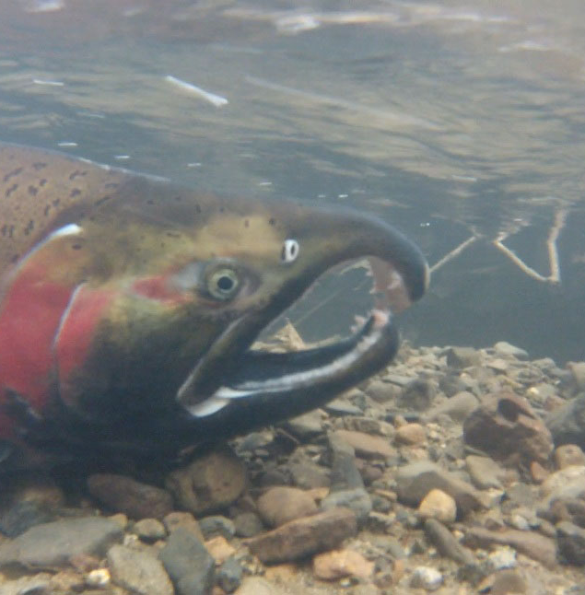
Workshop Agenda Will Focus on Problem Solving
Data Submittal Issues
Issue 1: Connecting quality metadata to datasets
Issue 2: Expected Content is not being submitted in existing DES for natural origin salmon and steelhead
Data Retrieval/Data User Issues
Issue 1: Data Consumers accessing CAP CAX and other salmonid related regional data systems can’t easily map stocks, species, populations between these systems e.g., FishGen, RMIS, PTAGIS, CAP CAX, FINS, etc. How can we streamline access for data consumers?
Issue 2: Mismatch between field names shown in CAP queries and the data providers’ public website. How can we alleviate confusion or concerns about the data in CAP CAX?
Issue 3: Other ways we can improve data for the same stock/population that resides in multiple systems more easily accessible?
Issue 4: Discuss whether updated data queries for accessing data for groups/stocks is adequate to support Columba Basin Collaborative data needs, another target user, or are other improvements needed?
Photo credit: NOAA
Notes:
JEN
Emphasize discussion of challenges and solutions

Slide 28
Also…Review Accomplishments and Plan for the Future
Refresher on the CAP structure and processes
Results from the past 6 years (what has changed since the last CAP Workshop in 2017)
CAP’s Next Data Categories
Review the data categories/species identified in the CAP 5-year Plan
Discuss intent to explore development for next HLI data category DES (perhaps Bull Trout) in FY24-25 and possible grant funding
Discuss other data category/species to be tackled next – what and when? Habitat? Sturgeon?
Preparing for the future of efficient data exchanges
Funding opportunities
Future of data mobilization
Photo credit: NOAA
Notes:
JEN

Slide 29
2022 ETIS Update
Important Dates﻿﻿
Conference Program | Online Program | At a Glance Schedule
Registration Deadline | November 10, 2022 until sold out
Lodging Reduced Rate Deadline | October 15, 2022
Conference Dates | 14 to 16 November 2022

Slide 30
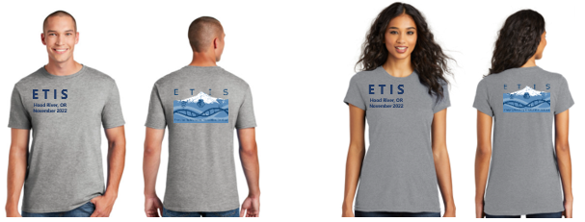
2022 ETIS Update – Registration
Registration with CVENT.
Please visit https://cvent.me/v5OB1x to register.
Registration fee is $150 for in-person or virtual.
All attendees will have access to the recordings afterwards.
This is the perfect event for you if you want to...
Learn about the latest technologies in aquatic monitoring for data collection, data management, and data visualization.
Share how you’ve improved your work with technology.
Network with other monitoring professionals implementing technologies in new ways.

Slide 31
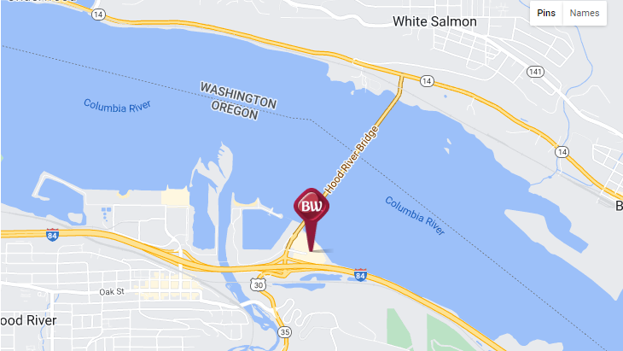
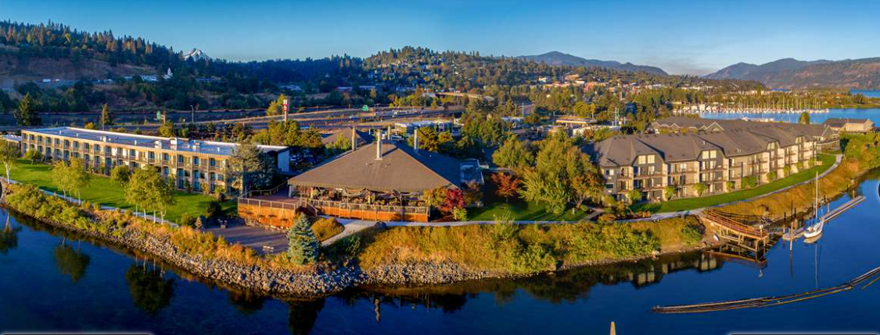
2022 ETIS Update - Lodging
Best Western Plus Hood River Inn
1108 E Marina Drive
Hood River, OR, 97031
Rooms available at the reduced rate of $149 per night plus tax. Call 1-800-828-7873 and indicate that you are attending ETIS. Reduced rate deadline is October 15, 2022. FY23 federal government per diem rate available for federal employees through October 15, 2022; government ID and travel authorization required upon check-in.

Slide 32
2022 ETIS Update – Program
Program highlights – 63 amazing presentations (50 oral and 13 as posters) with the following focus:
Genetics
Remote Sensing
Electronic reporting
Predictive modelling
Data management
Artificial intelligence or Machine learning
Data visualization

Slide 33
2022 ETIS Update – Keynote Speakers
Monday: Mark Saunders from the Pacific Region International Year of the Salmon/North Pacific Anadromous Fish Commission: The High-Tech Future of Salmon Resource Management: Marvel or Muddle?
Tuesday: Samantha Chisholm-Hatfield from the Oregon State University: Traditional Ecological Knowledge (TEK)
Wednesday: Leila Kaneda from SightLine Applications: Machine Learning – Your New Best Friend

Slide 34
ETIS 2022 Update – Sponsors

Slide 35
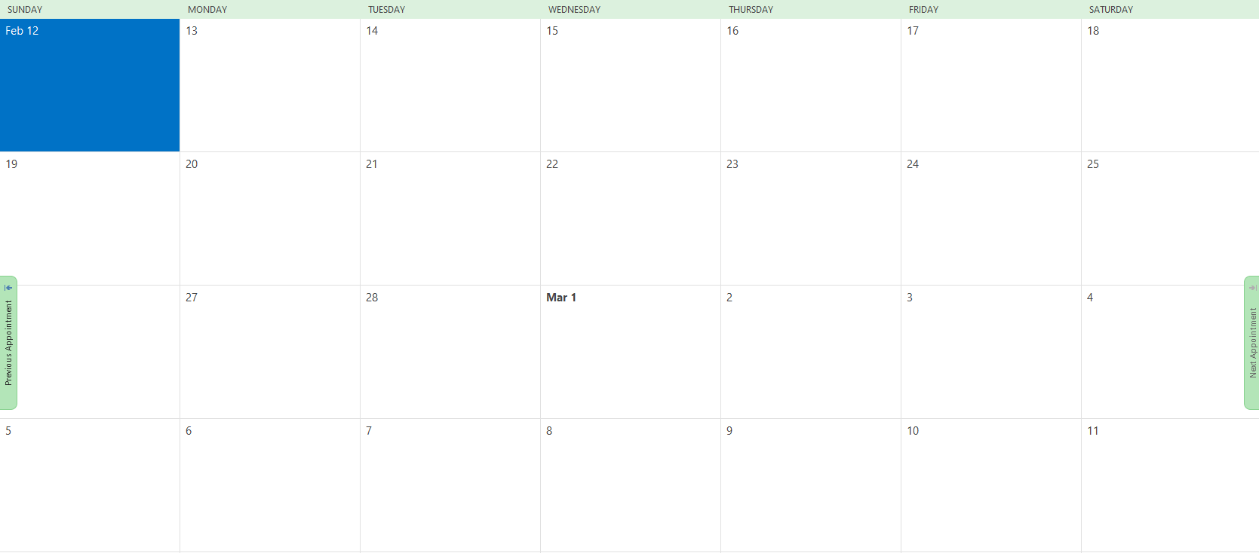
FY23 Budget and February 2023 SC meeting
FY23 Budget
Mari Williams & Monica Diaz
Subcontracts (cost & time amendments / new)
February 2023 SC meeting
Hosted by IDFG, Boise Idaho
PSC Annual Meeting
Would one of these days work?
21
22
23
President Day
28

Slide 36
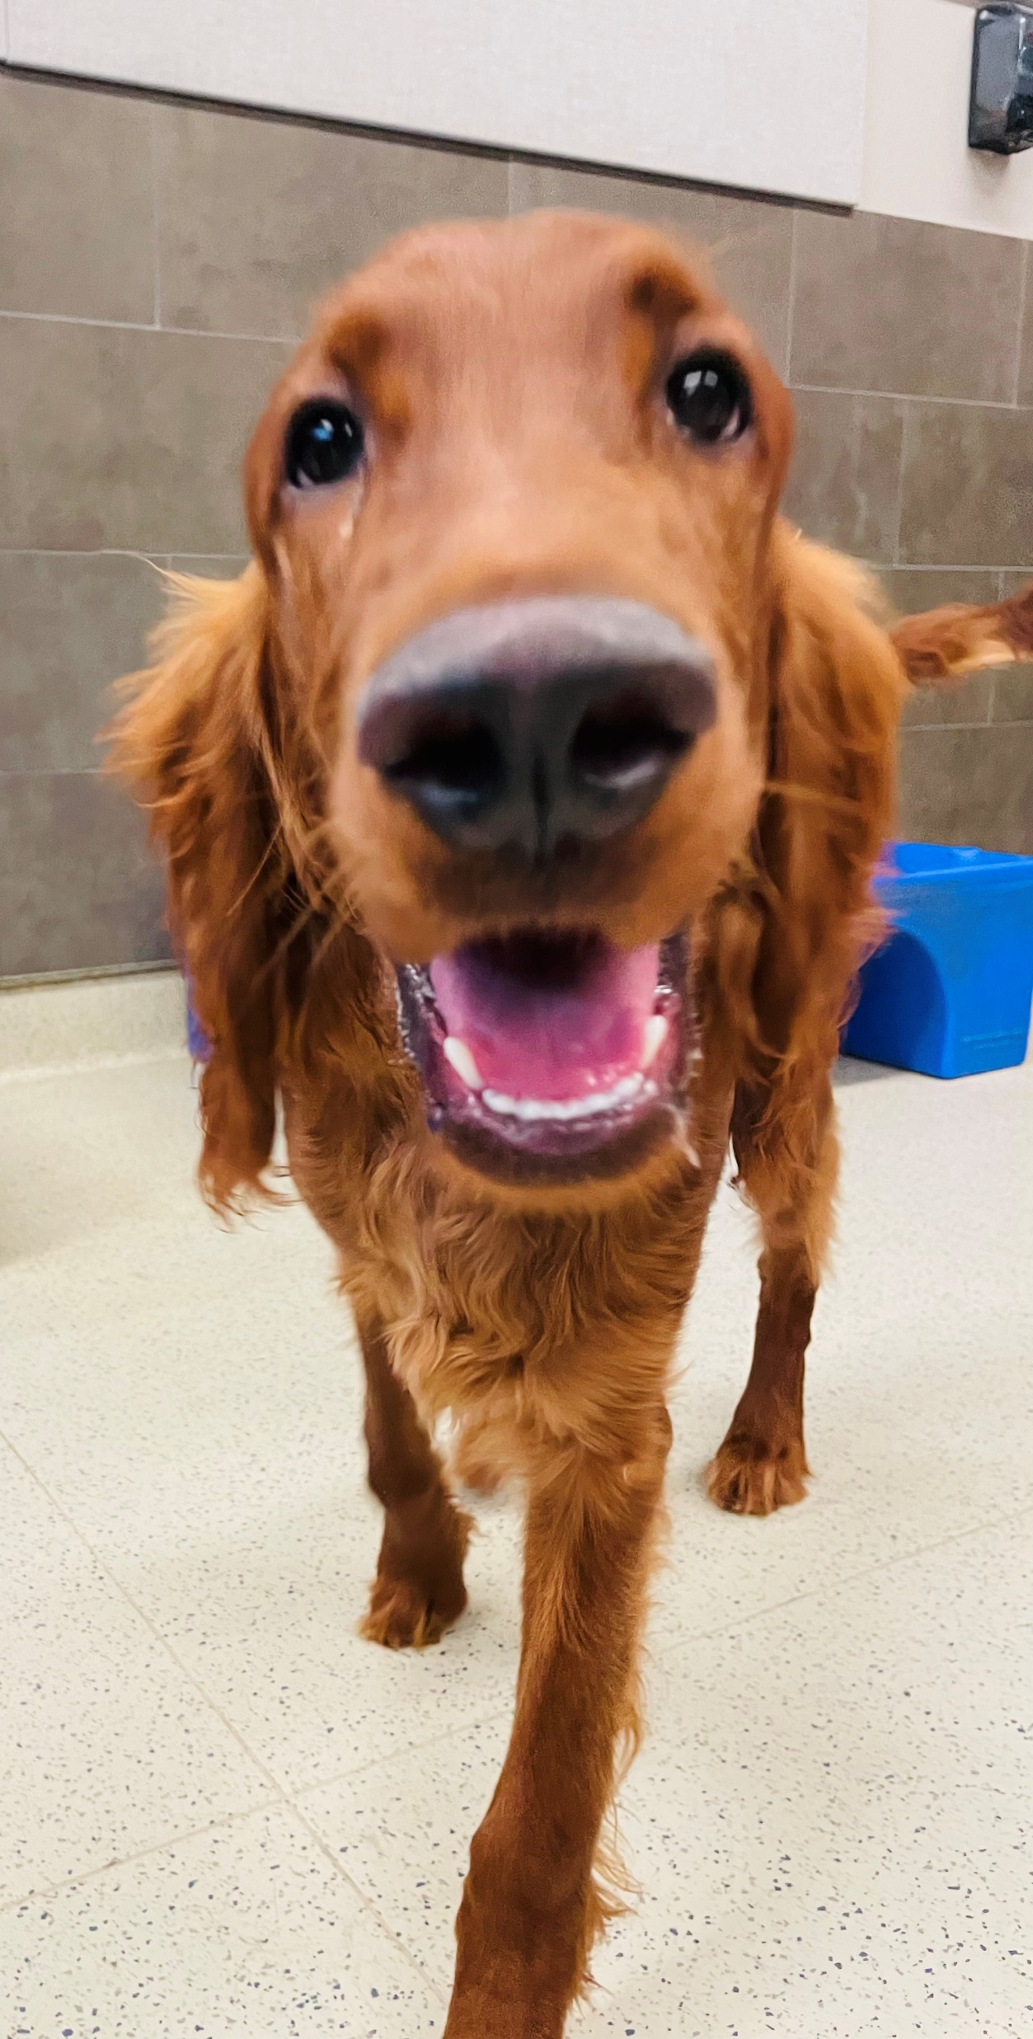
Adjourn!

