Slide 1
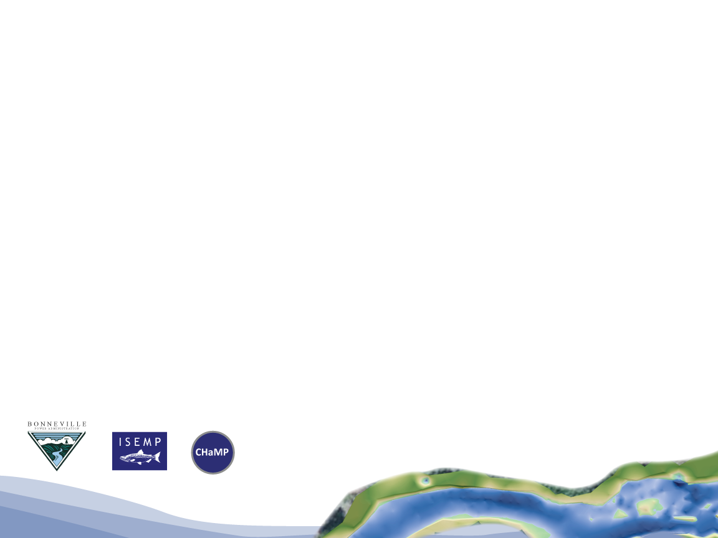


CHaMP Invertebrate Monitoring
CHaMP and ISEMP State of the Science Workshop
Portland, Oregon – February 25th and 26th, 2014
Presenter:
Nick Bouwes
Collaborators:
Nick Weber, Jeremiah Heitke

Slide 2
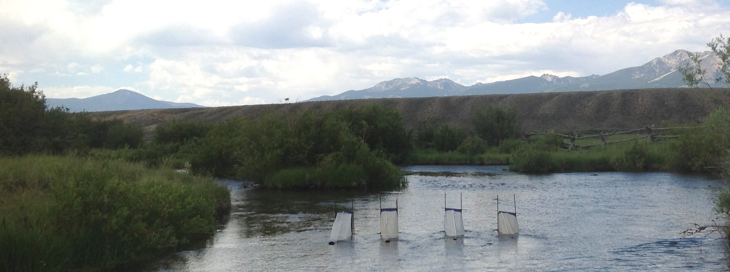
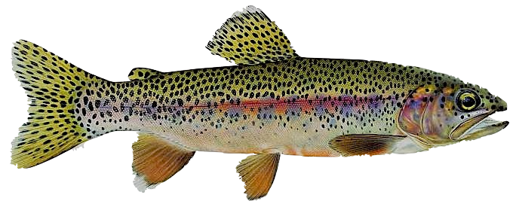
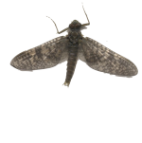
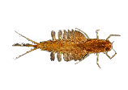
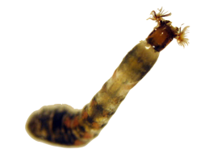

CHaMP Invertebrate Monitoring
Repeatability – Field sampling precision
Comparability – Cross-walks
Applicability – Relevance to fish

Slide 3
Repeatability – Field Sampling Precision
CHaMP 2011 - 2012

Slide 4
Repeatability – Field Sampling Precision
CHaMP 2013
Sites (signal)
Among nets
Repeat visits
Number of nets
Net clogging
Discharge sampled
Environmental groups
Taxonomic groups
Separate/pooled nets
% variance

Slide 5
Repeatability – Field Sampling Precision
CHaMP 2013
Terrestrial drift – highly variable
Drift Component
Sites
Visits
S:N
1.75
0.12
2.84

Slide 6
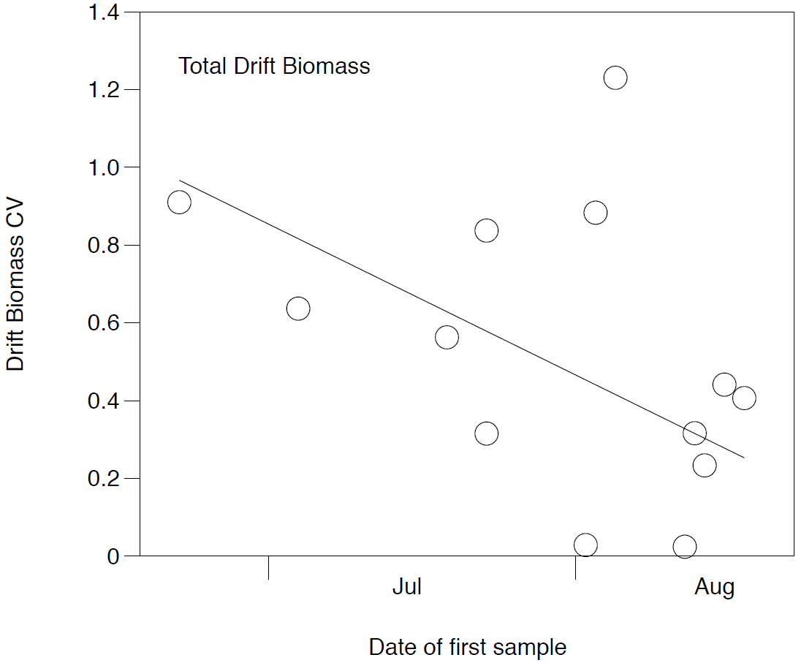
When to sample drift?

Slide 7
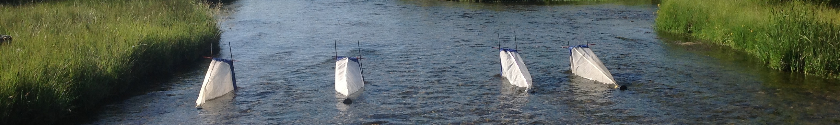
The effects of clogged nets
CHaMP 2013
Clog nets removed
S:N
7.93

Slide 8
How many nets?
CHaMP 2013
More nets = small increases precision – Drift relatively uniform

Slide 9
Repeatability – Field Sampling Precision
CHaMP 2013
Benthic abundances
Sites
Visits
S:N
1.5

Slide 10
Comparability – Crosswalk
CHaMP 2011 - 2012

Slide 11
Comparability – Crosswalk
CHaMP 2011 - 2012
Who is in the drift? And Why?
How many in the drift? And Why?
Family
Probability in Drift

Slide 12
Comparability – Crosswalk
CHaMP 2011 - 2012
Abundance in Drift
Notes:
So, first is the relative importance of different predictors in explaining the probability of different taxa to enter the drift.
- relative importance describes the amount of the variation one variable explains to the others in the model.
- The most important variable in determining the probabiliyt of occurrence in the drift was taxonomic classification
- Followed by the abundance of each family from benthic samples
- Much less important, and explaining a relatively small amount of data were environmental characteristics such as site gradient and percent fast water habitat.
- Who you are and how many of you have a strong role in determining occurrence in the drift.

Slide 13
Comparability – Crosswalk
CHaMP 2011 - 2012
Abundance in Drift
Benthic Density (29.5%)

Slide 14
Comparability – Crosswalk
CHaMP 2011 - 2012
Predicted drift density
Observed drift density

Slide 15
Applicability – Relevance to fish
2013 relationship test
55 Sites – 3000 individual O. mykiss

Slide 16
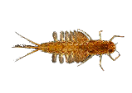

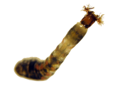
Applicability – Relevance to fish
Preliminary ISEMP relationship
Simplified foraging relationship
Weber et al. 2014 in press

Slide 17
Applicability – Relevance to fish
Preliminary test of relationship (7 Sites)

Slide 18
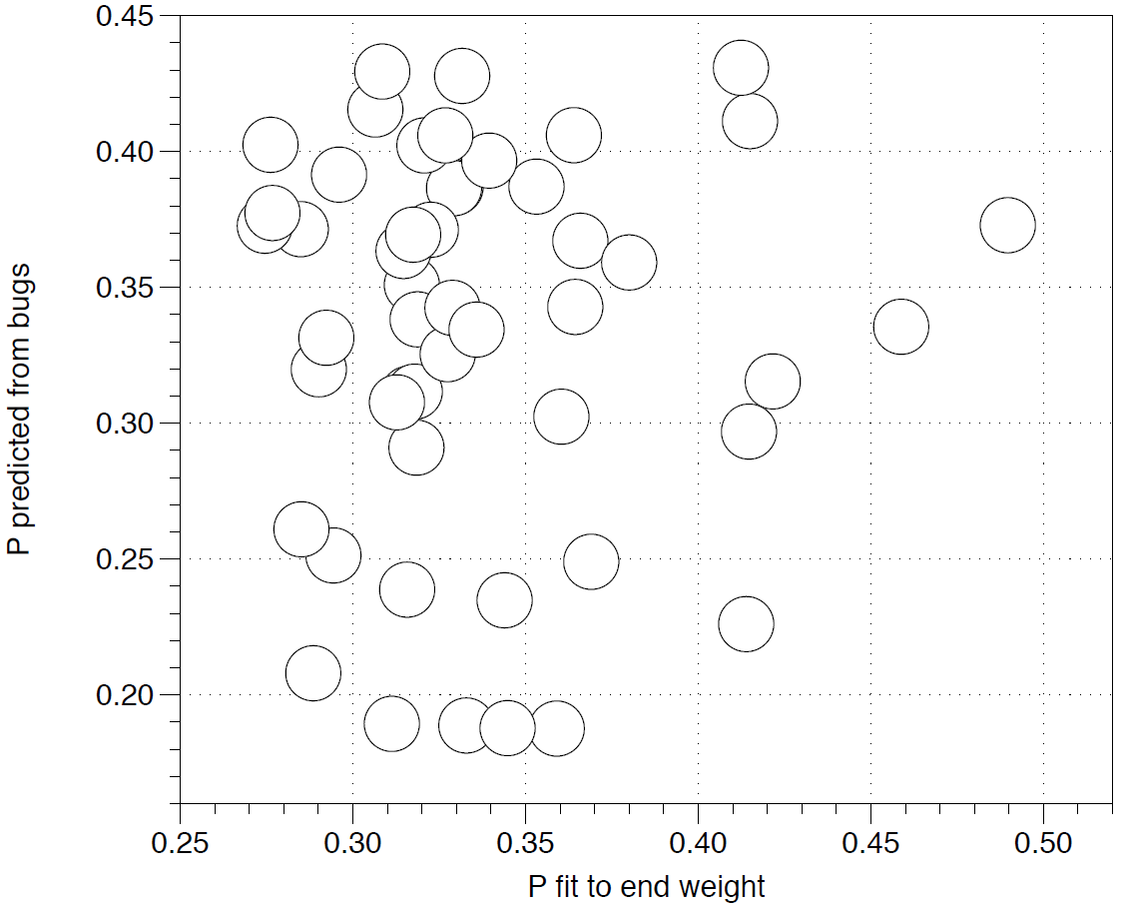
Drift vs Consumption
2013 relationship test

Slide 19
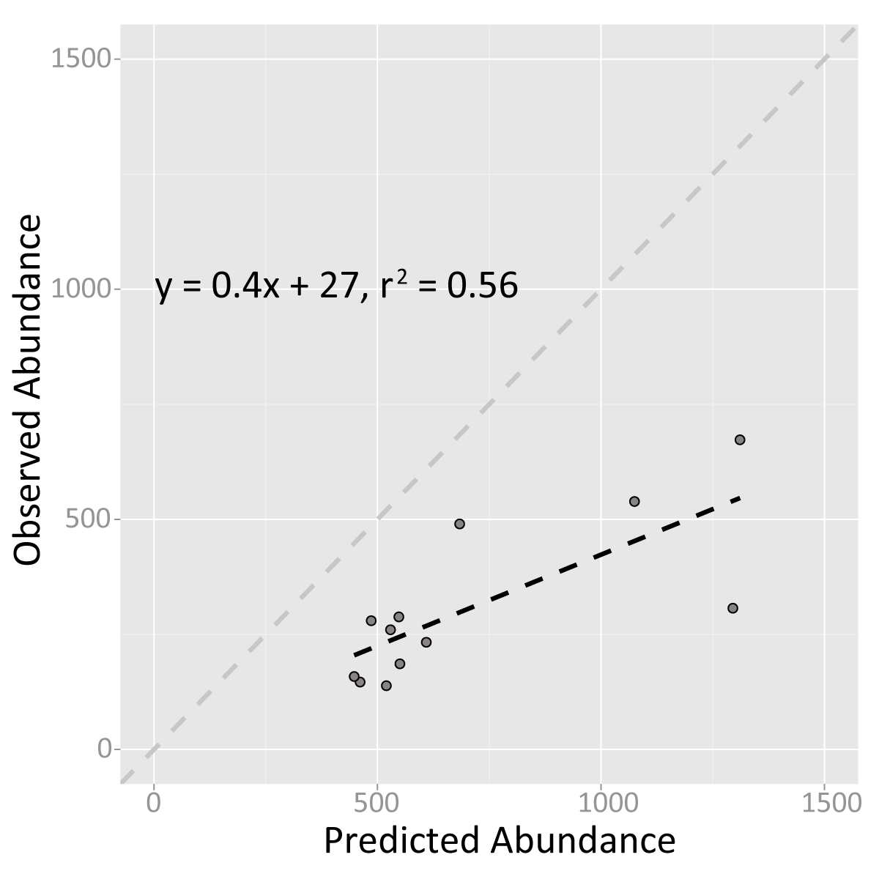
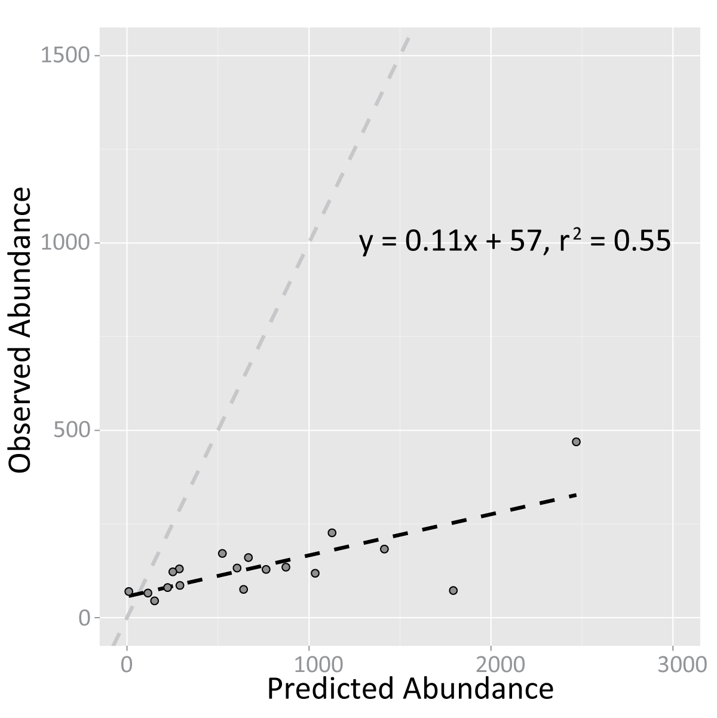
NREI models and status
Asotin
John Day
Predicted Carrying Capacity
Predicted Carrying Capacity
Notes:
We’ve done this in Asotin and JD using 2013 CHaMP data and are pleased with the results. On the x-axis for both of these plots is our predicted carrying capacity, and on the y-axis is a population estimate generated using fish sample data. The plotted circles represent sites in each basin. We had 12 sites in Asotin and 18 sites in John Day. We found different relationships for the two basins, but the results suggest the majority of sites in either basin might be below their carrying capacities.

Slide 20
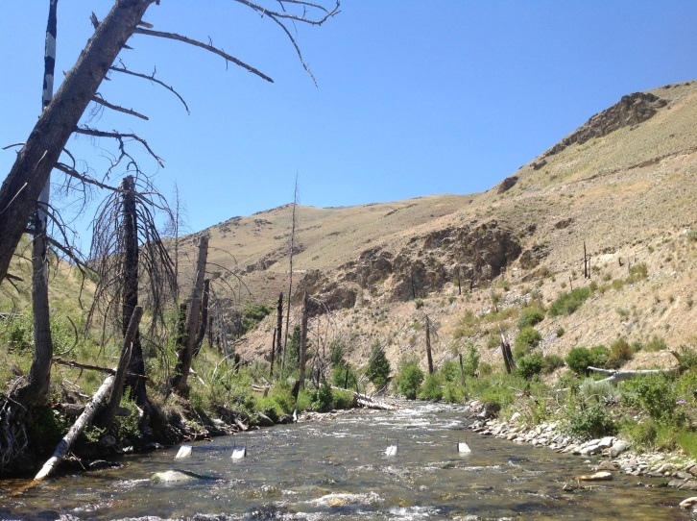
Conclusions
Repeatable
  Don’t sample at high flows
  Avoid clogged nets
  Two nets appears adequate
Potential to predict drift from benthic
  But what about terrestrials?
Applicability to fish
  Simple bioenergetics model is not enough
  Paired with physical habitat, drift is useful information
What is the alternative

Slide 21
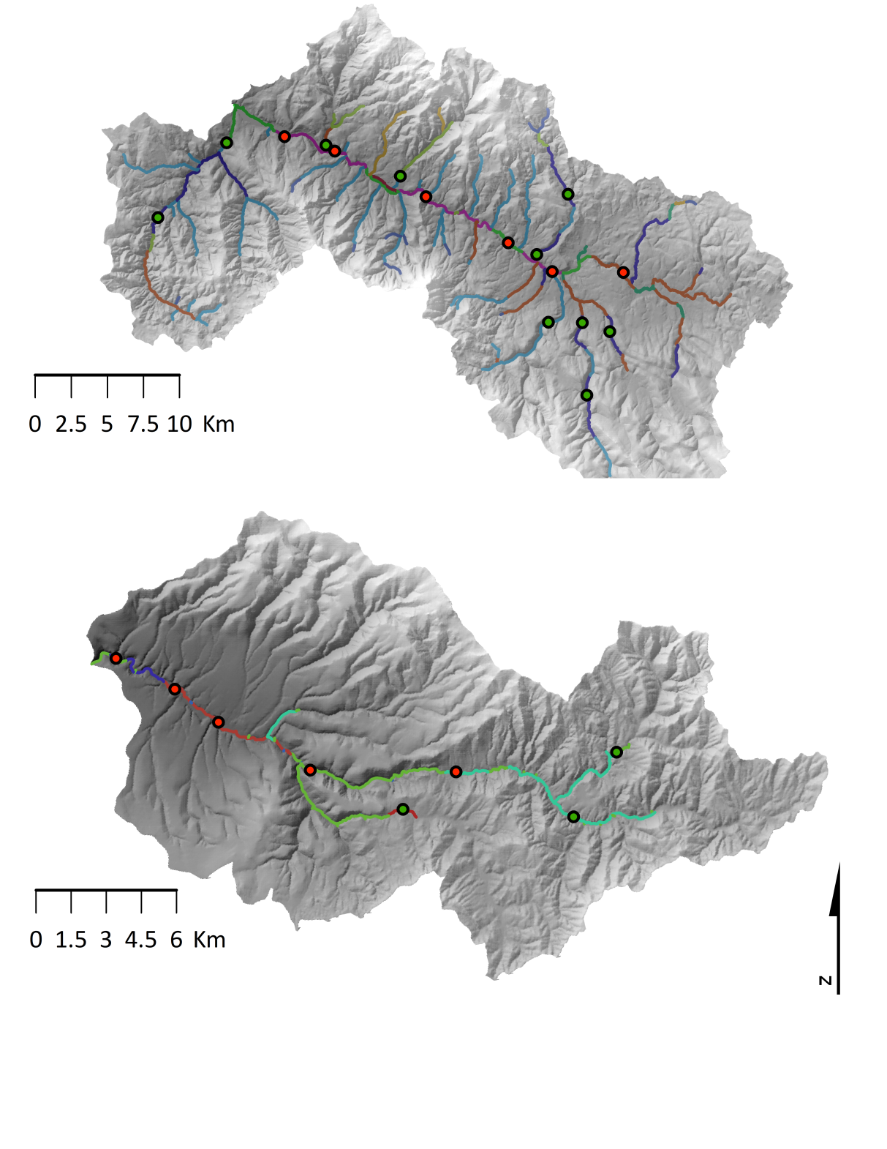
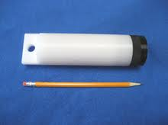
Middle Fork John Day
Sampling design
23 sites
  Middle Fork and South Fork John Day River
  Stratified by geomorphic classification unit
Short and long-term deployment
  2-3 day
  21 day
Used PME miniDOT loggers
Murderers Creek

Slide 22
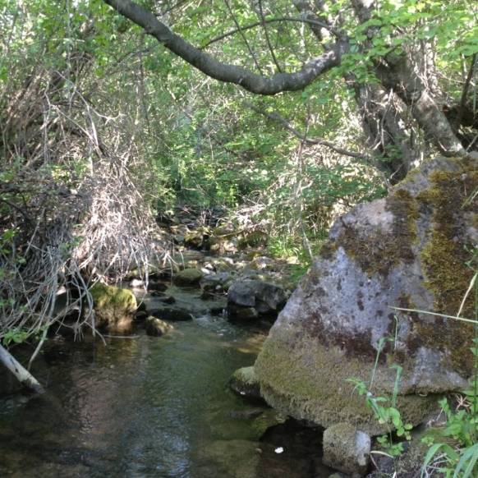
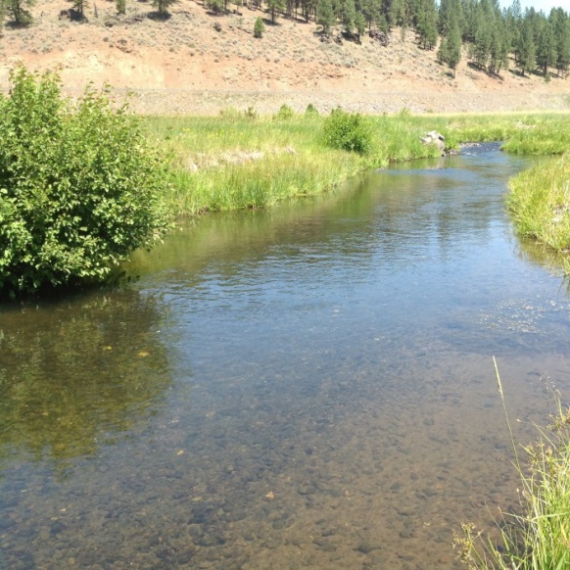
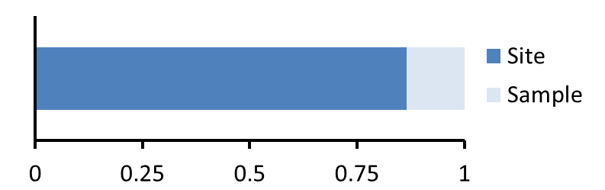
Preliminary Results:
Tributaries
Net production negative
Gross production 0.15 – 6.1 mg O₂ L d⁻¹
Mainstem
Net production positive
Gross production 4.3– 17.2 mg O₂ L d⁻¹
Signal to noise: 6.5

Slide 23
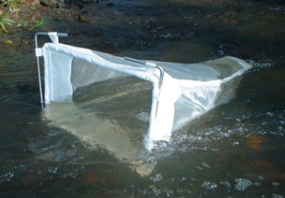
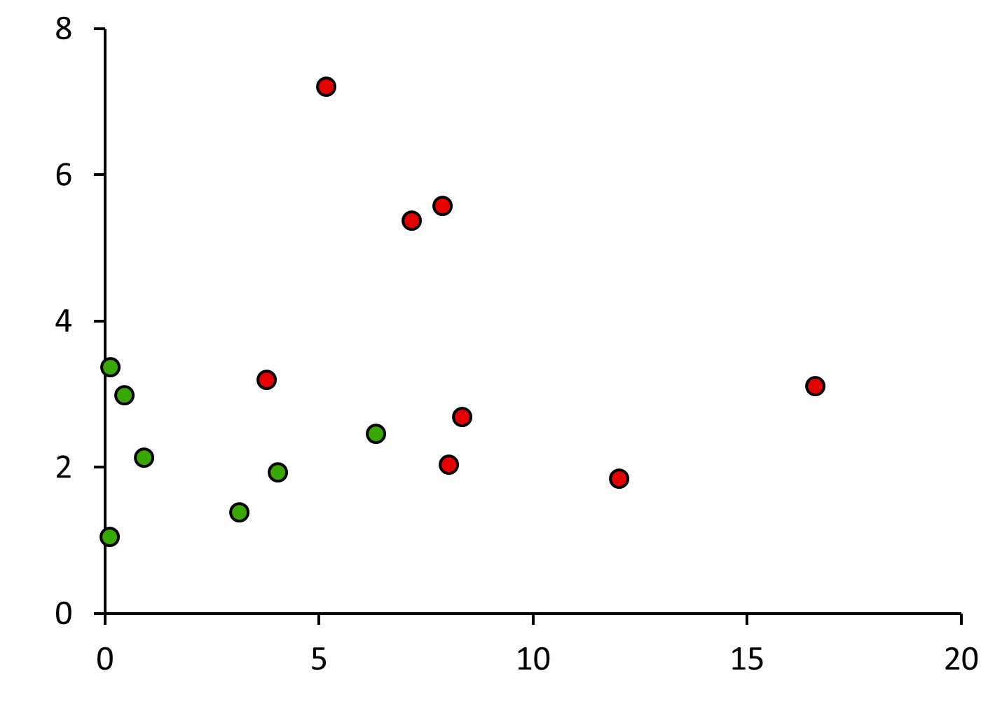
Drift
Mainstem
Tributaries
Ln (aquatic biomass)
GPP (g O₂ L⁻¹ d⁻¹)

Slide 24
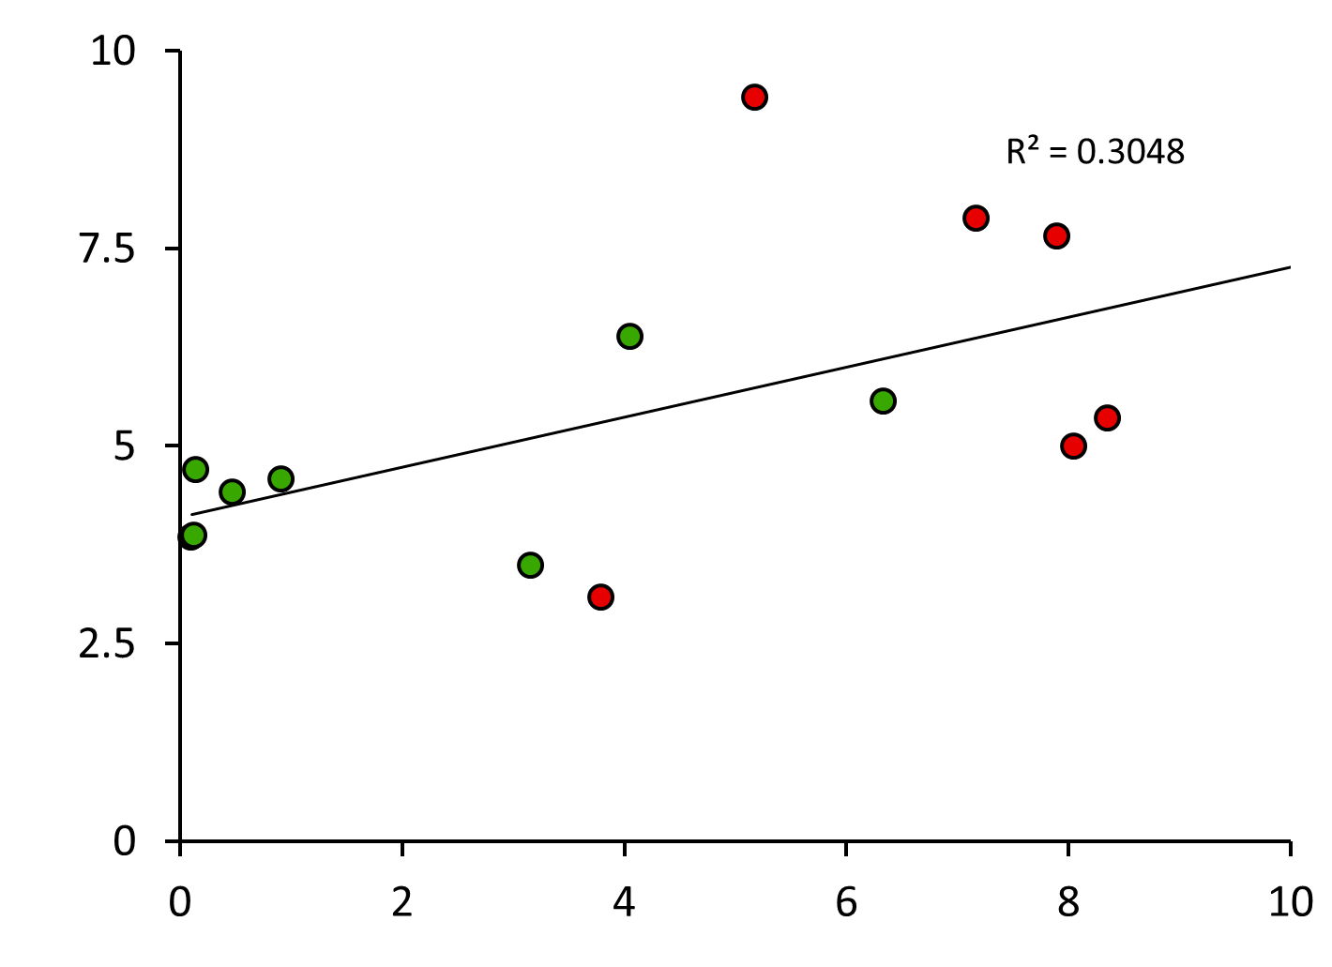
Drift
Mainstem
Tributaries
Ln (aquatic density)
GPP (g O₂ L⁻¹ d⁻¹)

Slide 25
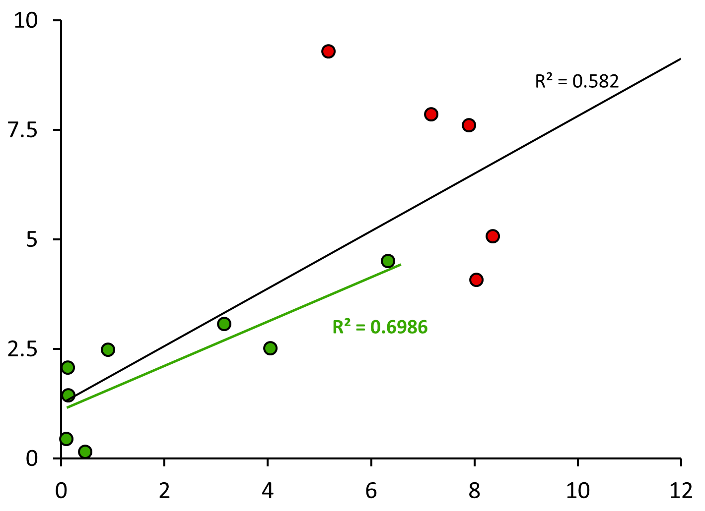
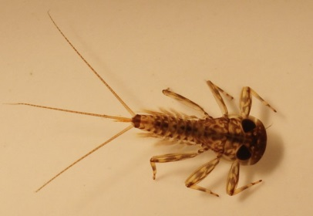
Drift
Mainstem
Tributaries
Ln (scraper density)
GPP (g O₂ L⁻¹ d⁻¹)

Slide 26
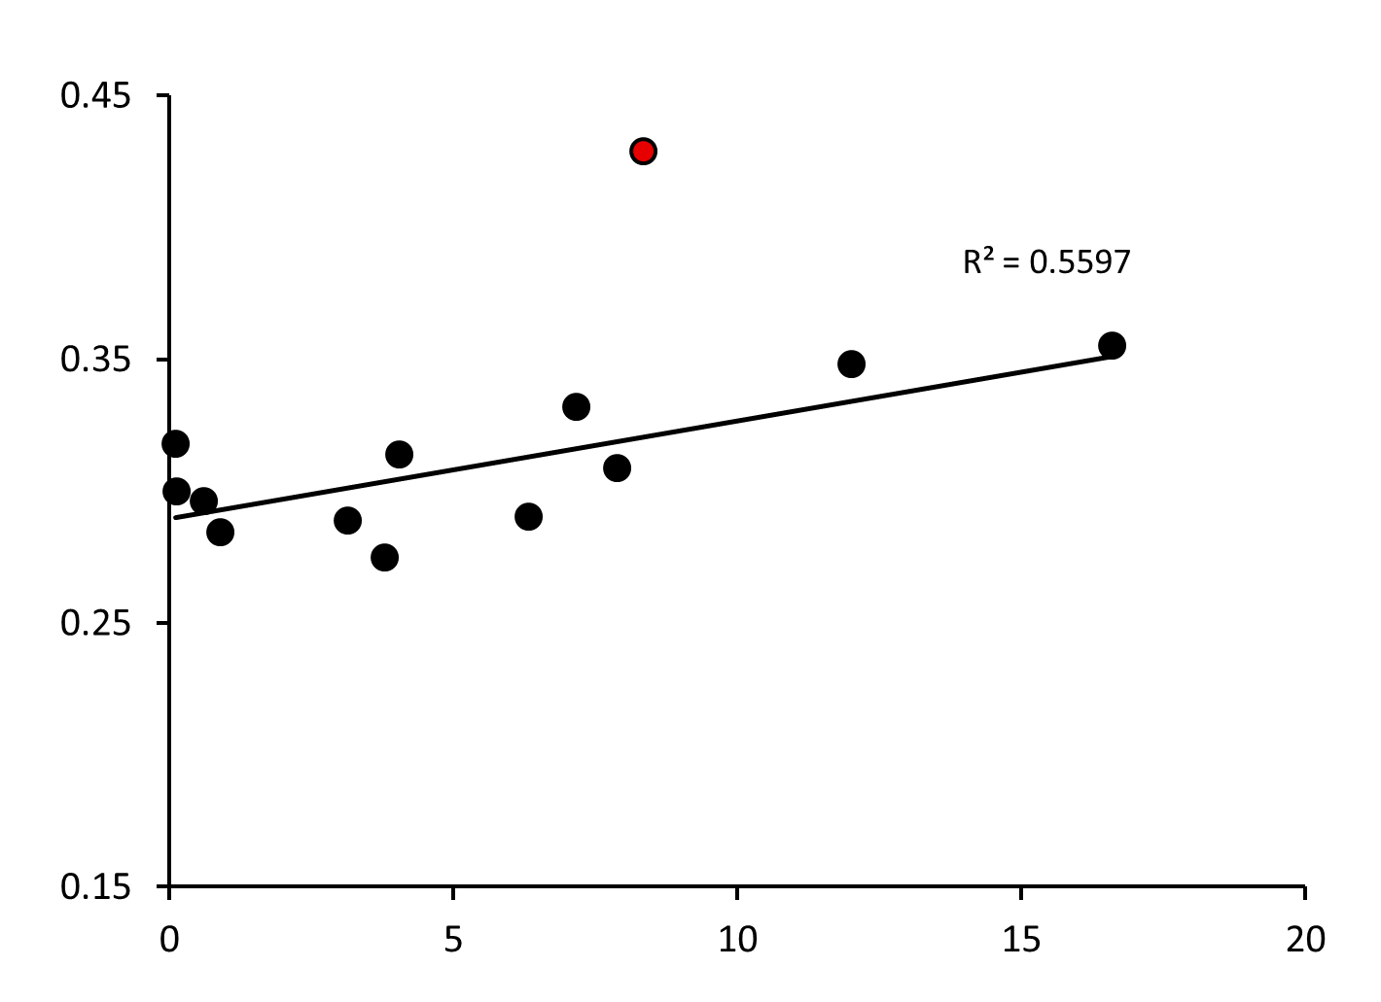
Fish growth
BioE Pvalue
GPP (g O₂ L⁻¹ d⁻¹)

Slide 27
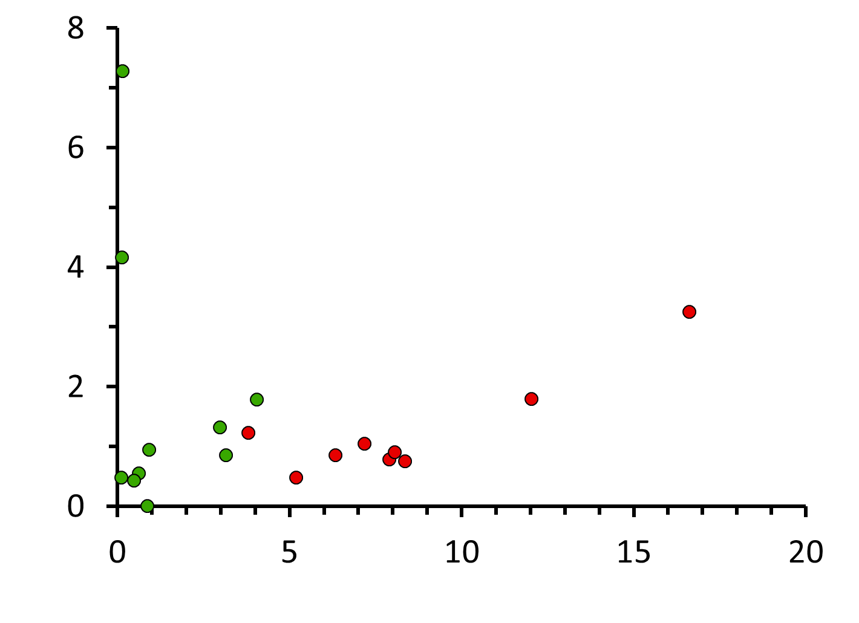
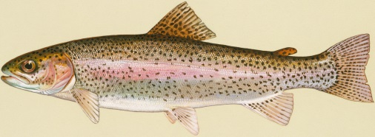
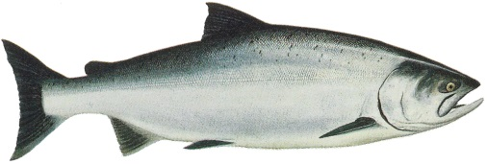
Fish abundance
Mainstem
Tributaries
Density (Fish m⁻¹)
GPP (g O₂ L⁻¹ d⁻¹)

Slide 28
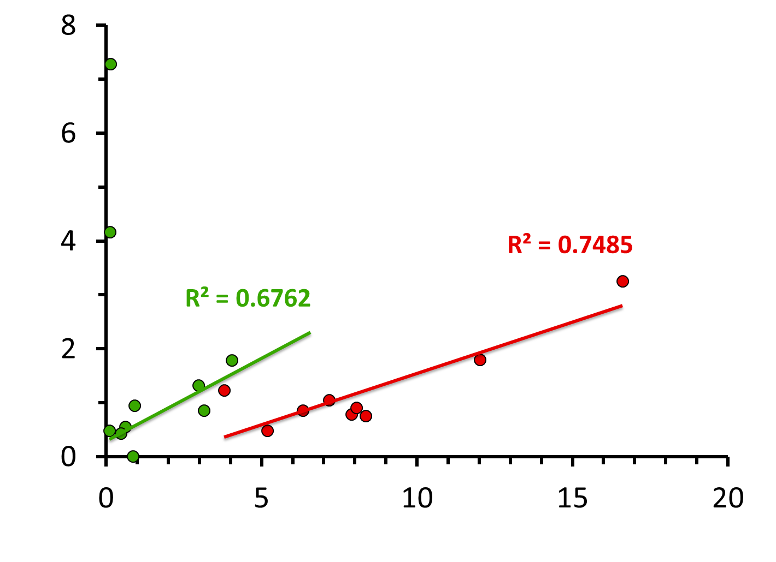
Fish abundance
Mainstem
Tributaries
Density (Fish m⁻¹)
GPP (g O₂ L⁻¹ d⁻¹)

