Slide 1
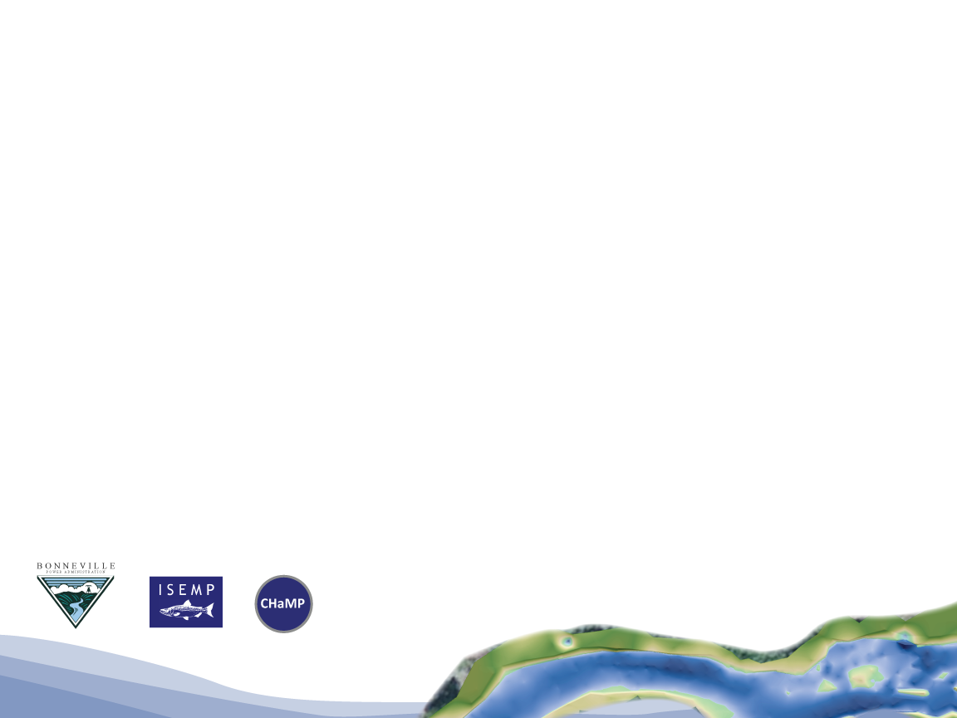


KMQ 2 -Planning, Prioritization and Implementation:
CHaMP and ISEMP State of the Science Workshop
Portland, Oregon – February 25th and 26th, 2014
Presenter:
Name
Collaborators:
Name 1, Name 2, and Name 3

Slide 2
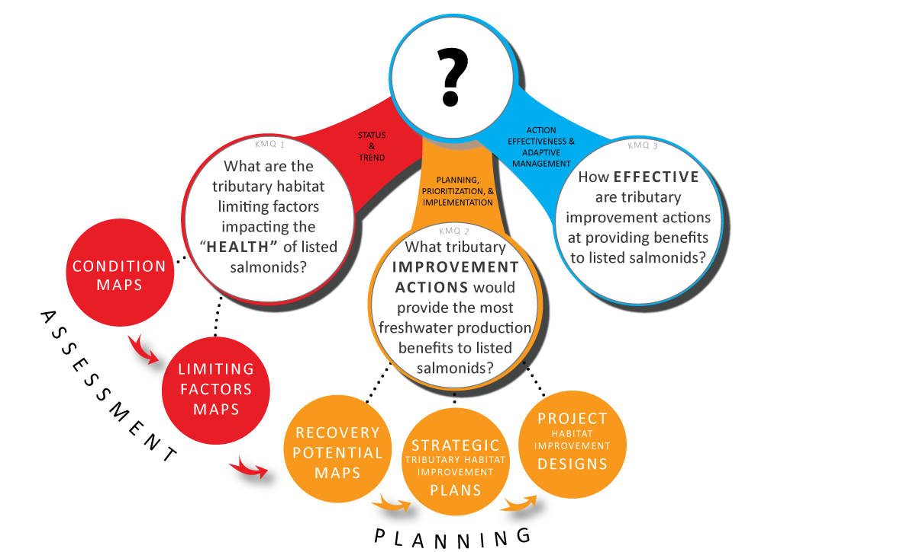
Addressing
KMQ 2:
More strategic improvement actions could save millions through more realistic investment in actions more likely to work!

Slide 3
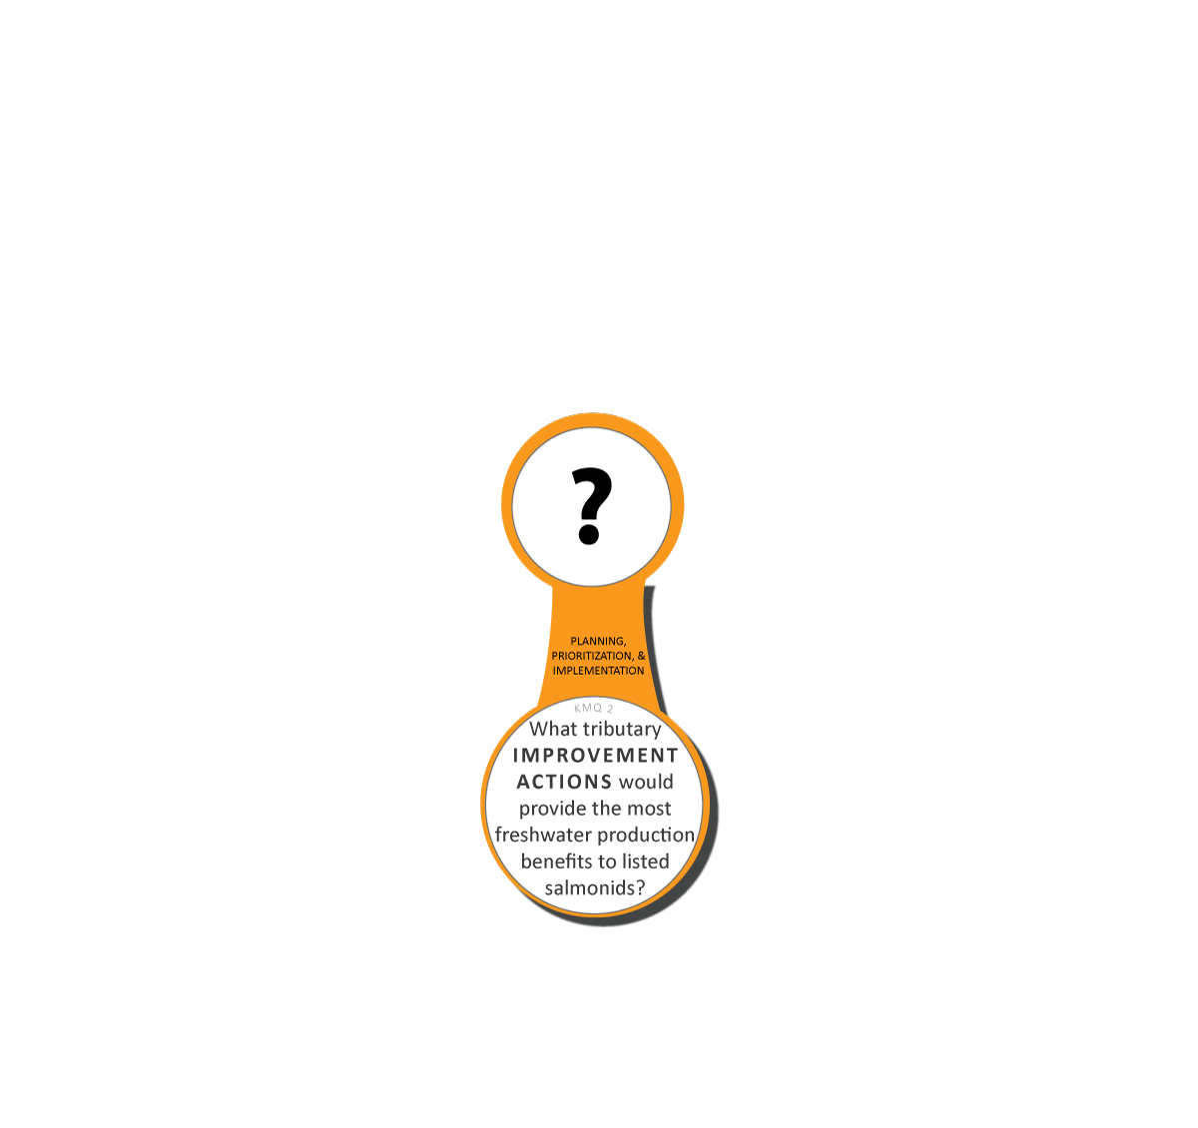
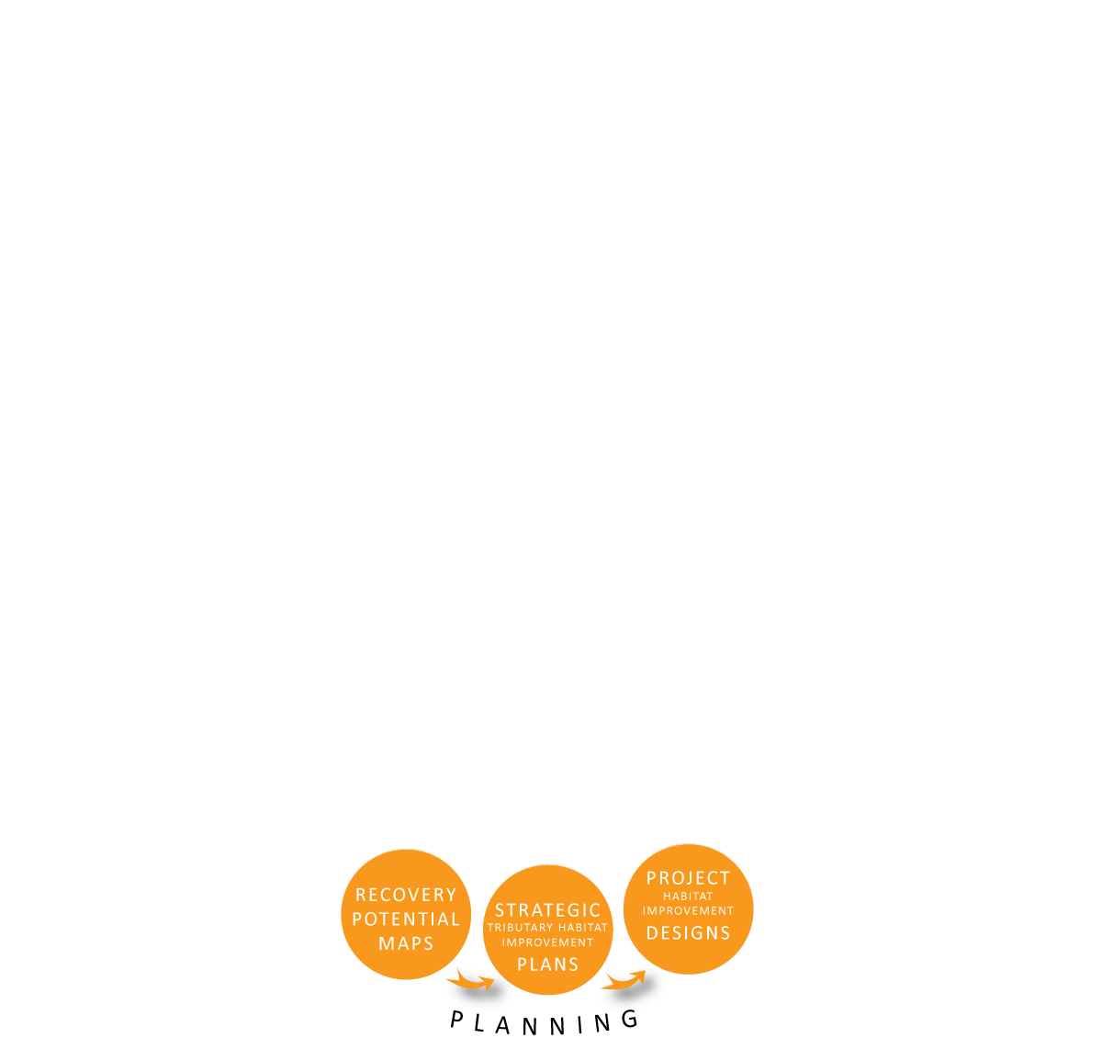
KMQ 2:
Summary Products
Can be better informed by CHaMP/ISEMP/AEM
Still requires expert and stakeholder input (e.g. Atlas)
Can be directly produced from CHaMP/ISEMP
Can be better informed by CHaMP/ISEMP/AEM
Still requires expert designers…
Notes:
Describe the habitat condition that could be achieved (for example, you are not going to turn a gorge into a meandering pool:riffle stream type): along with our current condition, these provide the bookends to what is feasible. We hope the ability to reach our goals lies somewhere between here.
Next, we need to balance this habitat template with management objectives (which may go beyond anadromous fish); prioritize which actions provide the most benefits for the costs: this is perhaps best achieve by weighing several scenarios to determine which is expected to provide the most bang for the buck. In addition, these alternative scenarios may be the basis for adaptive management strategies in the event the prefer strategy is not working
Finally, the plan should include on-the-ground designs that make sense within the context of their setting, can show a link to identified limiting factors, and are cost effective

Slide 4



Outline – KMQ 2
Using LCM to predict fish response to different habitat improvement scenarios – Lemhi – QCI
Informing recovery options for spring Chinook salmon in the upper Grande Ronde River – CRITFC
Coordination in Planning - Entiat
Leveraging CHaMP Data as Baseline for Design – Entiat – Terraqua
Using CHaMP Data as analogs for design – Tucannon - ELR
Design Hypothesis Testing – Asotin - ELR

Slide 5
Outline – KMQ 2
Using LCM to predict fish response to different habitat improvement scenarios – Lemhi – QCI
Informing recovery options for spring Chinook salmon in the upper Grande Ronde River – CRITFC
Coordination in Planning - Entiat
Leveraging CHaMP Data as Baseline for Design – Entiat – Terraqua
Using CHaMP Data as analogs for design – Tucannon - ELR
Design Hypothesis Testing – Asotin - ELR

Slide 6
Using a Model to Guide Actions and Predict Outcomes – Lemhi River
CHaMP and ISEMP State of the Science Workshop
Portland, Oregon – February 25th and 26th, 2014
Presenter:
Chris Beasley
Collaborators:
Joe Benjamin and Jody White

Slide 7
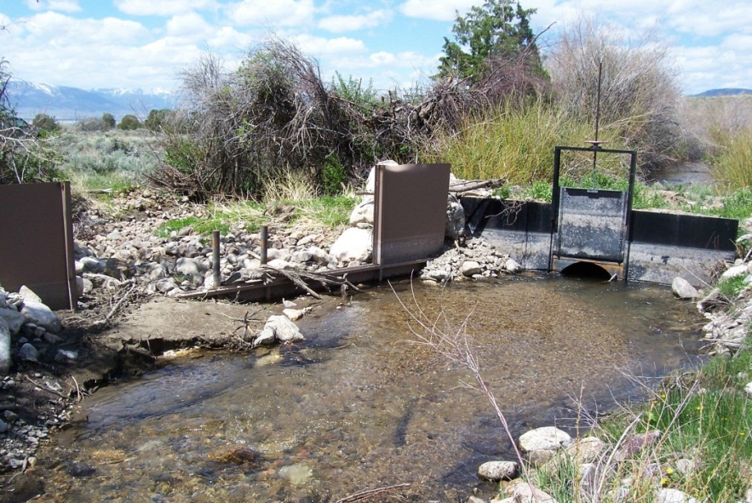
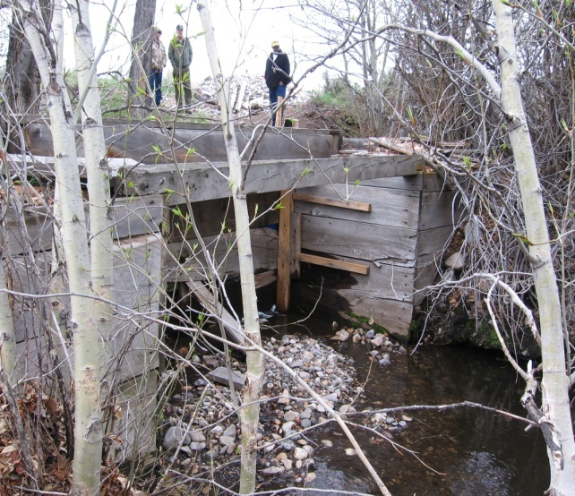
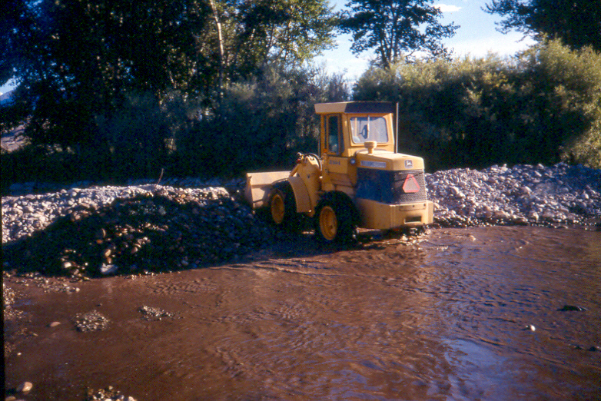
Context
Restoration targets:
4% increase in Steelhead smolts/female.
7% increase in sp/su Chinook smolts/female.
Lemhi restoration actions:
Channel reconstruction – quality.
Tributary reconnection – quantity/quality.

Slide 8
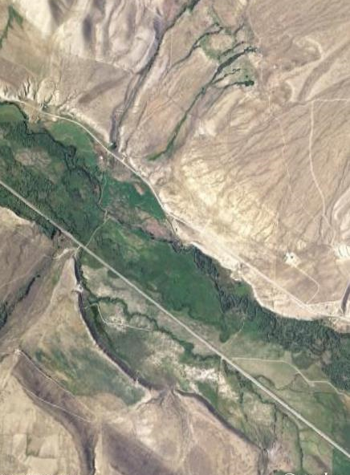
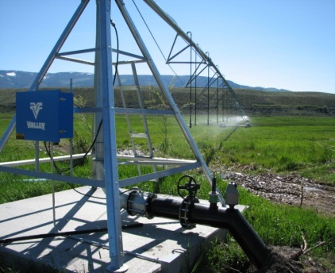
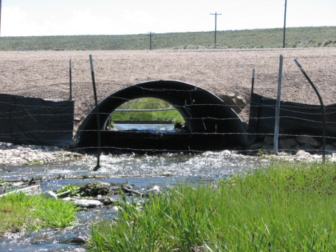
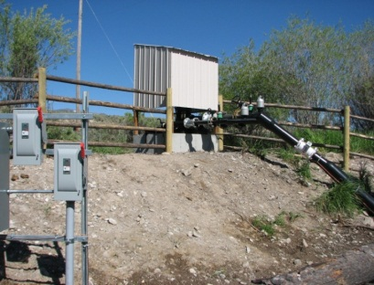
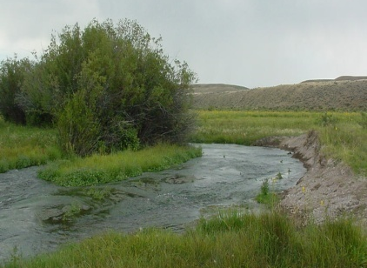
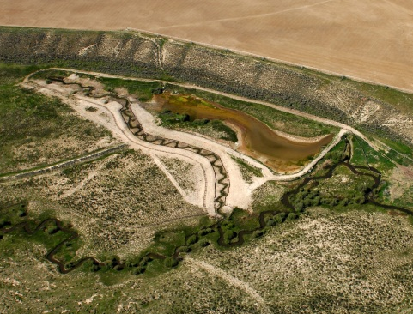
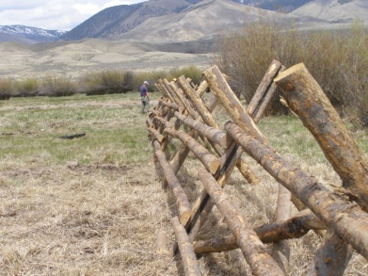
Context
Empirically constructed LCM.
LCM can be used to:
Evaluate alternatives.
Identify necessary extent of actions.
Estimate effectiveness.

Slide 9
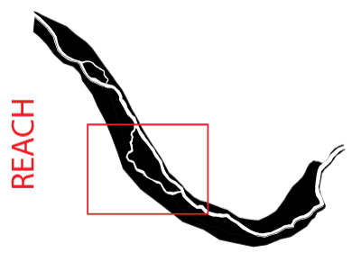
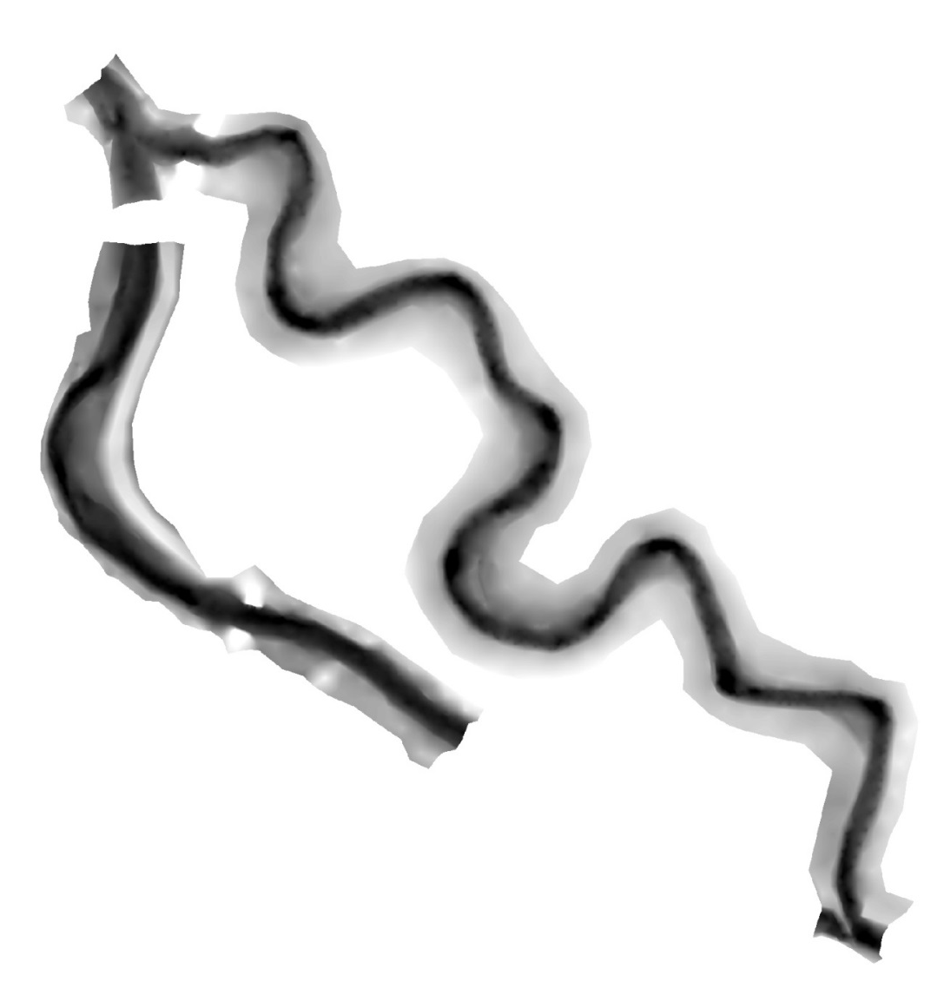
Habitat Restoration – Site Based
Habitat
Metric
Sinuosity
Pool frequency
Percent fines
LWD Frequency
LWD in Pools
After Restoration
2
2
5.3
11
7.4
Baseline
1
1
65
7
0.3
LCM
Chinook Predictions
Baseline
564 smolts
7 adults
After Restoration
823 smolts (46%)
10 adults (38%)

Slide 10
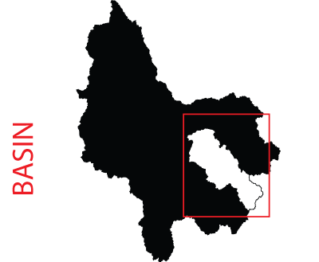
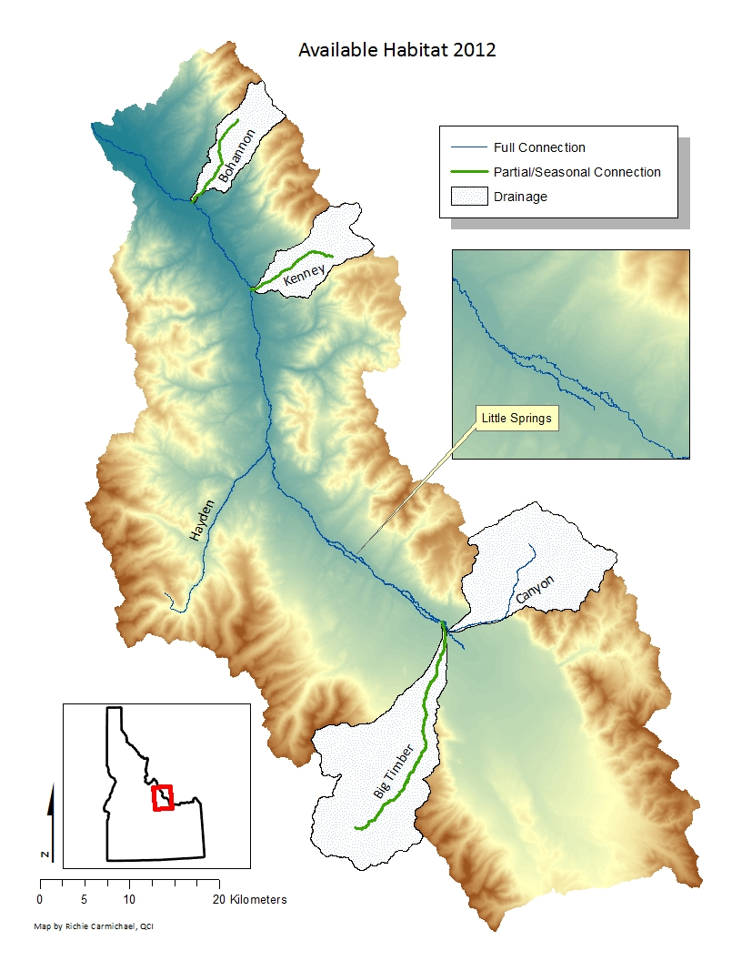
Lemhi River Tributary Reconnection
Baseline
Wetted area: 1.27 km²
Pool area: 0.37 km²
Steelhead
All Restoration Actions
164 smolts/adult (10% increase)
Tributary reconnection
Wetted area: 1.55 km² (22%)
Pool area: 0.44 km² (19%)
Chinook
All Restoration Actions
19.3 smolts/adult (3% increase)

Slide 11
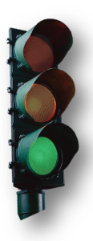
Lemhi River Tributary Reconnection
Baseline
Wetted area: 1.27 km²
Pool area: 0.37 km²
Steelhead
All Restoration Actions
164 smolts/adult (10% increase)
Tributary reconnection
Wetted area: 1.55 km² (22%)
Pool area: 0.44 km² (19%)
Chinook
All Restoration Actions
19.3 smolts/adult (3% increase)

Slide 12

Lemhi River Tributary Reconnection
Baseline
Wetted area: 1.27 km²
Pool area: 0.37 km²
Steelhead
All Restoration Actions
164 smolts/adult (10% increase)
Tributary reconnection
Wetted area: 1.55 km² (22%)
Pool area: 0.44 km² (19%)
Chinook
All Restoration Actions
19.3 smolts/adult (3% increase)

Slide 13
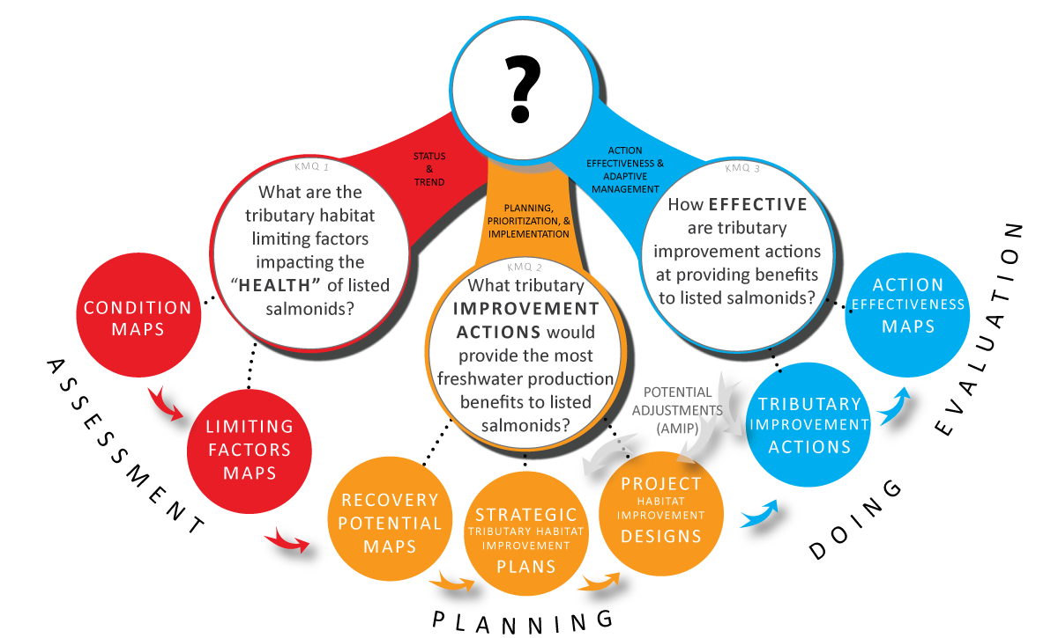
Adaptive Management

Slide 14

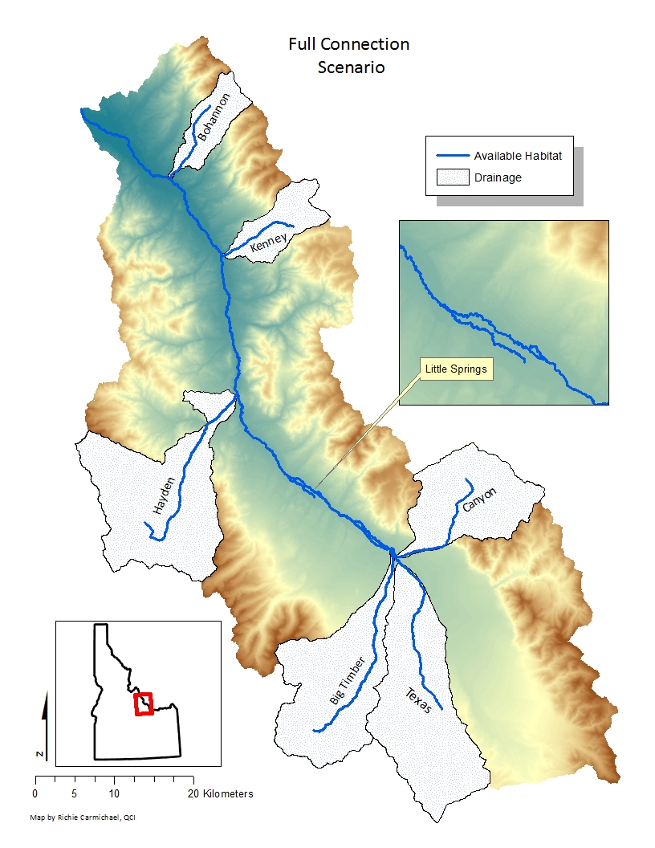
Lemhi River: Simulated Scenario
Baseline
Wetted area: 1.27 km²
Pool area: 0.37 km²
Steelhead
Tributary reconnection
167 smolts/adult (12% increase)
Tributary reconnection
Wetted area: 1.7 km² (34%)
Pool area: 0.46 km² (24%)
Chinook
Tributary reconnection
20.1 smolts/adult (7% increase)

Slide 15
ISEMP LCM – Value Added
Simulations fast and straightforward.
Which actions are most cost effective and logistically feasible?
How much restoration is required?

Slide 16
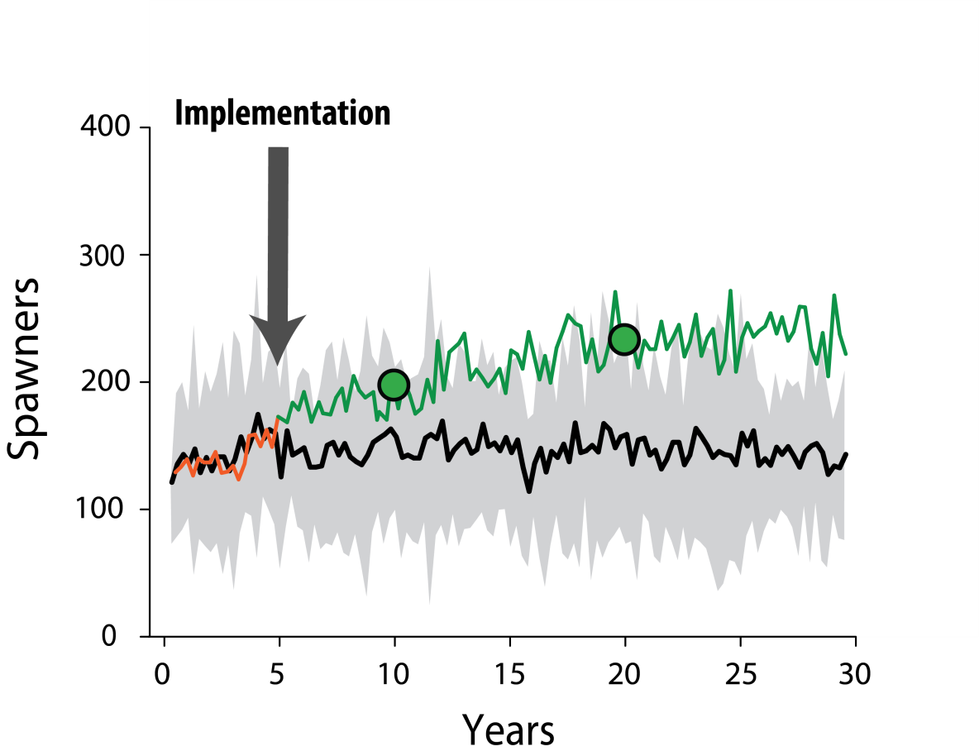
ISEMP LCM – Value Added
Estimating outcomes prior to full effectiveness.
Can use interim performance measures to test predictions.
Notes:
This is possible as these relationships are based on mechanistic understandings

Slide 17
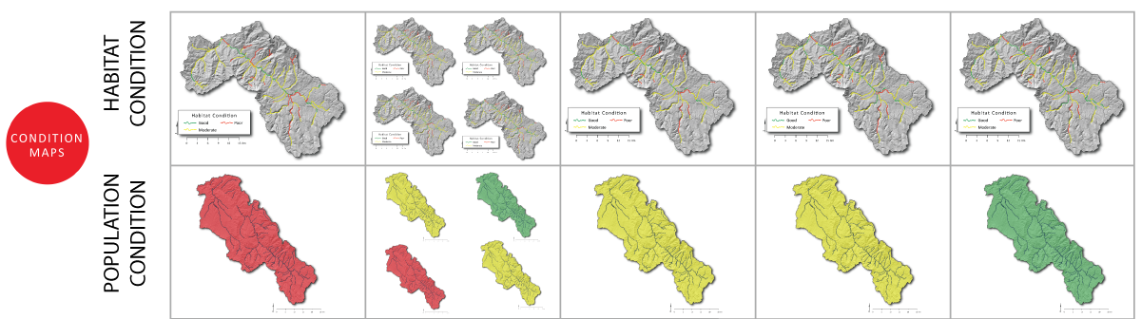
Planning – CRITFIC & TERRAQUA

Slide 18
Outline – KMQ 2
Using LCM to predict fish response to different habitat improvement scenarios – Lemhi – QCI
Informing recovery options for spring Chinook salmon in the upper Grande Ronde River – CRITFC
Coordination in Planning - Entiat
Leveraging CHaMP Data as Baseline for Design – Entiat – Terraqua
Using CHaMP Data as analogs for design – Tucannon - ELR
Design Hypothesis Testing – Asotin - ELR

Slide 19



Informing recovery options for spring Chinook salmon in the upper Grande Ronde River
CHaMP and ISEMP State of the Science Workshop
Portland, Oregon – February 25th and 26th, 2014
Seth White, Casey Justice & Dale McCullough
Columbia River Inter-Tribal Fish Commission
Collaborators:
Ted Sedell, Chris Horn, Rich Carmichael & Joseph Feldhaus Oregon Department of Fish & Wildlife
Confederated Tribes of the Umatilla Indian Reservation
CHaMP-ISEMP Programs
Funding:
BPA Project # 2009-004-00

Slide 20
Outline
Brief introduction to CRITFC Accords habitat project in the upper Grande Ronde River
History of CRITFC’s collaboration with CHaMP-ISEMP
Examples of summary products for restoration planning

Slide 21
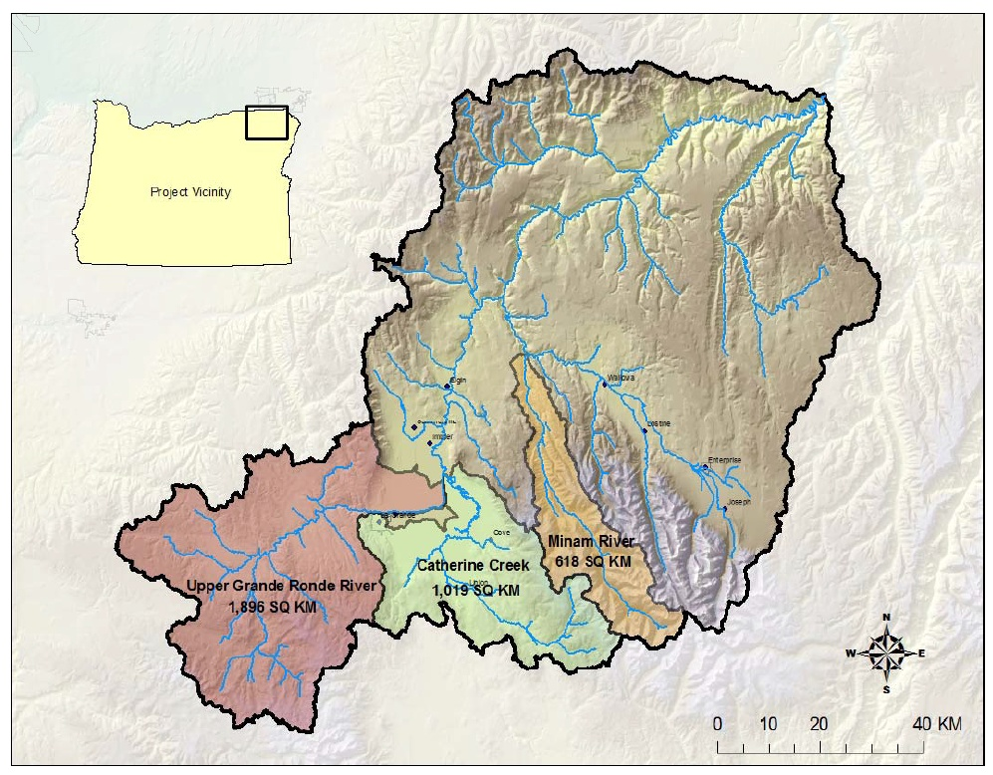

Slide 22
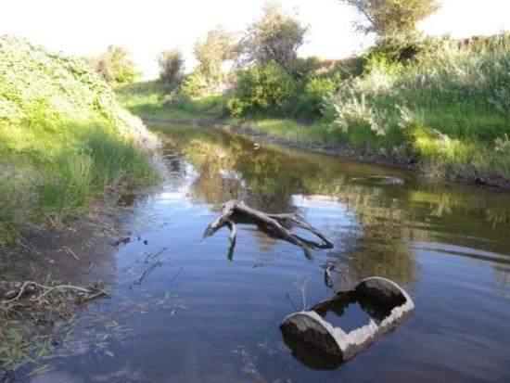
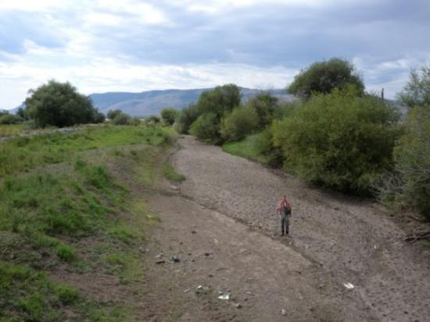
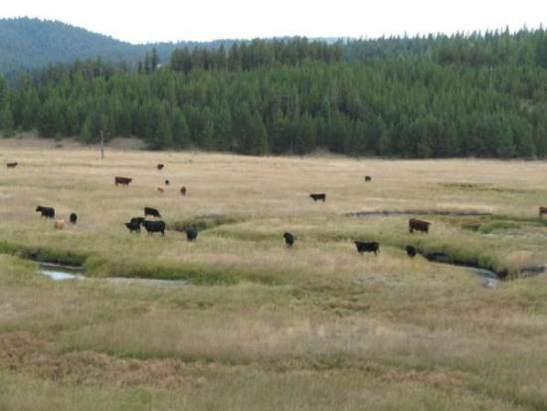
Upper Grande Ronde current habitat condition
Spring Chinook salmon and steelhead listed as “Threatened” under ESA
Upper Grande Ronde and Catherine Creek listed as “Critical Habitat”
Heavily degraded habitat from timber harvest, agriculture and irrigation, and cattle grazing
Notes:
Upper Grande Ronde and Catherine Creek spring Chinook salmon populations are currently listed as “Threatened” under the Endangered Species Act. Likewise, the habitat areas supporting these imperiled fish populations were designated by NOAA as “critical habitat” in 2005. Despite a significant effort to restore habitat conditions over the past couple decades, habitat conditions in these basins remain severely degraded. The picture on the upper left was taken near the mouth of Catherine Creek, and shows high levees on either side of the channel restricting channel migration, silty substrate conditions, and garbage in the stream channel. The picture on the lower left shows the mainstem Catherine Creek near the town of Union with a completely dry streambed during the peak irrigation season in summer. The photo on the lower right shows heavy cattle grazing in the Vey Meadows area of the Upper Grande Ronde with no woody riparian vegetation and no exclusion fences to prevent cattle from damaging the streambanks or salmon redds.

Slide 23
Project objectives
Assess status & trends in key limiting factors affecting ESA-listed spring Chinook
Evaluate potential for stream restoration actions to improve key limiting factors
Develop a life cycle model to link biotic responses of spring Chinook populations to projected changes in stream habitat conditions

Slide 24
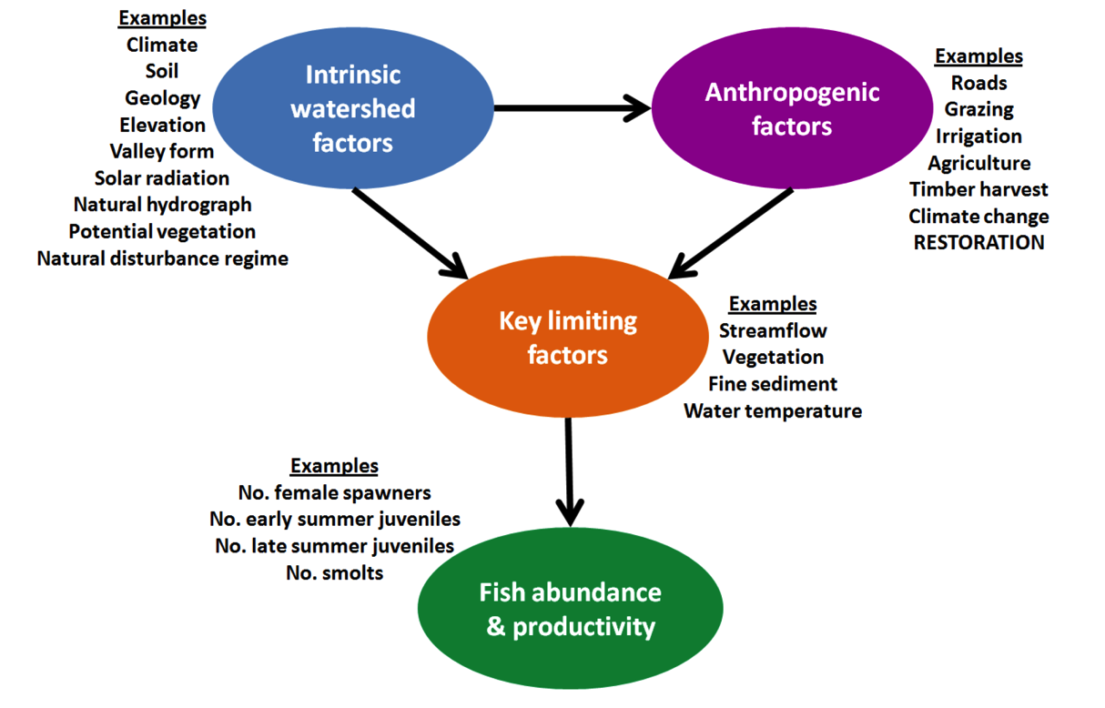
Conceptual framework for modeling fish productivity & capacity
Notes:
Steps to building a model predicting Chinook rearing capacity
Develop stream classification system based on hypothesized relationships between intrinsic watershed factors and key limiting factors.
Conduct empirical tests of stream classification via modeling relationships between intrinsic watershed factors and key limiting factors, accounting for influence of anthropogenic factors.
Model relationship between key limiting factors and Chinook rearing capacity, accounting for the influence of intrinsic factors (via the stream classification system) and anthropogenic factors.
Validate model via empirical tests using the range of impacted and reference conditions—reference conditions defined using the stream classification system and areas with low levels of anthropogenic factors.
Note: reference conditions can also be predicted based on known relationships between intrinsic watershed factors and key limiting factors, and anthropogenic factors.
Predict Chinook rearing capacity under different levels of anthropogenic factors, including restoration activities.

Slide 25
Spawners
DRAFT Life cycle model structure
Prespawning temp (p and/or c)
Spawning habitat area or % spawnable habitat (c)
Eggs
p = productivity
c = capacity
S = survival
Fines (p)
Summer temp (p and/or c)
Habitat area/composition (c)
Summer low flow (p and/or c)
Hydro, ocean…
Migratory fall parr
Summer parr
Resident fall parr
Path 1
Path 2
S₂ (ODFW winter-spring)
Spring upriver smolts
S₁ (CRITFC len-temp-abund)
LGR smolts
S₃ (CRITFC len-temp-abund)

Slide 26
Outline
Brief introduction to CRITFC Accords habitat project in the upper Grande Ronde River
History of CRITFC’s collaboration with CHaMP-ISEMP

Slide 27
CRITFC-CHaMP collaboration
CRITFC has separate funding, yet involved in CHaMP:
  Protocol & metric development, field data collection, analyses, interpretation & reporting

Slide 28
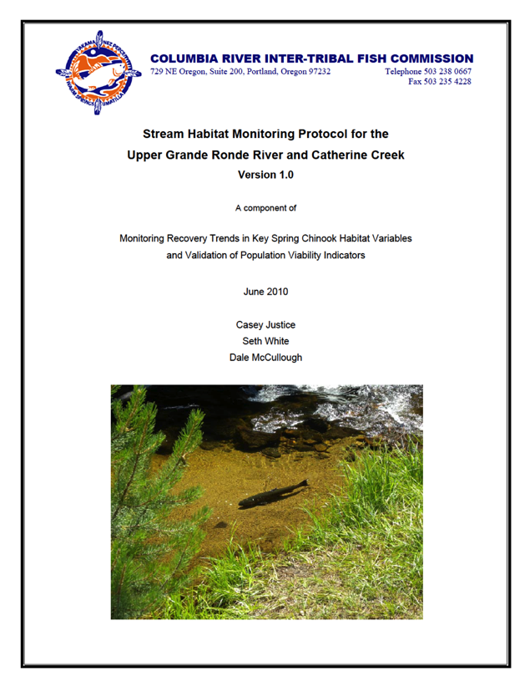
CRITFC-CHaMP collaboration
CRITFC has separate funding, yet involved in CHaMP:
  Protocol & metric development, field data collection, analyses, interpretation & reporting
Timeline
  2010: CRITFC implements own habitat protocol in UGR, Catherine Ck. & Minam

Slide 29
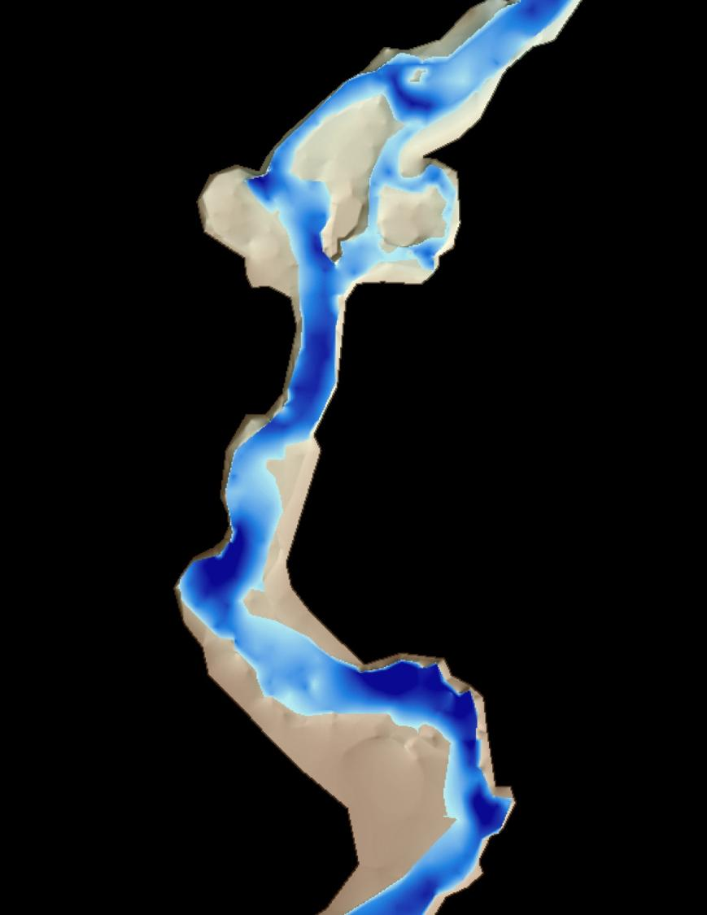
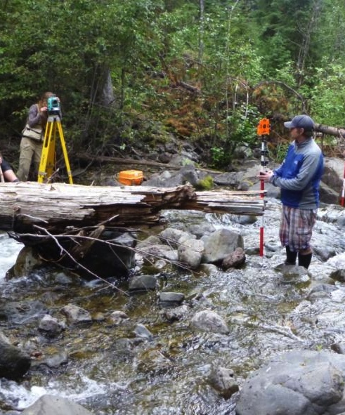
CRITFC-CHaMP collaboration
CRITFC has separate funding, yet involved in CHaMP:
  Protocol & metric development, field data collection, analyses, interpretation & reporting
Timeline
  2010: CRITFC implements own habitat protocol in UGR, Catherine Ck. & Minam
  2011 – Present: CRITFC & ODFW adopt CHaMP
    Coordinate with larger regional program
    Take advantage of DEM products (DoD, HSIs, NREI, etc.)

Slide 30
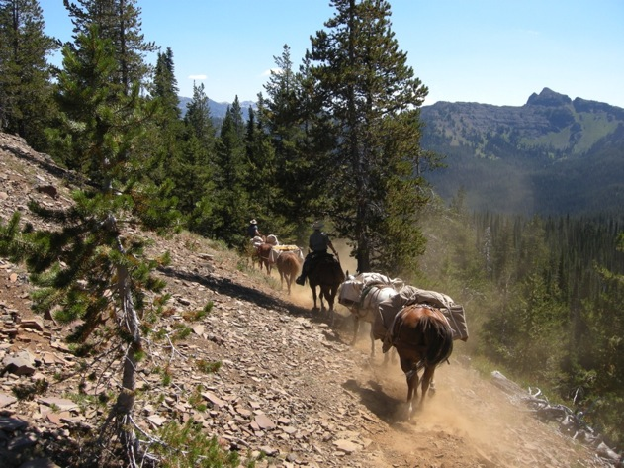
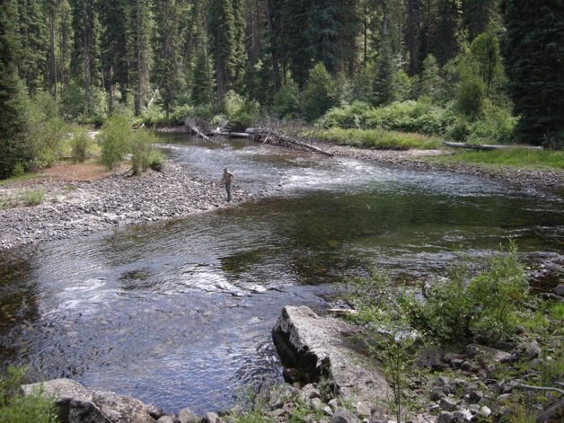
CRITFC-CHaMP collaboration
CRITFC has separate funding, yet involved in CHaMP:
  Protocol & metric development, field data collection, analyses, interpretation & reporting
Timeline
  2010: CRITFC implements own habitat protocol in UGR, Catherine Ck. & Minam
  2011 – Present: CRITFC & ODFW adopt CHaMP
    Coordinate with larger regional program
    Take advantage of DEM products (DoD, HSIs, NREI, etc.)
  2013: CTUIR adopts CHaMP; ODFW & CRITFC initiate CHaMP in Minam R.

Slide 31
Outline
Brief introduction to CRITFC Accords habitat project in the upper Grande Ronde River
History of CRITFC’s collaboration with CHaMP-ISEMP
Examples of summary products for restoration planning

Slide 32
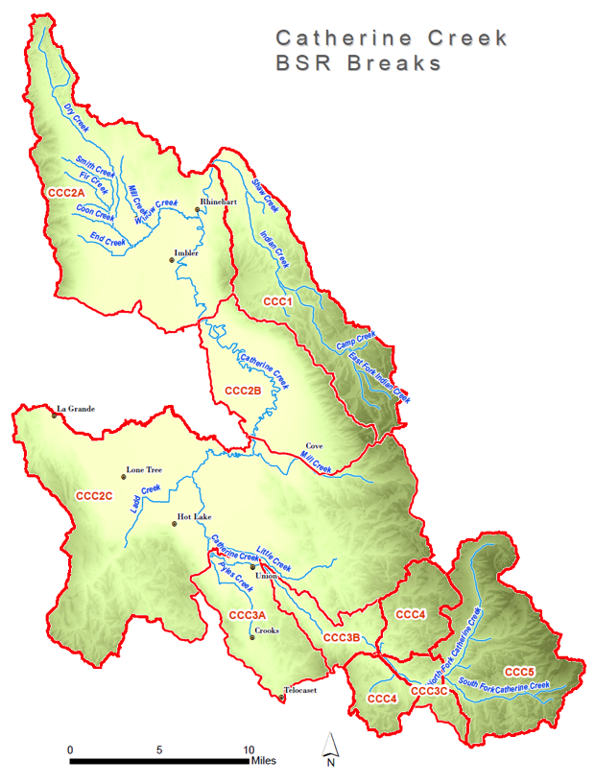
Grande Ronde Atlas
Guided by Timmie Mandish & Sean Welch, BPA
Science TAC composed of multiple agencies (ODFW, CTUIR, USFS, BOR, CRITFC, NOAA, Union SWCD, Grande Ronde Model Watershed, others…)
Process in a nutshell:
  Designation of “biologically significant reaches”
  Assignment of fish life use to BSRs
  Assessment of limiting factors in BSRs
  Identification and prioritization of restoration activity types

Slide 33
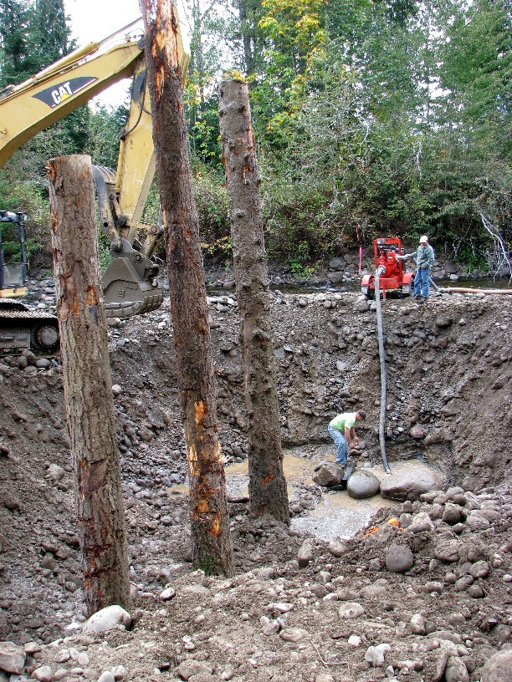
What do restoration planners want?
Wrong Answer #1: Opportunistic approach

Slide 34
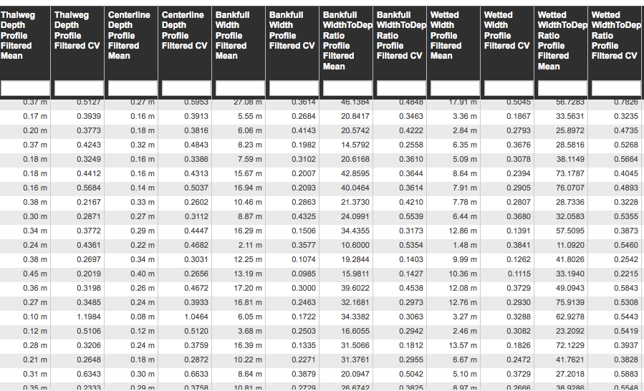
What do restoration planners want?
Wrong Answer #2: Raw data (inc. measurements and metrics)

Slide 35
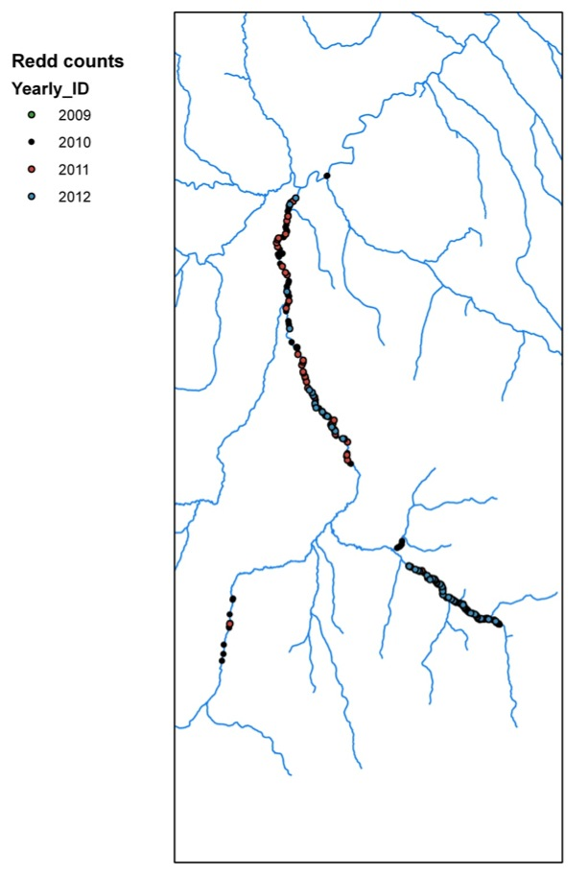
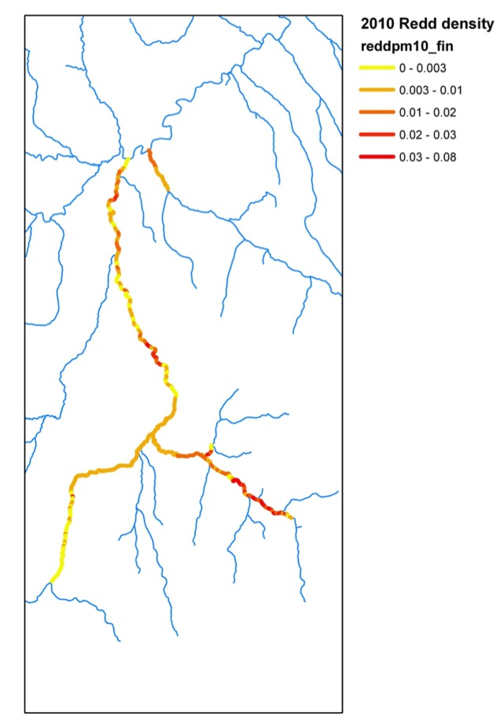
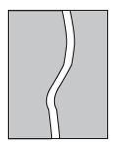
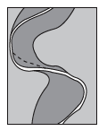
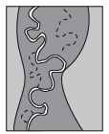
Effective shade in the upper Grande Ronde
Where do fish spawn in the upper Grande Ronde?
Redd counts
+
Survey extent
+
Spawning extent
+
Extrapolation to unsurveyed areas*
=
*Extrapolation based on River Styles valley setting

Slide 36
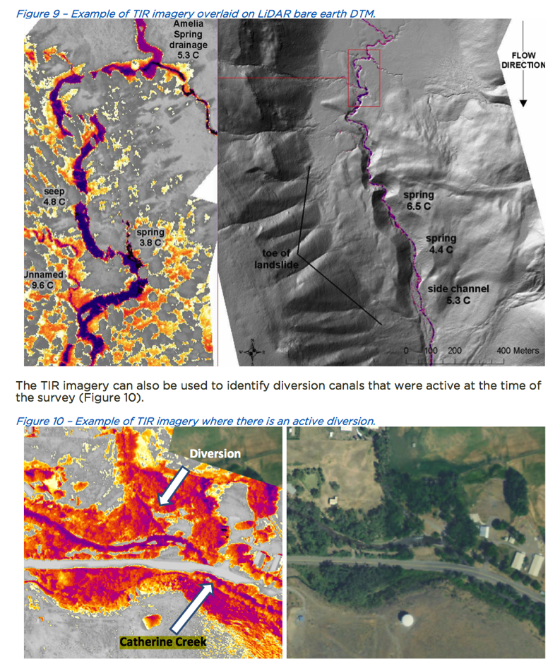
What about the raw thermal imagery?
Spatially-continuous FLIR images
- Potential for use in recovery planning, but can (& should) be taken further

Slide 37
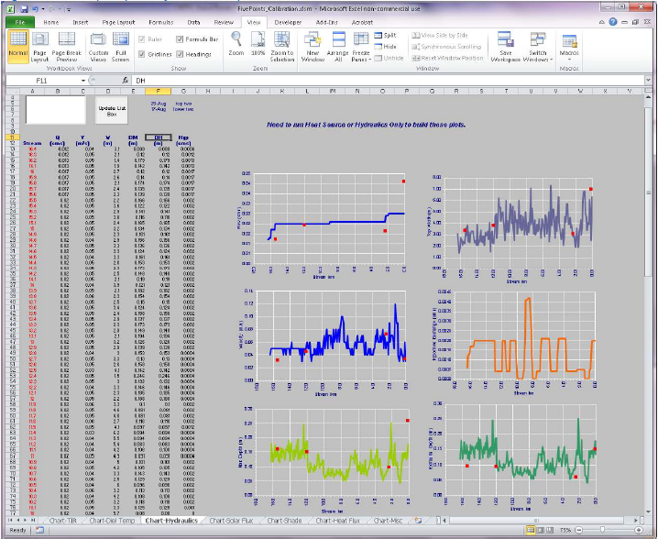
Heat Source Model
Calibrated for July 10 – September 20, 2010
CRITFC Heat Source model
Developed with Watershed Sciences
Channel/streamside geometry
(LiDAR)
Riparian vegetation (LiDAR)
Stream temperature (FLIR)
Discharge
Climate
Notes:
The Heat Source Model uses information about channel geometry, riparian vegetation, stream temperature, discharge, and climatic conditions to estimate water temperature for every minute of the day every 100 meters along the stream channel. The model currently predicts temperatures for the Summer period of July 10 – September 20.

Slide 38
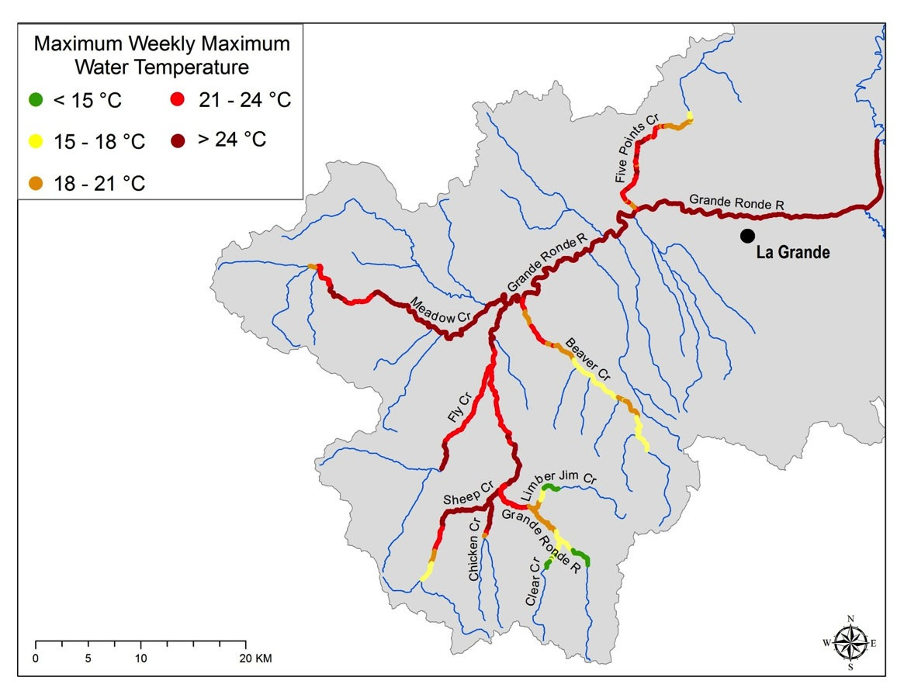
Heat Source Results
Relevant temperature metrics for fish
Present (2010) condition in upper Grande Ronde
Notes:
This figure shows some results from the Heat Source model results for the Upper Grande Ronde under current conditions (i.e., 2010). We calculated the maximum 7-day running average of the daily max temperatures (MWMT) for every 100 m node across the entire basin. Considering that fish growth and survival can be adversely affected by water temperatures exceeding 18 °C, this figure really highlights the serious problem that we have in the Grande Ronde basin with respect to water temperature.

Slide 39
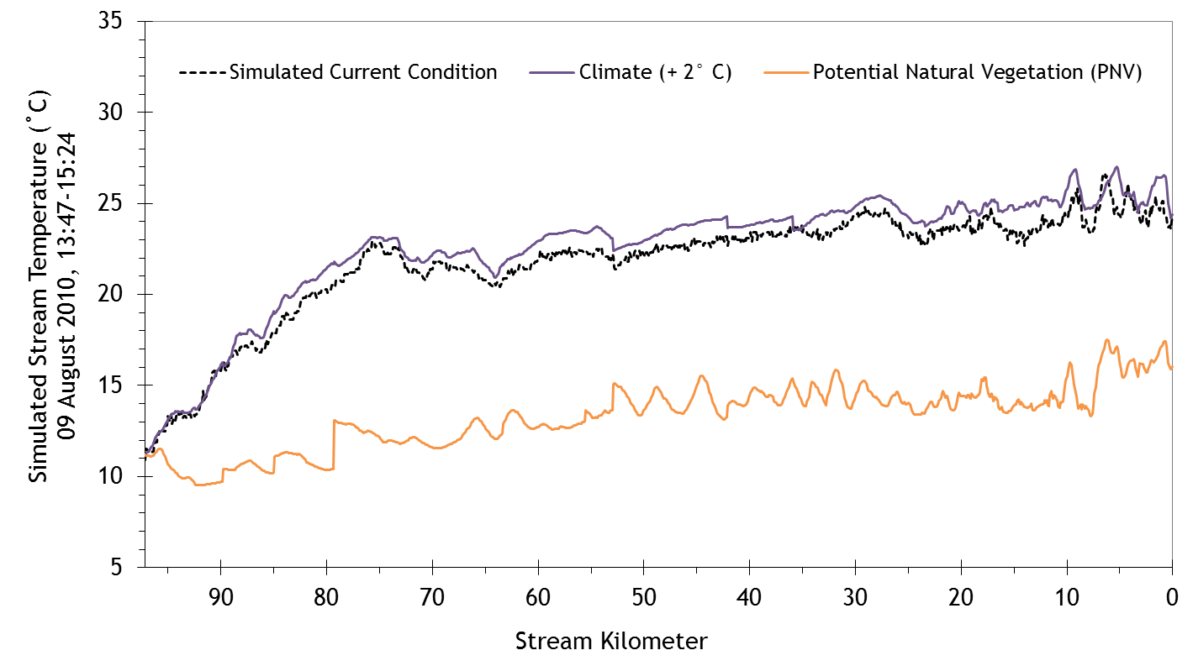
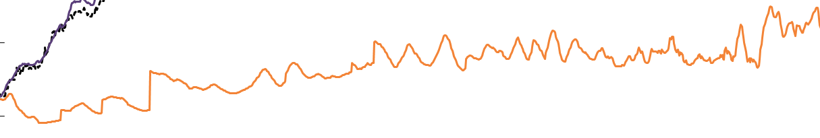
Heat Source model results
Mainstem upper Grande Ronde River
22 – 24 ºC Total elimination of juvenile Chinook
18 – 22 ºC Shift to warmwater fish community
(Temperature thresholds from McCullough 1999. USEPA Report # EPA 910-R-99-010)
Notes:
This is an example of the model output from the Heat Source model for the upper Grande Ronde River. The black dashed line shows the water temperature profile under current conditions as you move from the headwaters to the mouth. The orange line shows the simulated temperature profile if riparian vegetation was restored to 100% of its natural potential. The purple line shows the simulated temperature profile for a climate change scenario where air temperatures were increased by 2 degrees C. These results demonstrate the enormous reduction in water temperatures that may be possible in an ideal scenario where riparian vegetation throughout the basin was restored to its full potential.

Slide 40
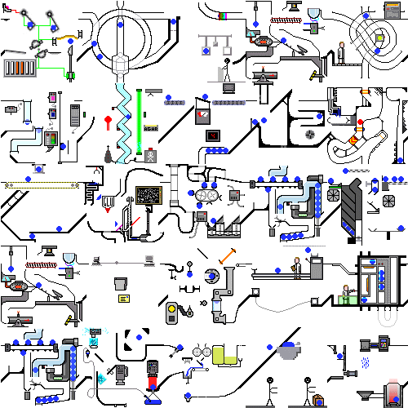
What do restoration planners want?
Wrong Answer #3: Fancy models

Slide 41
Structural equation modeling (SEM)
Using CHaMP, fish abundance, and benthic macroinvertebrate data
Large wood/100m
(bankfull)
GR-IBI
Drainage area
Juv. Chinook/100m²
Pool frequency
This model:
Speaks to importance of landscape controls
Validates hypotheses about the direct & indirect effects of wood on parr density
Suggests benthic invertebrates are more sensitive to wood (and perhaps to restoration) than fish
Is necessary but not sufficient for restoration planning
Strong positive effect
Weak positive effect
Negative effect

Slide 42
Example of data inputs to CRITFC life cycle model
Fry through smolt stages
Intrinsic watershed (GIS: elevation, gradient, etc.)
Limiting factors
(CHaMP: fine sediment, % cobbles, incubation temp)
SEM
Land use
(GIS: % forest, road density, impervious cover, etc.)

Slide 43
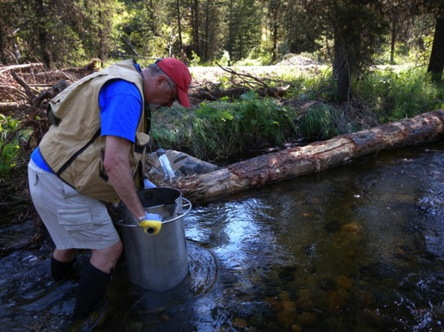
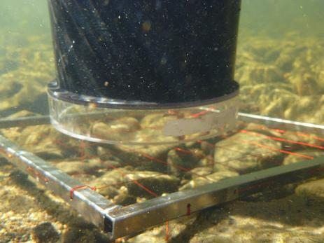
Relationship between McNeil cores and CHaMP pool tail fines
McNeil fines < 6mm
Pool tail fines < 6mm (CHaMP)
Notes:
Relationship between pool tail fines less than 6 mm measured using CHaMP methods and fine sediment less than 6 mm measured using McNeil core samples. Fine sediment measured using a core sampler should be a better predictor of egg survival than surface fines because depth fines more closely represent the sediment conditions experienced by eggs during incubation. Although depth fines are not measured in the CHaMP protocol, these data suggest that CHaMP estimates of pool tail fines could be used to predict fine sediment at depth.

Slide 44
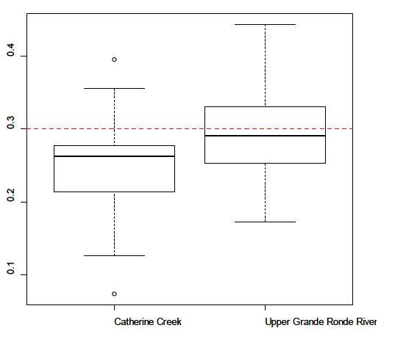


Estimated effect of fines on egg-fry survival
Prop. fines < 6.35mm
Catherine Creek
Upper Grande Ronde
Estimated egg-fry survival (%)
Reiser and Bjornn (1991) and Weaver and Frailey (1991)
Catherine Creek
Upper Grande Ronde
Notes:
The amount of fine sediment in the spawning gravel can be used to predict egg-to-fry survival using functional relationships derived from the literature. Such relationships may be used in life cycle models to evaluate potential fish response to changes in fine sediment levels. In this case, the relationship between percent fines and embryo survival was obtained from published laboratory studies (Reiser and Bjornn (1991), Weaver and Frailey (1991)). We used the curve for Chinook salmon to estimate the impact of fine sediment on Chinook salmon egg-to-fry survival in Catherine Creek and the Upper Grande Ronde River.

Slide 45
What DO restoration planners want?
Guidance on (a) life-stage specific and (b) population-level limiting factors
Likely outcomes of alternative restoration scenarios (e.g., what happens to water temperature if we restore riparian vegetation on private land vs. public?)
The above information summarized and mapped at a spatial resolution useful for planning (e.g., Assessment Units)

Slide 46

THANK YOU

Slide 47
Outline – KMQ 2
Using LCM to predict fish response to different habitat improvement scenarios – Lemhi – QCI
Informing recovery options for spring Chinook salmon in the upper Grande Ronde River – CRITFC
Coordination in Planning - Entiat
Leveraging CHaMP Data as Baseline for Design – Entiat – Terraqua
Using CHaMP Data as analogs for design – Tucannon - ELR
Design Hypothesis Testing – Asotin - ELR

Slide 48

Entiat IMW Experimental Design
Notes:
Hybrid hierarchical staircase design
Comparison of treatment and control areas
Treatments staggered through time and space

Slide 49
Entiat IMW Partners
Coordination Partners
ISEMP
U.C. Salmon Recovery Board
Bonneville Environmental Foundation
Oversight & Landowner Involvement
Entiat Watershed Planning Unit
Project Sponsors
Cascadia Conservation District
Chelan County NRD
Chelan-Douglas Land Trust
Washington Rivers Conservancy
Yakama Nation
Technical Review
Entiat Habitat Subcommittee
U.C. Regional Technical Team
Effectiveness Monitoring
Terraqua, Inc.
U.S. Forest Service- Entiat Ranger District
U.S. Fish and Wildlife Service
U.S. Forest Service–PNW Research Station
Washington Department of Ecology
Project Design
U.S. Bureau of Reclamation
Yakama Nation
Chelan County NRD
U.S. Fish and Wildlife Service
Notes:
Foundation of successful IMW is support and integration of many agencies and partners
First and foremost the landowners – Entiat strong history of active community development – one of the first subbasins to have a watershed plan; before launching the IMW got the support of the EWPU
Support of RTT, UCSRB, project sponsors and designers crucial – asking for some years of no implementation was a tough sell and remains an ongoing discussion
Partnering with co-managers to facilitate huge monitoring effort

Slide 50
Before
After
Notes:
Funding was an important puzzle to solve - Crucial piece was the Board’s move towards coordinating funding across the UC motivated by ISEMP and IMW concept.
Was competitive process within and among subbasins. Everyone gets a small piece of pie – small scale/small budget projects get funded, but larger scale/bigger budget projects difficult to fund eg Entiat IMW. Also under this model if one large project does manage to secure a lion’s share of the funding other project sponsors/subbasins are left with projects they’ve potentially put $$ into designing and permitting not getting funding for implementation in that year. Planning not long term and not coordinated among subbasins and sponsors. This approach will continue with SFRB and Trib $$ for eg, but now moving toward using this approach in concert with one facilitated by the Board and BPA $.

Slide 51
Outline – KMQ 2
Using LCM to predict fish response to different habitat improvement scenarios – Lemhi – QCI
Informing recovery options for spring Chinook salmon in the upper Grande Ronde River – CRITFC
Coordination in Planning - Entiat
Leveraging CHaMP Data as Baseline for Design – Entiat – Terraqua
Using CHaMP Data as analogs for design – Tucannon- ELR
Design Hypothesis Testing – Asotin - ELR

Slide 52
Location of Monitoring and Restoration Sites
ENT00001-2A9
ENT00001-2A8
Lake Creek
ENT00001-2A6
Tommy Creek
Stormy Creek
ENT00001-2A5
Mad River
Mud Creek
Tillicum Creek
ENT00001-2A3
Roaring Creek
ENT00001-2A2
ENT00001-2A1
(Overlay proposed restoration design elements on map)
Notes:
Valley Segment 3 extends from river mile 21.1 to river mile 26.0, at the boundary of USFS land and has greater influence from tributary alluvial fans.
Geomorphic reach boundaries were determined from changes in slope and geological controls (USBR 2009, Table 3)

Slide 53
CHaMP Data Can Be Used as
Basemap & Baseline for Design
Notes:
Valley Segment 3 extends from river mile 21.1 to river mile 26.0, at the boundary of USFS land and has greater influence from tributary alluvial fans.
Geomorphic reach boundaries were determined from changes in slope and geological controls (USBR 2009, Table 3)

Slide 54
Outline – KMQ 2
Using LCM to predict fish response to different habitat improvement scenarios – Lemhi – QCI
Informing recovery options for spring Chinook salmon in the upper Grande Ronde River – CRITFC
Coordination in Planning - Entiat
Leveraging CHaMP Data as Baseline for Design – Entiat – Terraqua
Using CHaMP Data as analogs for design – Tucannon - ELR
Design Hypothesis Testing – Asotin - ELR

Slide 55

Using CHaMP Sites as Analogs
Treatment
Control
Reference
Notes:
Lower Tucannon River map highlighting the highly dynamic and heterogeneous reference site

Slide 56

GCD to Describe Behavior… in a Poor Condition Variant

Slide 57

GCD to Describe Behavior… in a Good Condition Variant

Slide 58


Analogs for Design
Multi-threaded channel with diverse range of habitat serving critical functions for salmonids at various life stages
The regular turn-over of this habitat is maintained by dynamic behavior (regular erosion and deposition).
Notes:
Geomorphic Setting:
Partly-confined valley setting (good condition variant)
Depositional reach
Good connectivity with flooplain (i.e. out-of-channel habitat). Levees do exist in this reach but they are offset from the river so it has the ability move freely within the floodplain
Ability to migrate laterally
Side channels
High rates of geomorphic change. Both vertical and lateral.
Higher diversity and overall number of geomorphic units.
High turnover in geomorphic units
High habitat complexity

Slide 59

Notes:
Tucannon Fish Habitat:
The Tucannon River supports four ESA-listed Snake River Basin salmonid populations throughout all or a portion of their life stages (summer steelhead, spring Chinook salmon, fall Chinook salmon, and bull trout). Several restoration efforts have been identified or implemented to improve spawning and rearing habitat in the watershed for these salmonids.
The restoration program was implemented in an experimental fashion where treatment, control, and reference reaches were identified and surveyed to demonstrate project effectiveness. Here we compared the geomorphic changes in a treatment, control, and reference site surveyed by CHaMP as part of the Tucannon River Habitat Monitoring Plan (Bennett and Hill, 2013). The treatment site location was identified as a priority restoration reach in the Salmon Recovery Plan for Southeast Washington. The reference site was identified as a “protection” reach to protect and maintain natural channel processes and represents a desired condition for other reaches in the lower watershed. No restoration actions will take place in this reach. The poor condition variant control site has limited floodplain connectivity due to its confinement between levees and the valley hillslope. This confinement has reduced the ability of the channel to migrate laterally and has greatly reduced access to side channels and overwintering habitat for juvenile salmonids.
Provide an overview of restoration history (levees of the 1960’s) and the limiting factors. One of the restoration actions in the watershed are to remove levees, allowing the river to access the previously disconnected floodplain via natural channel processes.
Land use History:
Much of the lower Tucannon River was leveed after flood impacts in the 1960’s and many of these levees were reinforced after the flooding in 1996-1997 to protect infrastructure as well as agricultural activities. The establishment of these levees has resulted in artificial channel confinement which has reduced floodplain connectivity and the ability of the channel to migrate laterally, decreased channel complexity and the availability of side channel habitats, and decreased LWD recruitment to the river.
Limiting Factors:
Limited floodplain connectivity, channel complexity (including side channels) as well as lack of LWD have been identified as limiting factors influencing juvenile salmonids in the basin. In particular, the lack of adequate juvenile rearing habitat during winter and during times of spring runoff have been identified as limiting to juvenile populations.

Slide 60
Outline – KMQ 2
Using LCM to predict fish response to different habitat improvement scenarios – Lemhi – QCI
Informing recovery options for spring Chinook salmon in the upper Grande Ronde River – CRITFC
Coordination in Planning - Entiat
Leveraging CHaMP Data as Baseline for Design – Entiat – Terraqua
Using CHaMP Data as analogs for design – Tucannon - ELR
Design Hypothesis Testing – Asotin - ELR

Slide 61




Impressions of Asotin
Riparian not all that bad… compared to some places
Nothing like what it once was
Habitat highly simplified
  Armored
  Few pools / Not much large wood
  Few active bars

Slide 62



Typical DWS Structures

Slide 63

Simple DWS Hypothesized Response

Slide 64


Pilot or AEM Testing vs. Design Stage
Do we have to build it to test it?

Slide 65




A Design Hypothesis Test…
Existing Topography
Simulated Change
Simulated
Erosion
Simulated
Deposition
Wood
Structures
Notes:
We started with the original topography that can be seen here on the left. This is a section of a treatment site in SF Asotin. The yellow lines are elevation contours. We took this topography and modified it using the summarized information from the pilot structure experiments. Basically, we were trying to see what similar changes might mean for fish if structures at this treatment site acted similarly to the pilot structures.
The resulting topography is on the right. The yellow lines are still there, and the log icons represent LWD structure locations. You can see where we made changes in red and blue. Red changes represent areas of simulated erosion and blue changes represent areas of simulated deposition. These changes are consistent with what we saw in the pilot structure experiments.
Once the simulated erosion, deposition, and LWD structures were in place, we simulated hydraulics and NREI for both the existing topography and the simulated change scenario while holding all other model inputs constant.

Slide 66



Does Design Produce Intended Benefit for Fish?
NREI Before LWD Structures
Potential NREI
Wood
Structures
Flow
0
5
10
meters
Notes:
Here are the results. On the left, you can see the NREI map of the site prior to LWD structure installation. For both of these maps red corresponds to poor NREI and green corresponds to good NREI values. Yellow represents an NREI value of zero.
As you can see, NREI values are generally higher in the simulated change scenario on the right, suggesting that the structures could improve the lives of fish and make it easier for them to maintain or gain weight. A simple explanation for why these two topography sets resulted in different NREI values is that the structures and their associated geomorphic responses generally slowed water and caused some pooling, providing a higher proportion of favorable foraging locations and higher net rate of energy intake values in many places.
This particular example dealt with geomorphic changes, but NREI models could also be used to help understand how changes in temperature, food availability, or fish populations size structure might alter habitat use or suitability.

Slide 67
Summary KMQ 2
More explicit leveraging of RM& E for:
  Realistic Expectations
  Strategic Plans
  Supporting Specific Restoration Designs

