Slide 1
Supporting a BPA Framework to Help Meet Regional Salmonid Management Requirements
CHaMP and ISEMP State of the Science Workshop
Portland, Oregon – February 25th and 26th, 2014
Presenter:
Chris Jordan
Collaborators:
Joe Wheaton, Nick Bouwes, Martha Jensen, Wally MacFarlane, Carl Saunders, Gary O’Brien, Keith Steele

Slide 2
Underlying Motivation
How to improve tributary habitat to bring about population benefits to listed salmonids?
Key Management Questions:

Slide 3
Our Objectives Today & Tomorrow:
Our Question to You -
What types of summary products will be most useful to ______
Managers?
Expert panels?
Sub-Basin Planners?
ISRP?
TODAY: Show you what we think would be useful and what ISEMP/CHaMP products can support directly delivery of summary products and decision support tools (the what)
TOMORROW: Show you the science and tools behind delivery of this information (the how) & status updates
Notes:
We will spend rest of today going through specific examples of these summary products and highlighting the intermediate products and tools we have and are continuing to develop within ISEMP/CHaMP to support these summary products.

Slide 4
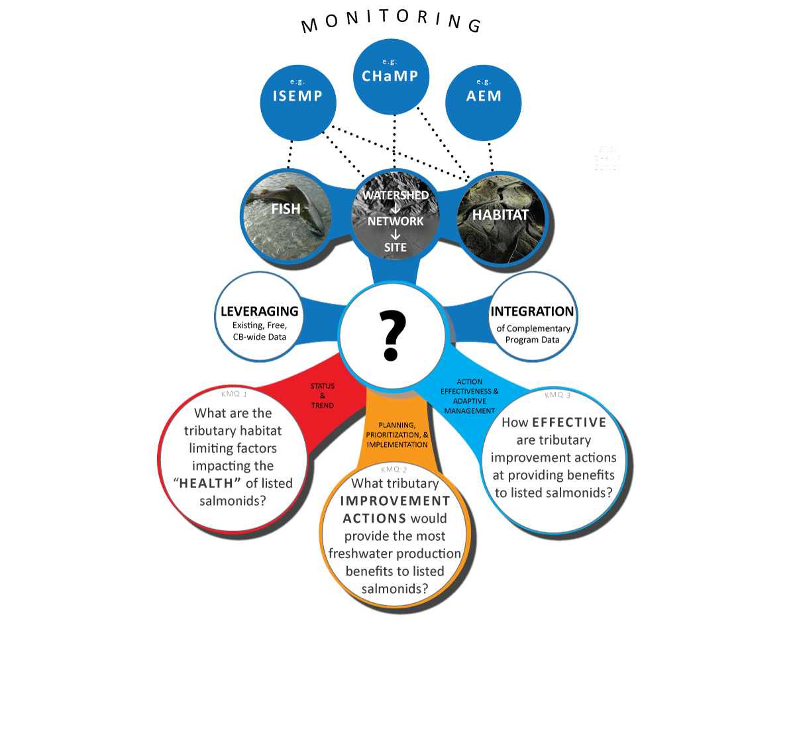
We are NOT Proposing That ISEMP & CHaMP Alone Can Provide All the Answers…
Answers to some KMQs already being provided by others (e.g. expert panels)
Some KMQs can not be answered by science and data alone (we need experts, stake holders and decision makers)
Better information is now emerging from BPA’s RME efforts
Community should use best available information to address KMQs as it emerges

Slide 5
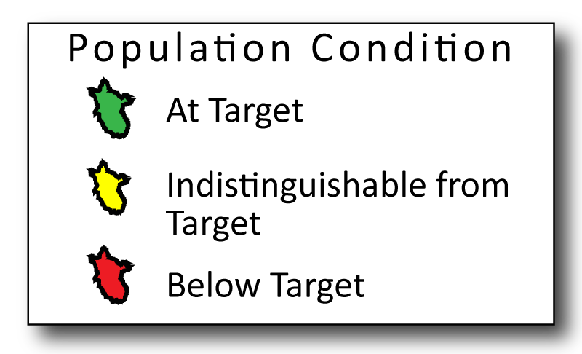
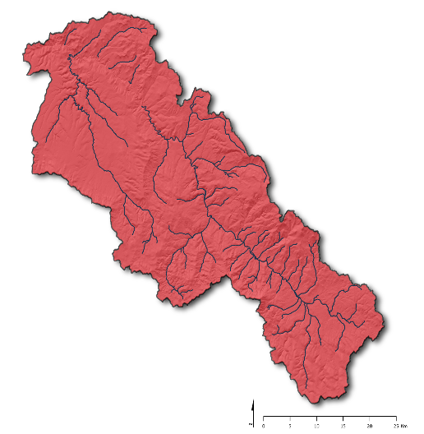
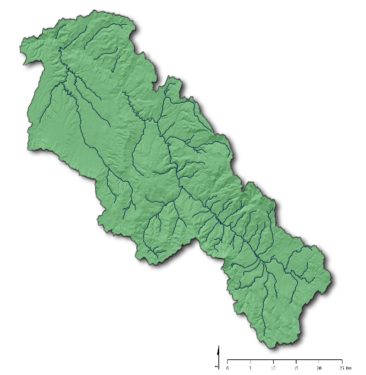
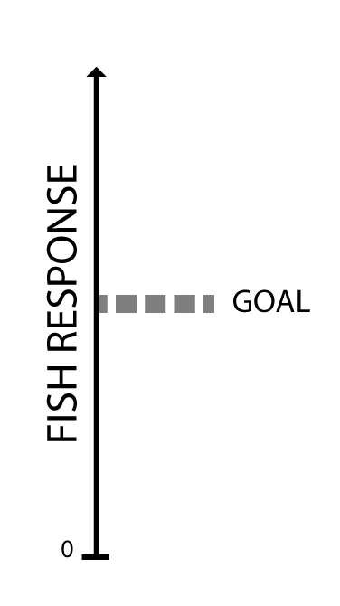
A Shared Vision:
Habitat Condition
TRIBUTARY
IMPROVEMENT
ACTIONS
POST
PRE
Notes:
Ultimately, the answer to these questions will be tied to salmon and steelhead populations. We need to be able to assess what condition populations are in. Is some fish response (here we use numbers) below, at, or above some defined goal. There will be errors on these estimates.
People do not like graphs. Use maps instead.

Slide 6
How do we realize that vision? Key Management Questions
Through tributary habitat improvements
RM&E needed to support all steps of the process
How to leverage RM&E to address these KMQs?
Notes:
But how?
Formerly, either expert panels or sub-basin planning process

Slide 7
BPA’s Tributary Habitat RM&E
“What are the tributary habitat limiting factors (ecological impairments) or threats preventing the achievement of desired tributary habitat performance objectives?”
“What are the relationships between tributary habitat actions and fish survival or productivity increases, and what actions are most effective?”
“How cost effective are various treatment types and BMPs for addressing identified habitat impairments?”
“Are tributary actions achieving the expected biological and environmental improvements in habitat?”
From: http://www.cbfish.org/ProgramStrategy.mvc/ViewProgramStrategySummary/3
Notes:
Did we state this at the beginning?

Slide 8
How To Get Data On

Slide 9
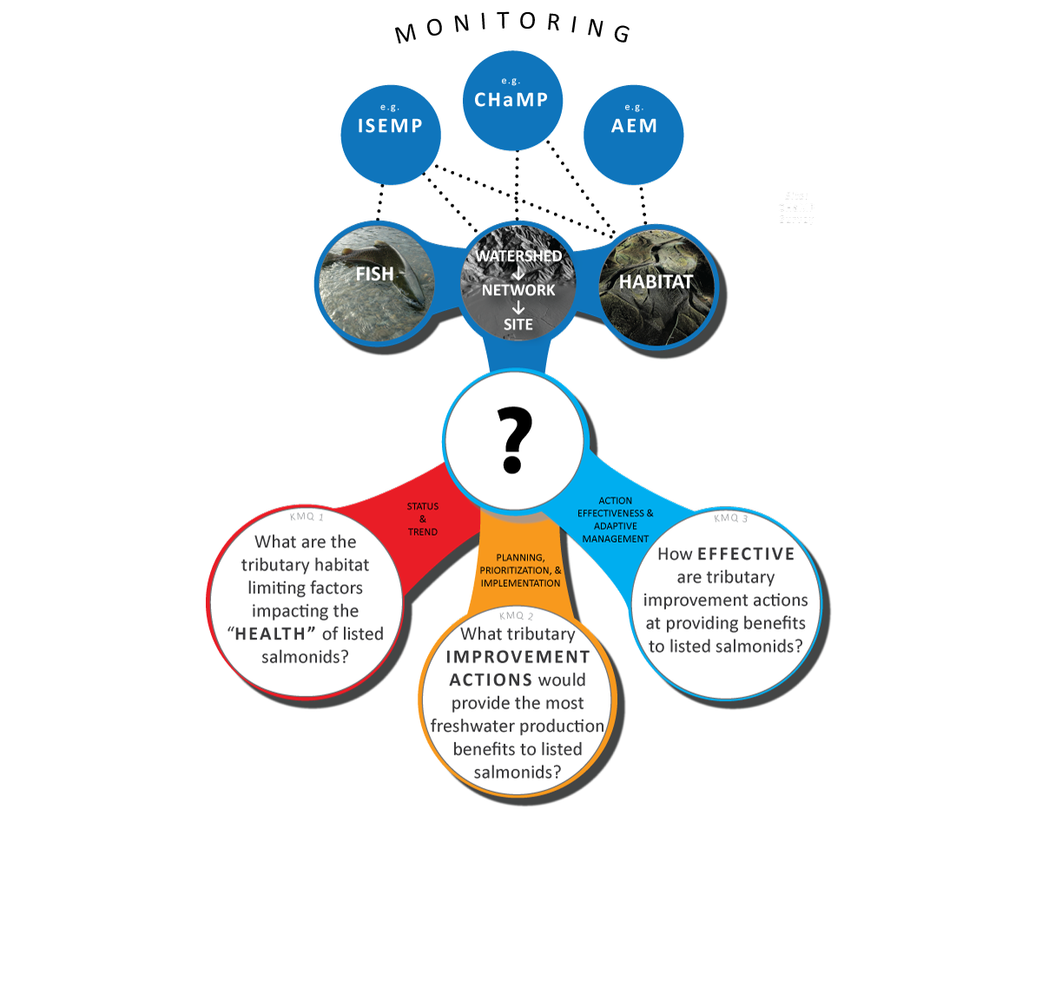
How To Get Data On
Monitor fish and habitat at site, segment, network & watershed scales
Notes:
Do we want the eye poke, that CHaMP set the new standard?
ISEMP has been developing monitoring protocols to collect both fish and habitat data. CHaMP is an example of one of these projects. We are developing these tools to synthesize this data and turn them into products.

Slide 10
Efficiency is Key

Slide 11
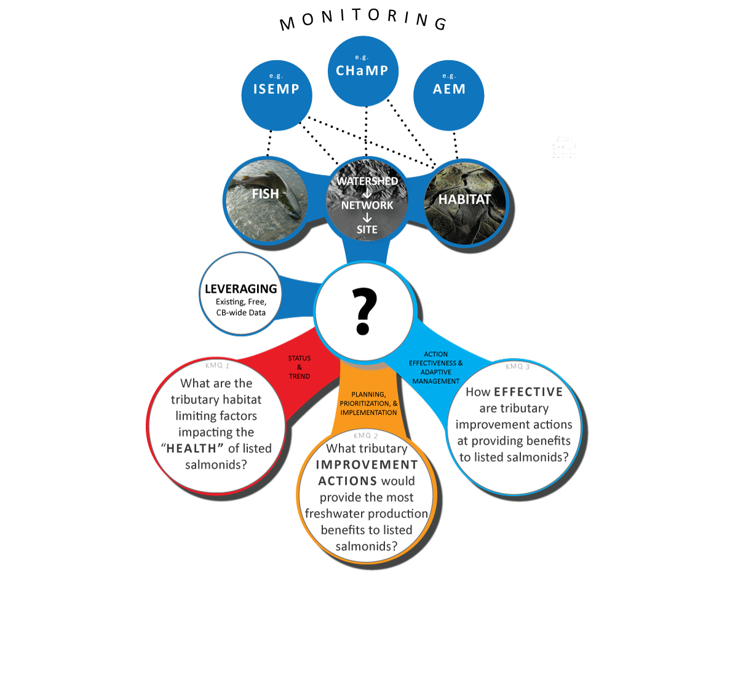
Efficiency is Key:
No existing data set out there tells the answers to these questions
Where appropriate, we want to leverage what information already exists.
Notes:
While designing and collecting data is a big part of what we do, we do not claim to be the only source of data that can be leveraged to develop products
There is not only a huge amount data collected at multiple scales, such as remote sensing data, that are stored in GIS available for free. But there are also disciplines dedicated to interpreting this multi-scalar data- such as geomorphologist interpreting landscape data to inform why channels look and respond they way they do. It only makes sense to use this incredibly relevant and useful information, and not assume that fish biologist alone can answer these questions
An incredibly useful and necessary product to help encourage a more regional of use of data and products is a common data storage system that can be used to help support products and decisions of these KMQs

Slide 12
Efficiency is Key:
No other existing program is geared to address these questions
Where appropriate, we want to capitalize on investments in other existing programs to integrate their information into this framework.

Slide 13
Regional Monitoring Program Integration
Given overlap, logical we should be able to leverage each others data
We are collaborating to find efficiencies
Different mandates and different KMQs make the work interesting
What are the first steps?
Notes:
In addition, there are other monitoring programs, PIBO and Oregon’s Aquatic Inventories, that collect similar or other data that can provide useful inputs and validation to products as well.
Plug and point out where in schedule we will address this ‘important’ topic….

Slide 14
Integration of Regional Monitoring Programs - Sites

Slide 15
Integration of Regional Monitoring Programs - Data
PNAMP ISTM Habitat Project

Slide 16
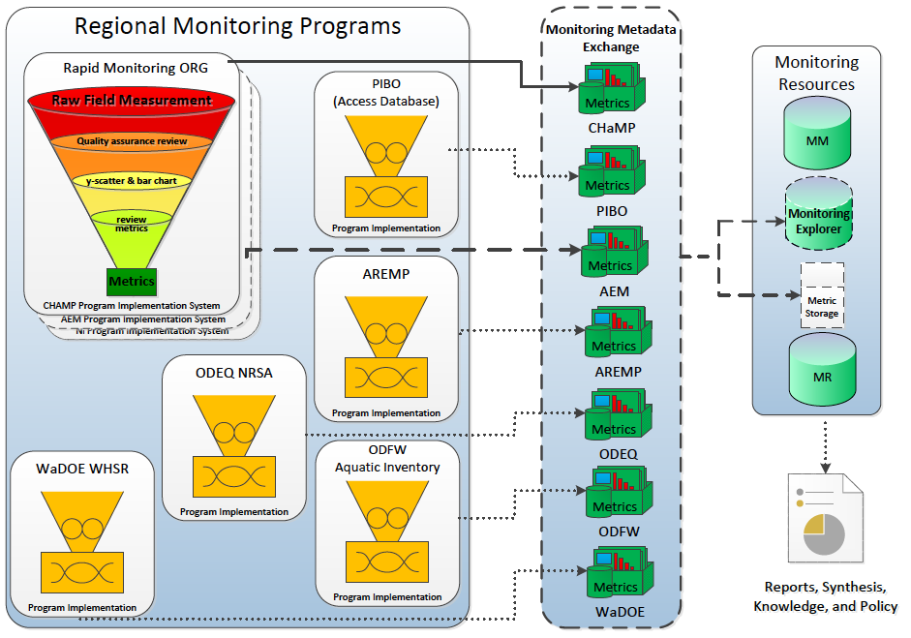
Integration of Regional Monitoring Programs – Data Management

Slide 17
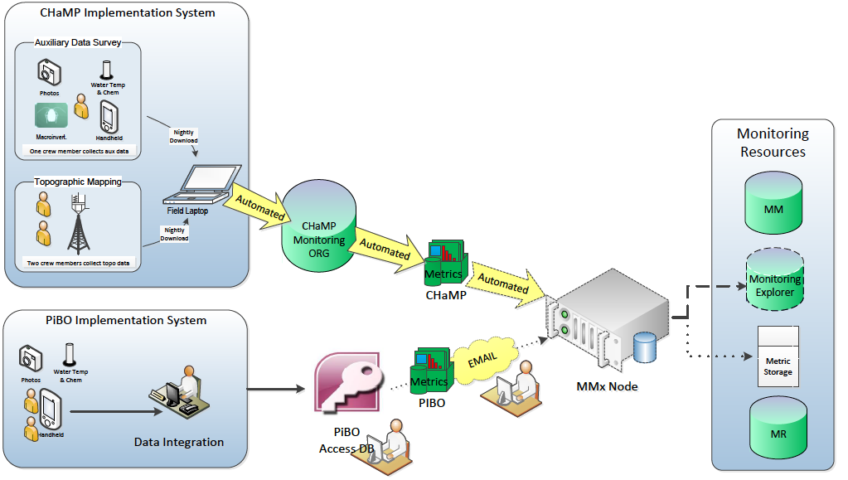
Integration of Regional Monitoring Programs – Data Test Case

Slide 18
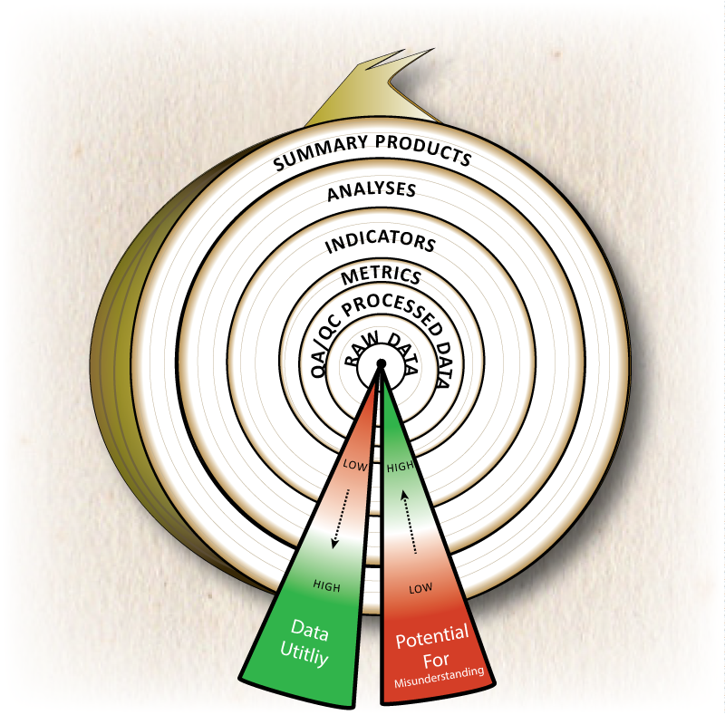
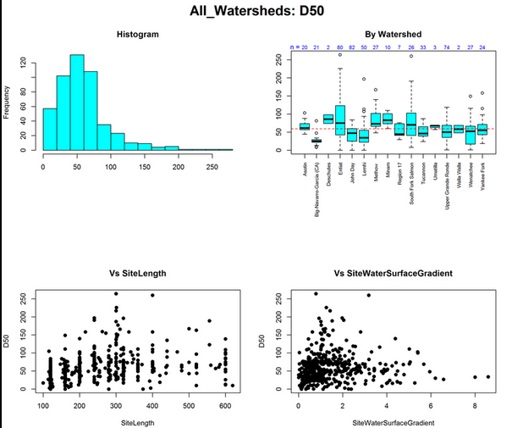
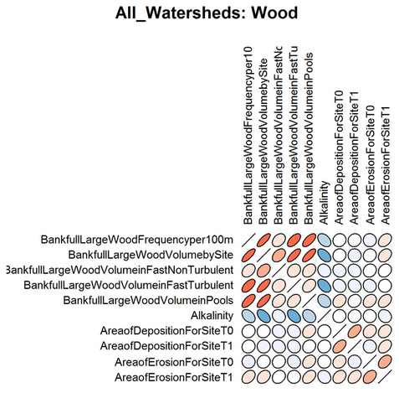
The answer is not just in metrics or raw data!
Notes:
TOO much focus has been given to metric discussions. Metrics by themselves don’t provide the ‘answers’ to KMQs. They require further analyses and interpretation before being translated and combined into direct ‘answers’ to KMQs.

Slide 19
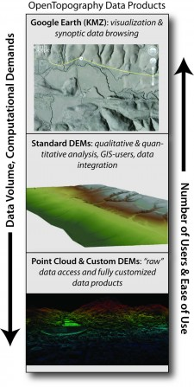
The answer is not just in metrics or raw data!
Notes:
TOO much focus has been given to metric discussions. Metrics by themselves don’t provide the ‘answers’ to KMQs. They require further analyses and interpretation before being translated and combined into direct ‘answers’ to KMQs.

Slide 20
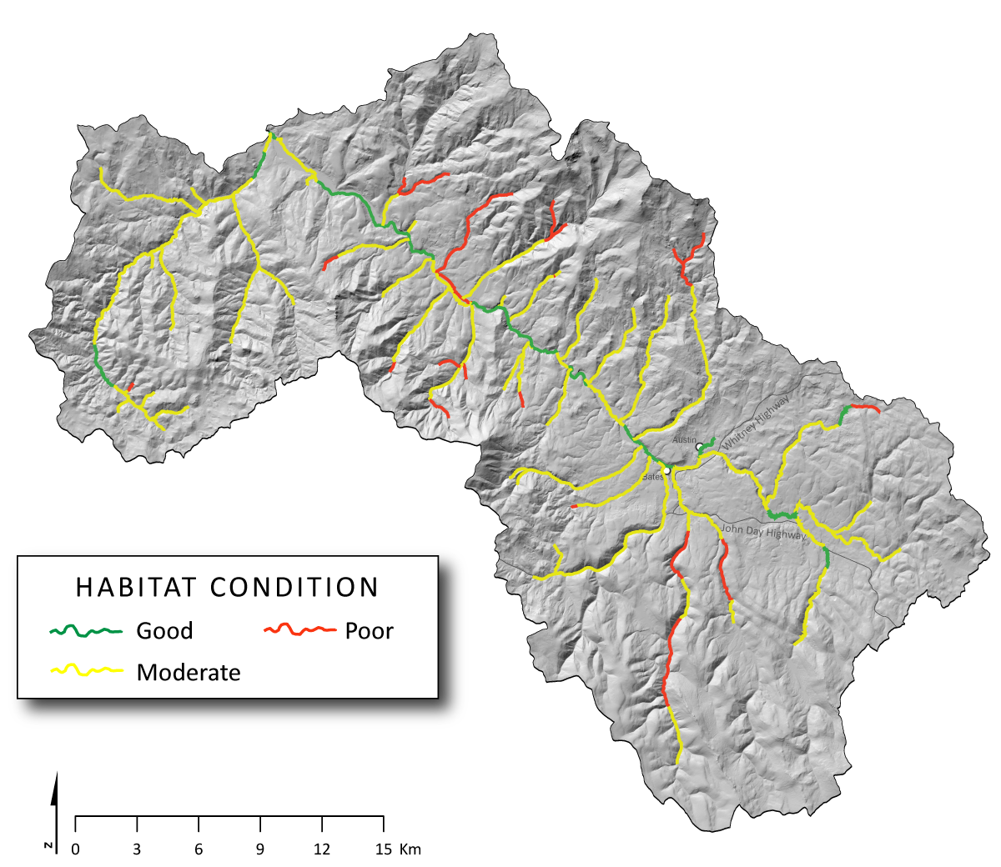
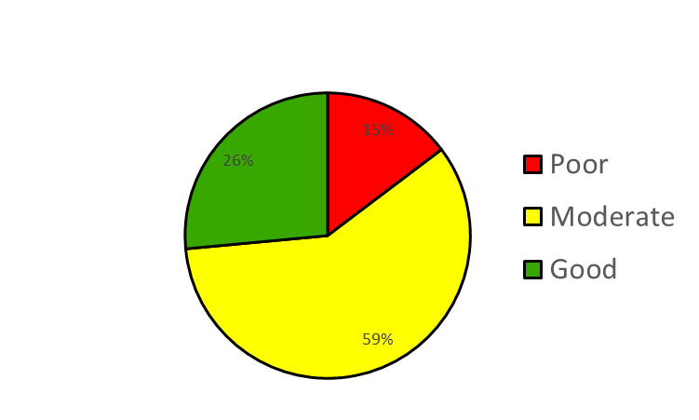
We Think the Answers Can be Displayed in Easy-to-Use Maps & Graphics…
Notes:
Point out that this is indeed what BPA’s Atlas effort emphasizes, and that this is nothing new. Maps provide context. There are lots of ways to produce these maps… and the devil in the details is critical. Its easy to produce an easy to interpret map, but the key is to produce a map with the ‘best available science and information’ available at the time.

Slide 21
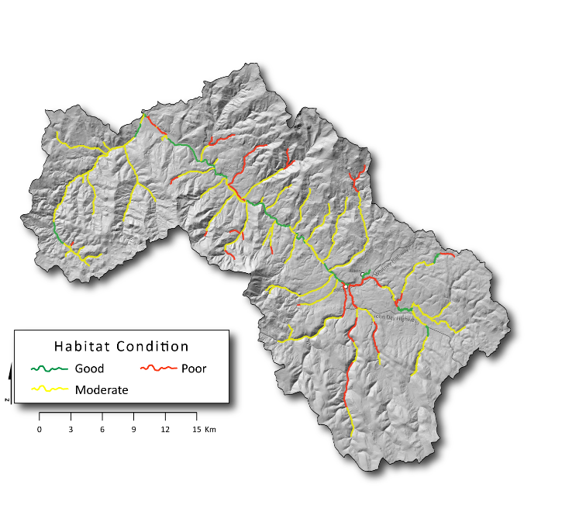
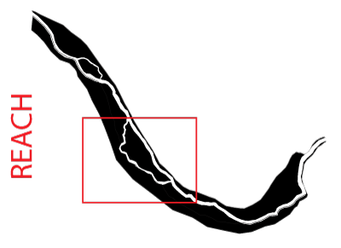
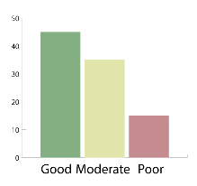
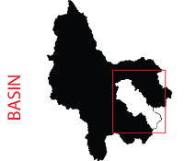
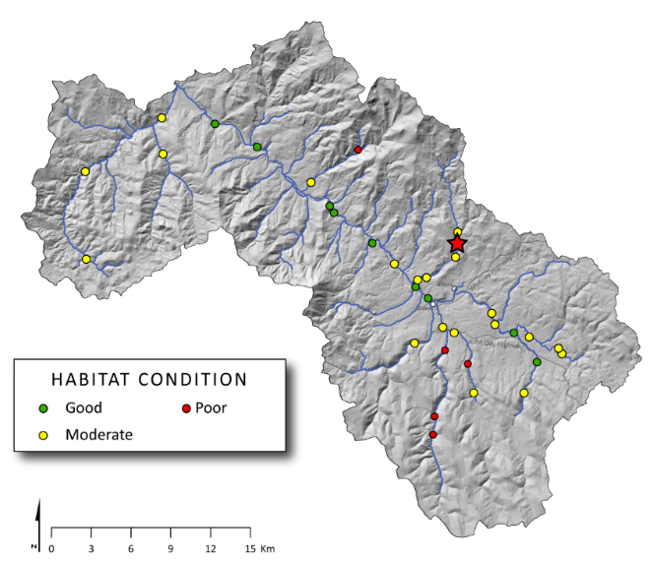
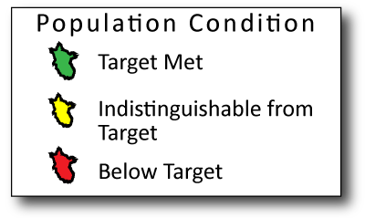
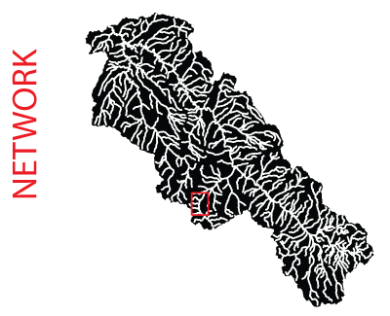
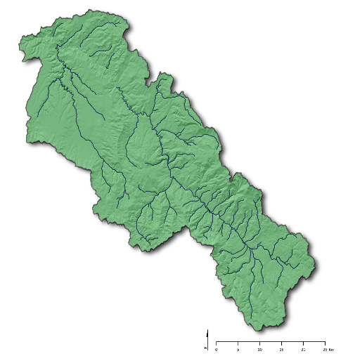
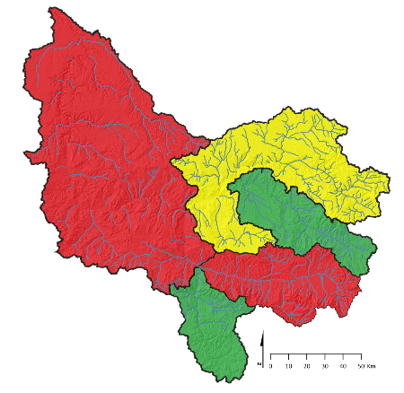
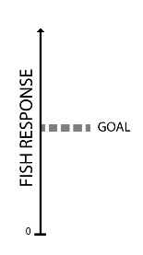
MAPS AT DIFFERENT SCALES TO ADDRESS DIFFERENT NEEDS
4
NETWORK
SUMMARY
1
SITE LEVEL
2
SITE SUMMARY:
3
SITES ON NETWORK
WATERSHED / POPULATION
5
6
MPG /BASIN

Slide 22
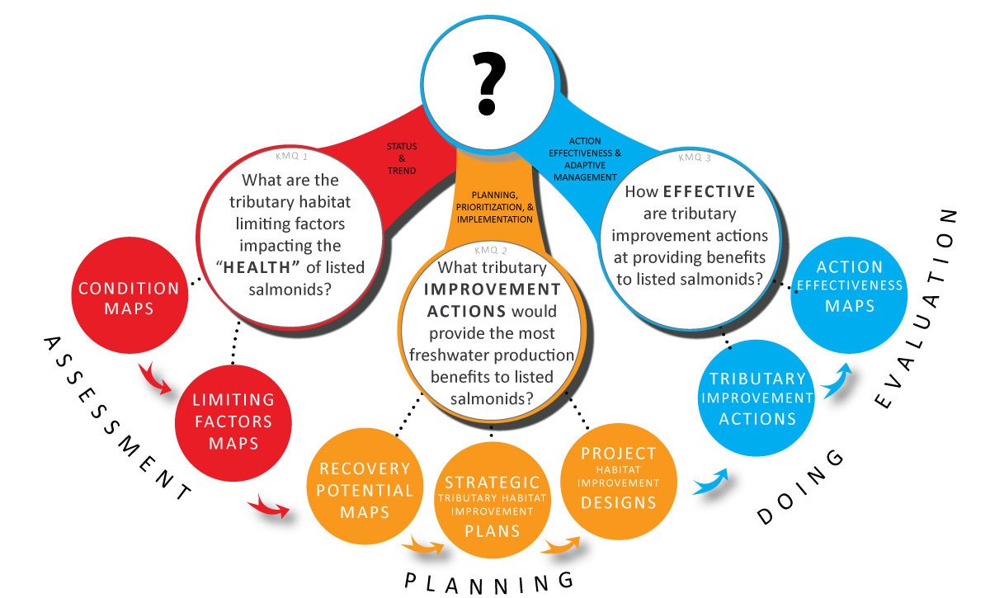
Summary Products – The WHAT, not HOW
What do some of these summary products look like?

Slide 23
We will not show all in this overview… But we will show all this afternoon

Slide 24
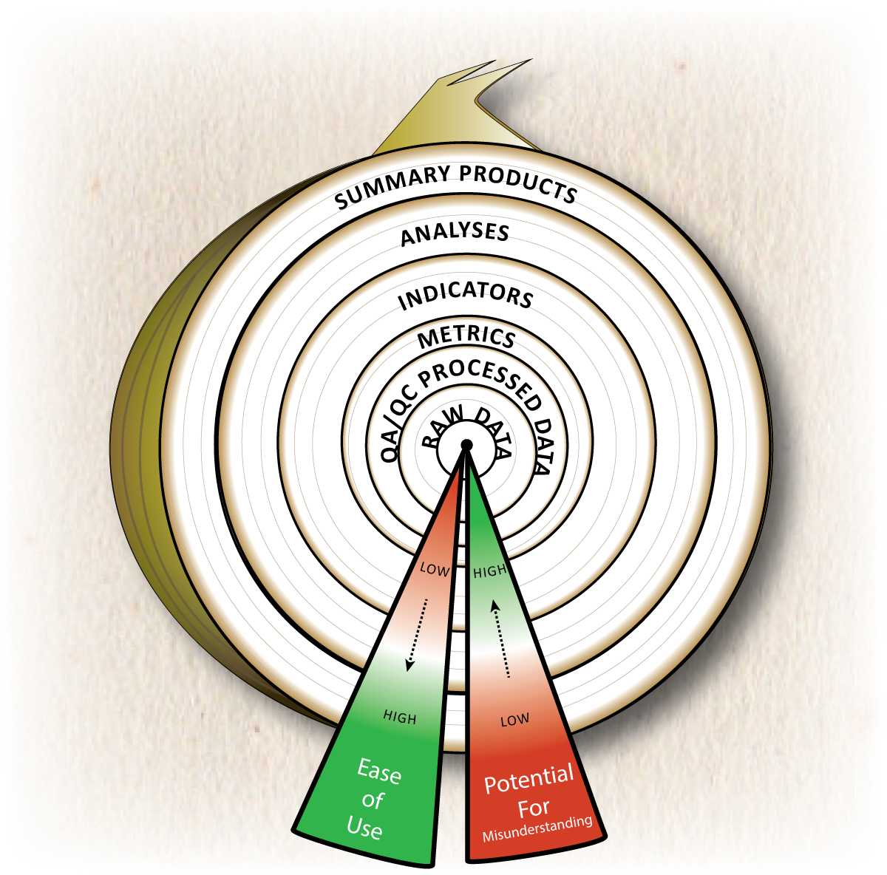
Just Showing Outer Layer

Slide 25
Those Other Products are Always Available

Slide 26
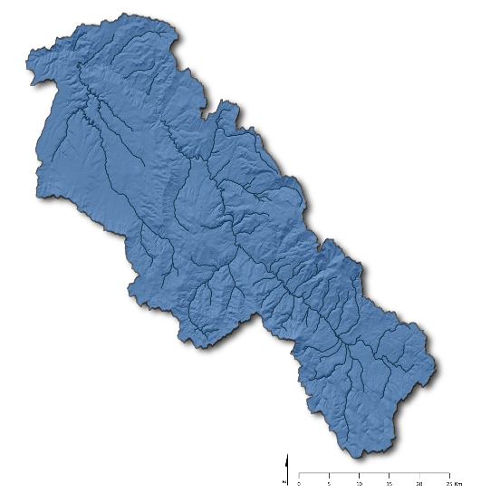
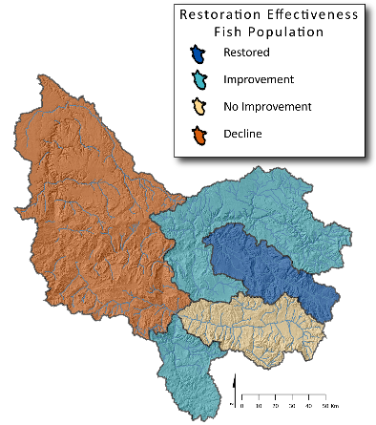
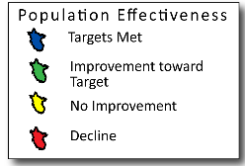
For this Overview, Focus on Two Scales
4
NETWORK
SUMMARY
1
SITE LEVEL
2
SITE SUMMARY:
3
SITES ON NETWORK
WATERSHED / POPULATION
5
6
MPG/BASIN

Slide 27
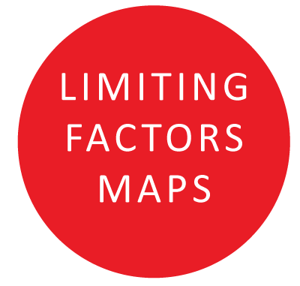
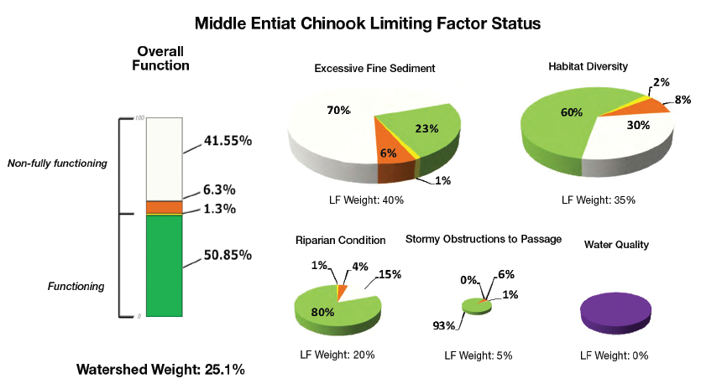
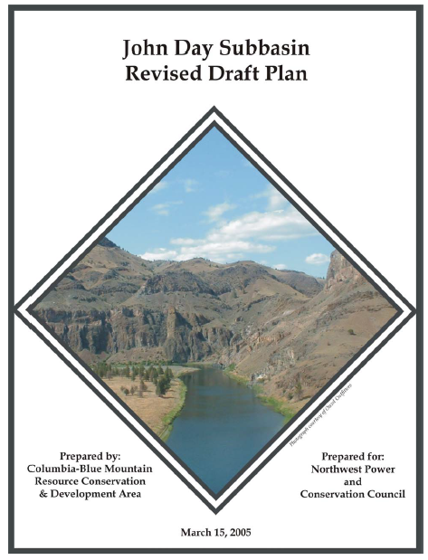
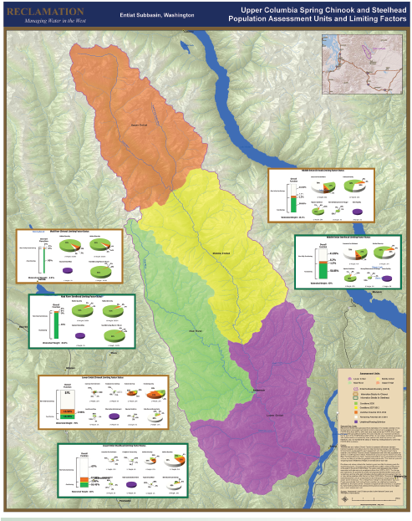
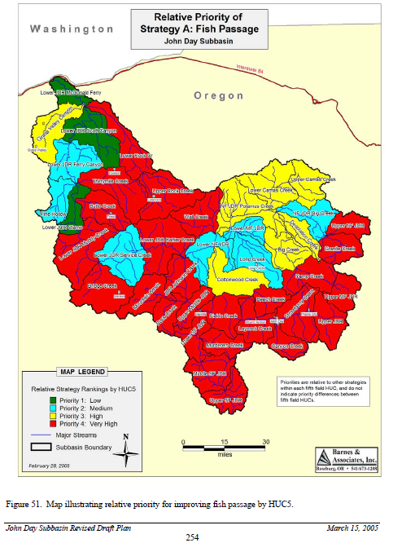
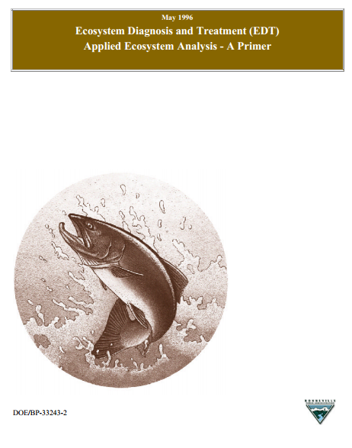
Summary Products Have Been Made Many Times Before…
Expert Panel Limiting Factors
Subbasin Plans
EDT

Slide 28
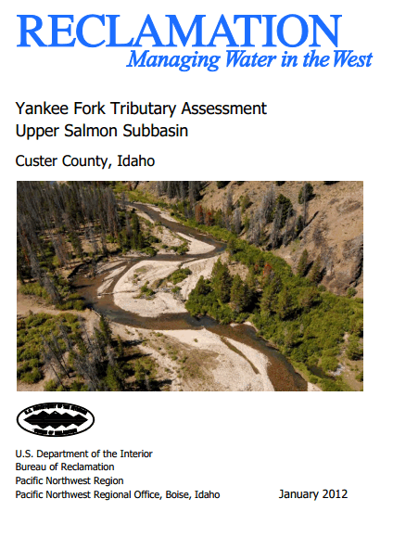
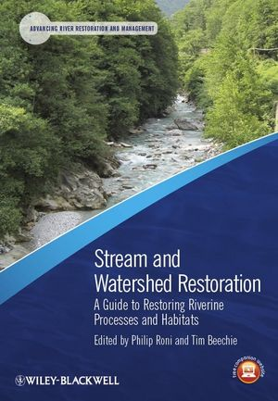
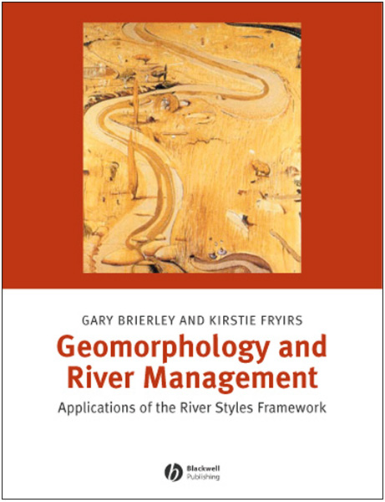
NOT a New Idea … BUT
Direct translation of CHaMP/ISEMP data & metrics into format directly useful to addressing Key Management Questions
Salmon-centric but bio-physically informed
More direct linkages, consistencies & efficiencies

Slide 29
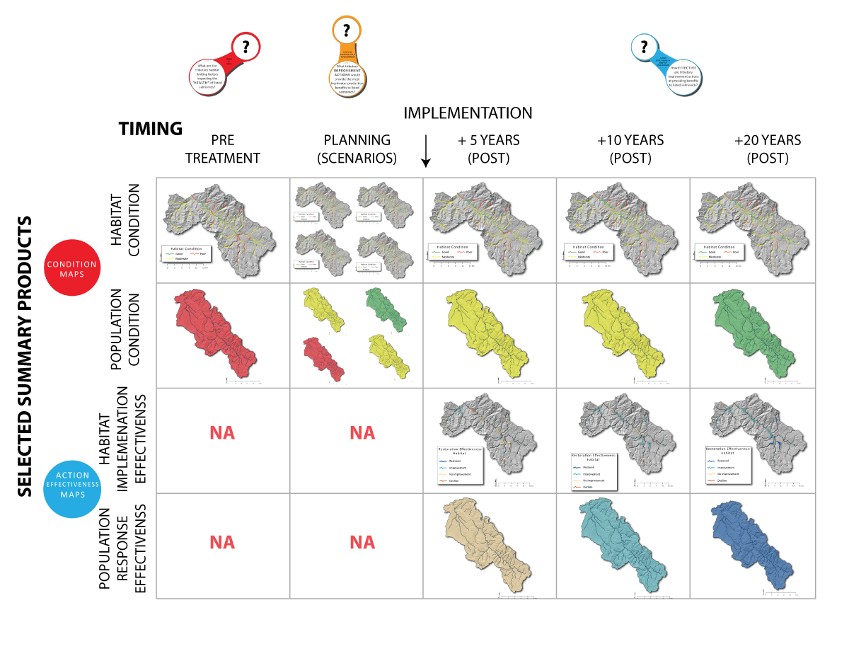
Summary Products in Sequence…

Slide 30
Start with Pre-Treatment Conditions

Slide 31
KMQ 1: Summary Products
Directly from CHaMP/ISEMP
Geomorphic Condition
Habitat Condition
Population Condition
Better Informed from CHaMP/ISEMP
Requires inventory of anthropogenically limiting factors
May still require expert judgment to synthesize
Notes:
We need to describe the current condition, what does the fish habitat currently look like in a representative set of subbasins of distinct fish populations relative the current condition of the fish population?
We also have to identify the habitat factors that currently limit these populations? If we are going to improve habitat efficiently, It makes the most sense to address these factors

Slide 32
Habitat Condition

Slide 33
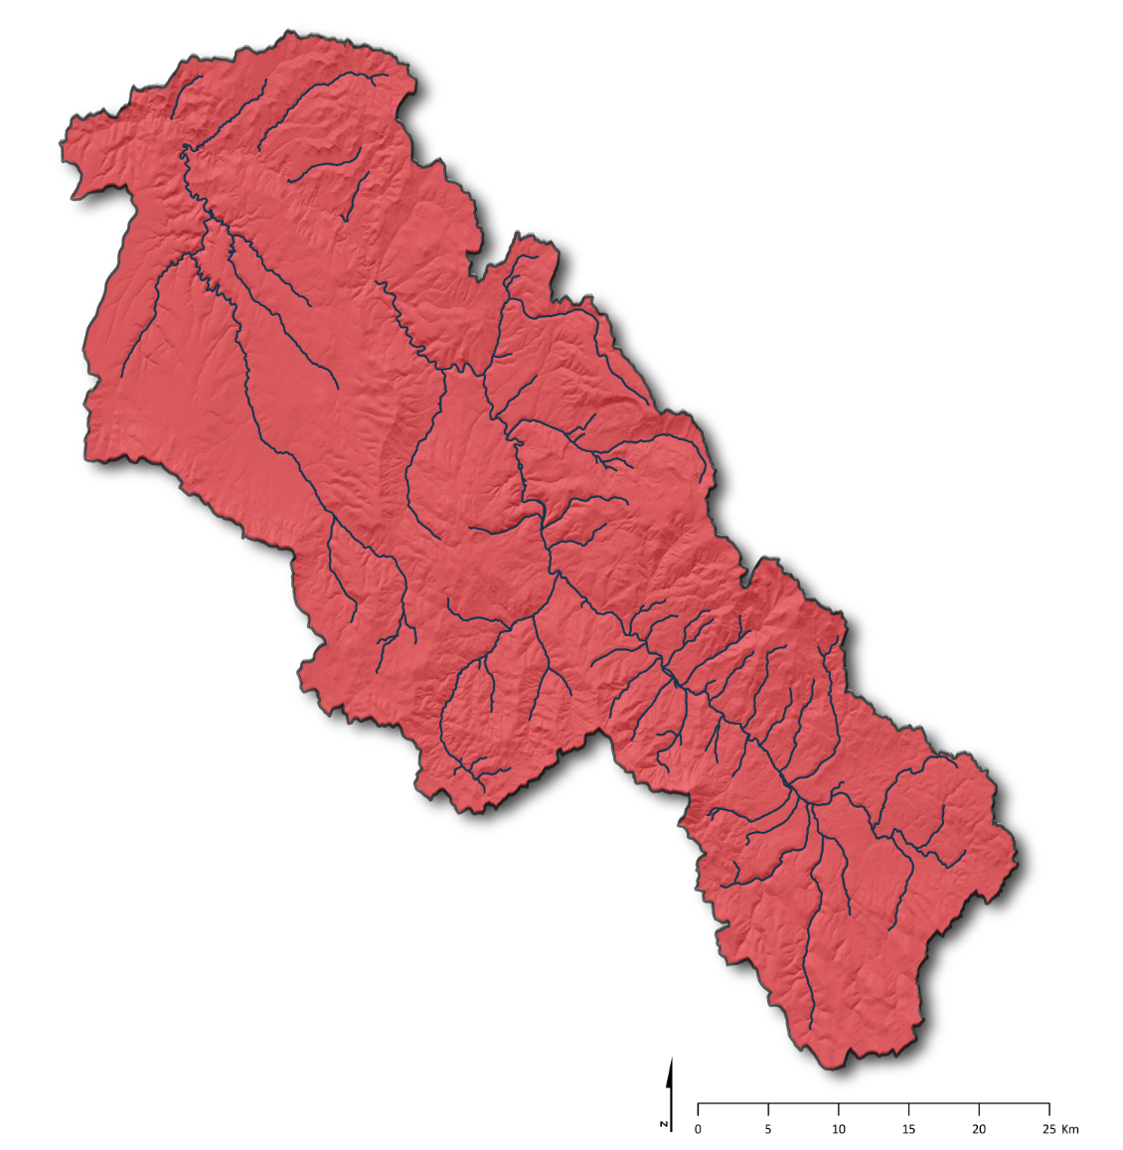
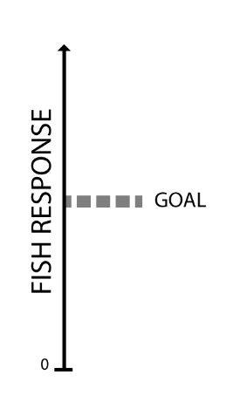
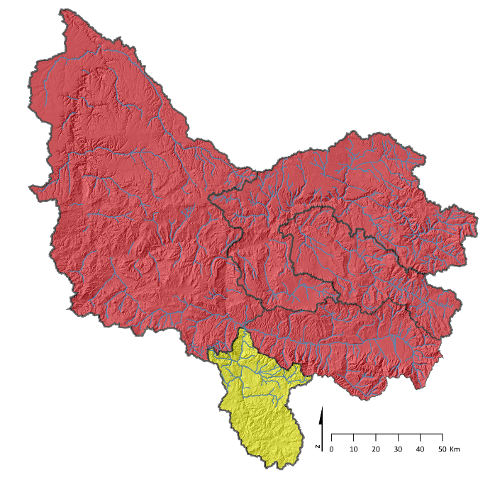
Population Condition

Slide 34
Condition Synthesized into Limiting Factors for Specific Populations

Slide 35
Planning – Projecting Scenarios of Condition

Slide 36
KMQ 2: Summary Products
Can be better informed by CHaMP/ISEMP/AEM
Still requires expert and stakeholder input (e.g. Atlas)
Can be directly produced from CHaMP/ISEMP
Can be better informed by CHaMP/ISEMP/AEM
Still requires expert designers…
Notes:
Describe the habitat condition that could be achieved (for example, you are not going to turn a gorge into a meandering pool:riffle stream type): along with our current condition, these provide the bookends to what is feasible. We hope the ability to reach our goals lies somewhere between here.
Next, we need to balance this habitat template with management objectives (which may go beyond anadromous fish); prioritize which actions provide the most benefits for the costs: this is perhaps best achieve by weighing several scenarios to determine which is expected to provide the most bang for the buck. In addition, these alternative scenarios may be the basis for adaptive management strategies in the event the prefer strategy is not working
Finally, the plan should include on-the-ground designs that make sense within the context of their setting, can show a link to identified limiting factors, and are cost effective

Slide 37
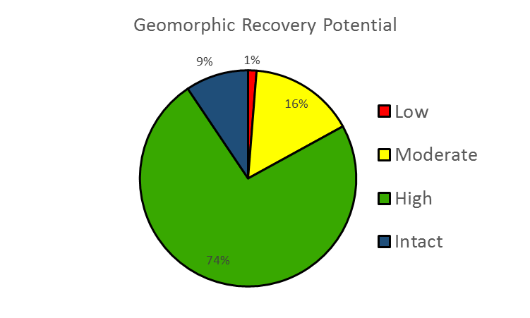
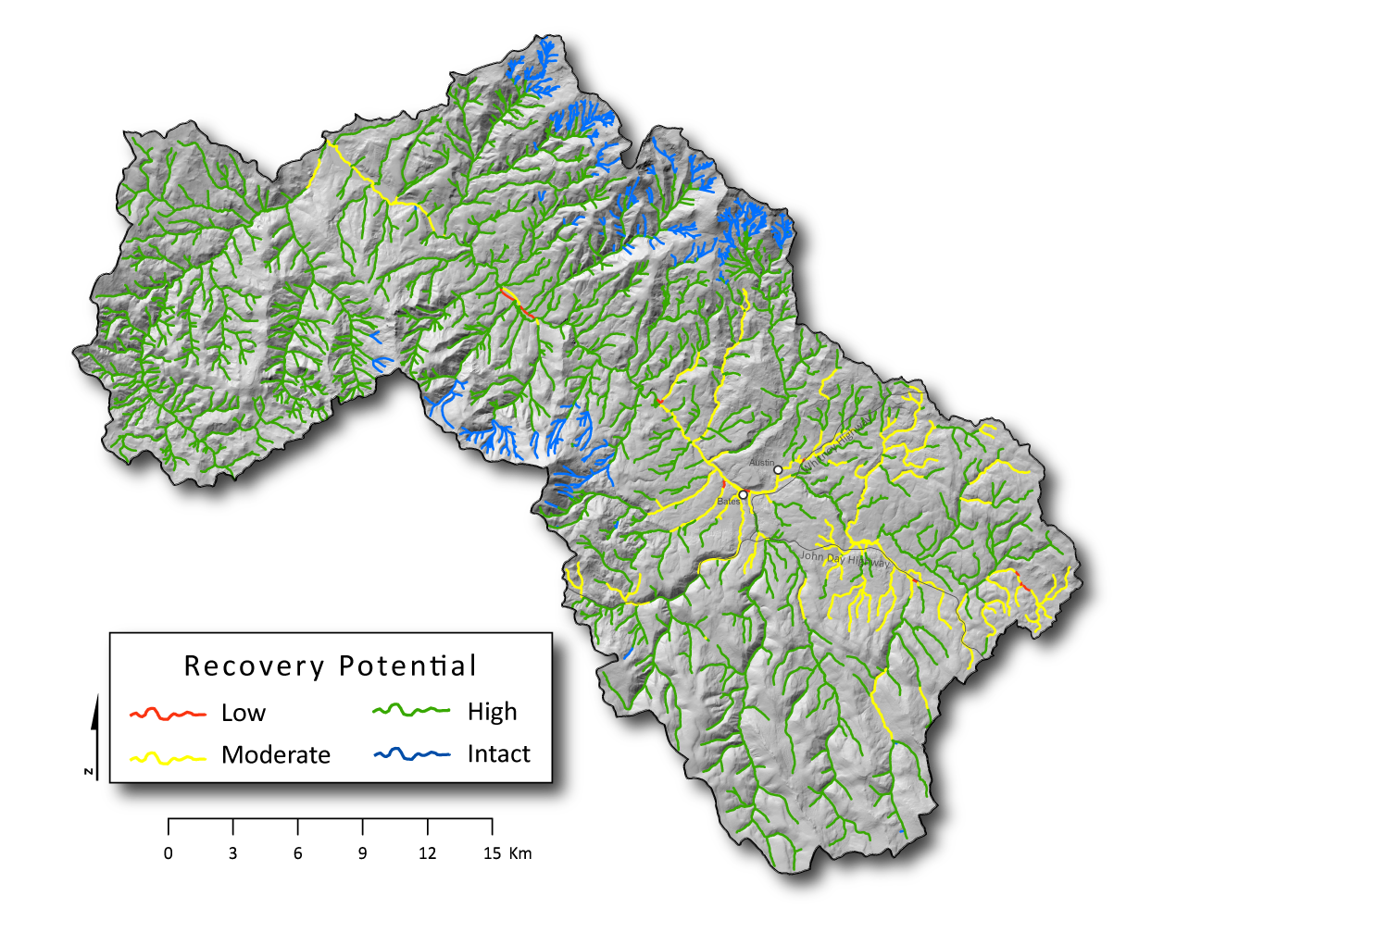
Geomorphic Recovery Potential

Slide 38
Planning – Culminates in Plans & Designs

Slide 39
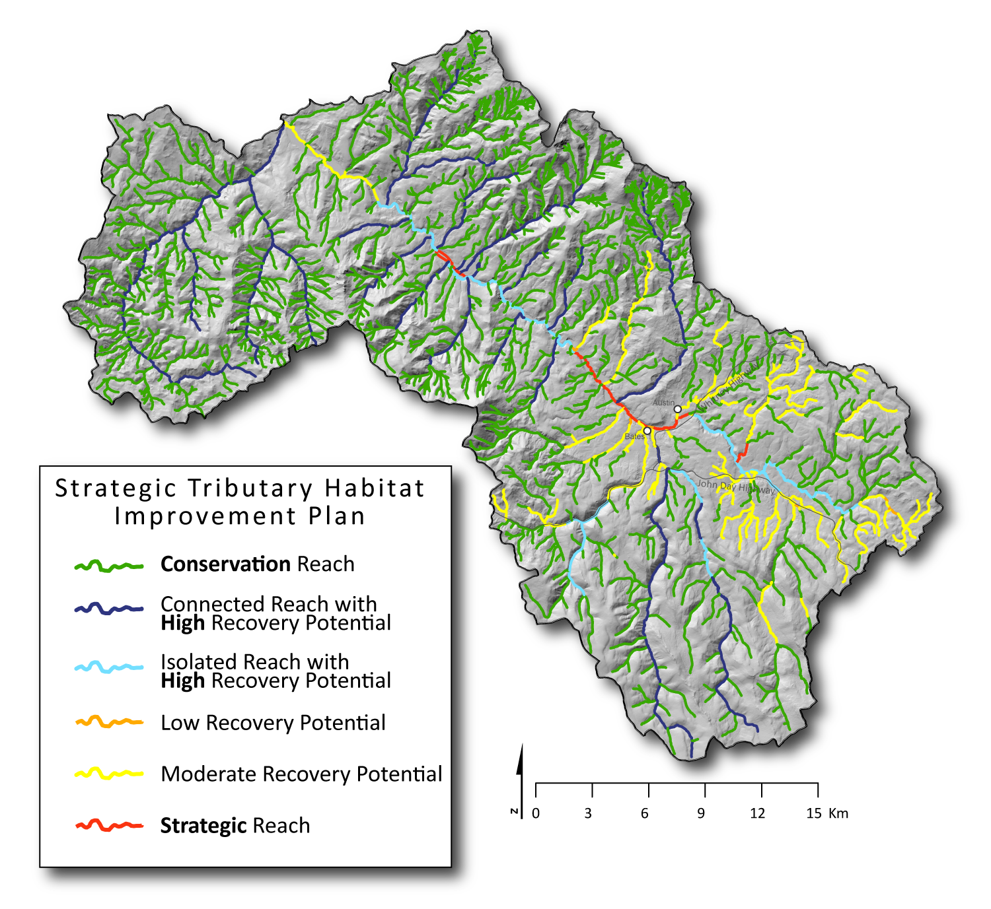
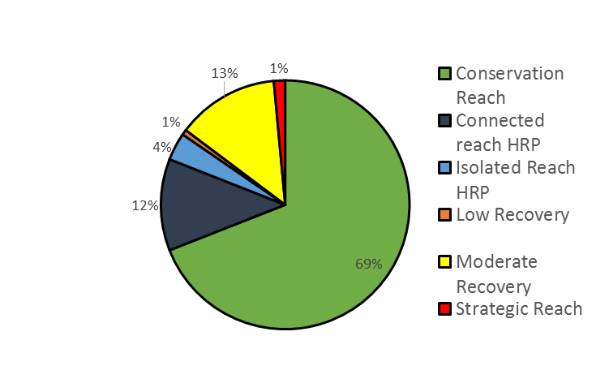
A Opportunistic Strategic Plan…

Slide 40
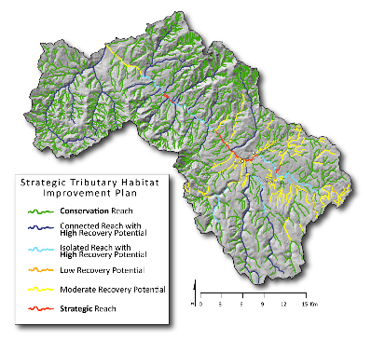
Tributary Improvement Actions Take Place
According to a strategic plan…

Slide 41
KMQ 3: Summary Products
ISEMP/CHAMP/AEM specifically designed to provide assessments
IMWs provide example of how
Lifecycle models
BPA already delivering through cbfish.org (Taurus)
Notes:
Did the plan get implemented? Chances are the realities of the real world will throw in some road blocks to the best intentions. An accurate description of what, where and when action were implemented is essential to linking restoration to the observed changes. It is surprising how often this is not done.
Second, we will have to evaluate if, what will then be, the current population condition has improved relative to our past condition. We also have to link this to actions that have been implemented.

Slide 42
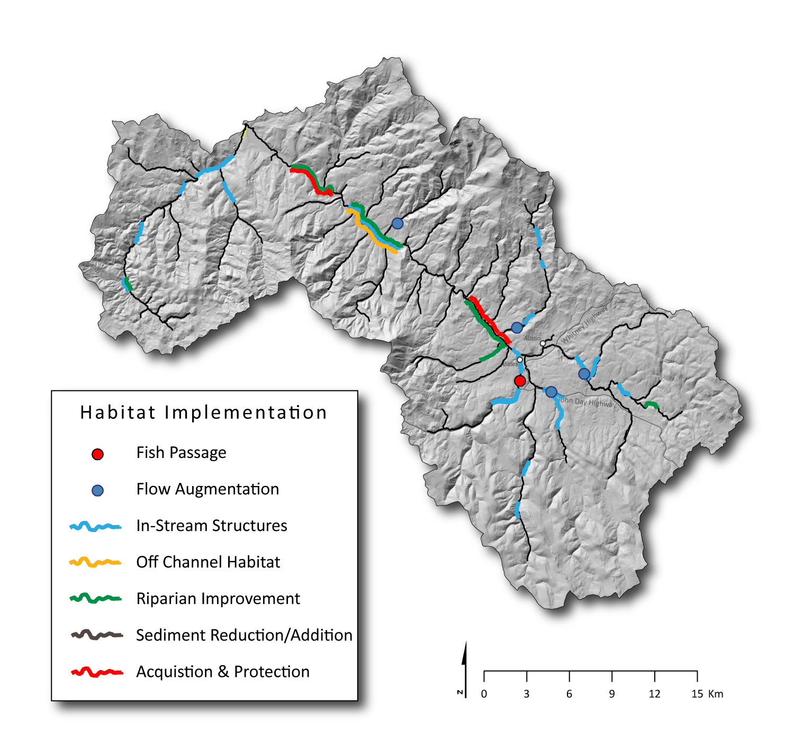
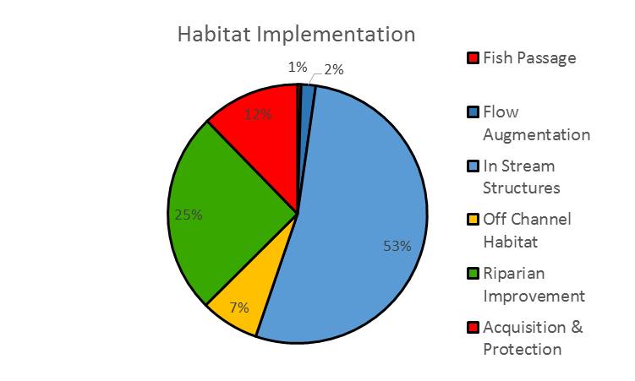
And there are maps for that…

Slide 43
So then what? We Wait & Assess Again

Slide 44
We Compare Pre- and Post- Condition
But expectations for timing of responses will vary…

Slide 45
We Compare Pre- and Post- Condition
Pre Habitat Condition
+5 Years Habitat Condition
Physical responses may be detected relatively fast…

Slide 46
We Compare Pre- and Post- Condition
Pre Population Condition
+5 Years
+10 Years
+20 Years
Fish population responses may take longer to detect

Slide 47
But Effectiveness is About More Than Just Status & Trend

Slide 48
Look At Effectiveness of Actions as Interim Measures
For habitat, look only where improvements made

Slide 49
Population Responses & Effectiveness at Each Population

Slide 50
Summary Products in Context

Slide 51
Scope to Adjust:
Adaptive Management

Slide 52
How To Provide Products:
http://champmonitoring.org
http://cbfish.org
http://monitoringresources.org
Build/expand a portal where we ingest, process, store and serve all this information into a Synthesis Engine
Notes:
An incredibly useful and necessary product to help encourage a more regional of use of data and products is a common data storage system that can be used to help support products and decisions of these KMQs

Slide 53
How Realistic is This Framework?

Slide 54
Status as of 2013

Slide 55
Why have we described our understanding of this framework?
To make your investment in RM&E most useful, we need to know how CHaMP/ISEMP data might be consumed
Discussions about Integration & metrics are more efficient in terms of clearly defined summary products
We want your input as consumers of our products on how to most effectively display information

Slide 56
Next… KMQs & Summary Products in More Detail

