Slide 1
CHaMP – ISEMP Analysis and Synthesis Workshop
Workshop Welcome
Portland, Oregon – February 25th and 26th, 2014

Slide 2
Introductory Remarks

Slide 3
Workshop Purpose & Objectives
Workshop Purpose:
To review how CHaMP-ISEMP habitat and fish data, analyses, and synthesis products could be used to support the FCRPS BiOp management community’s needs.
Objectives:
Present options for converting monitoring data and analyses into usable and consumable products to help answer BPA Key Management Questions (KMQs).
Gather feedback from managers and policy decision-makers, monitoring practitioners and others on the proposed approaches.

Slide 4
Day 1: This Afternoon
Management Focus - CHaMP-ISEMP Products to Support BPA and Regional Decision-makers
1:00 – 1:15 : Workshop Welcome
1:15 – 2:00 : Supporting a BPA Framework to help meet regional Salmonid Mgt. Requirements
2:00 – 2:45 : KMQ 1 – Evaluating Ecological Impairments
2:45 – 3:00 : Break – Restore the Flume
3:00 – 3:45 : KMQ 2 – Planning, Prioritization & Implementation
3:45 – 4:15 : KMQ 3 – Action Effectiveness & Adaptive Mgt.
4:15 – 4:30 : Synthesis and Prioritization for Day 2
4:30 – 6:30 : Informal Discussion Session

Slide 5
Day 2: Tomorrow Morning
Technical Focus - Review of the Science Underlying the Analyses & Synthesis Products
8:00 – 8:15 : Workshop Welcome
8:15 – 8:30 : Overview of the Science Used to Address KMQs
8:30 – 10:00 : The Details Supporting the Storylines, Syntheses, and Status Updates
10:00 – 10:15 : Break
10:15 – 11:15 : CHaMP Metrics and Diagnostics Review
11:15 – 11:45 : Considerations for ending the CHaMP Pilot Phase
11:45 – 12:00 : Wrap-up and Next Steps
12:00 : Adjourn

Slide 6
Management Decision Support Products
Monitoring Information
What goes here?
Key Management Questions

Slide 7
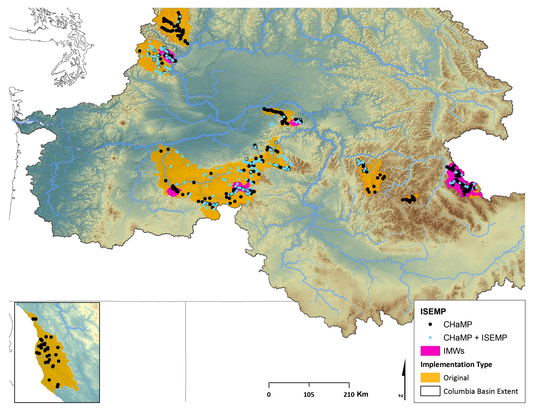
Relationship Between CHaMP & ISEMP
Points?

Slide 8
Integration of Regional Monitoring Programs - Sites

Slide 9
Is the CHaMP Pilot Phase Complete?
Are useful descriptions of stream habitat condition generated by CHaMP?
Do the CHaMP response design and survey design support habitat management decision making across the interior Columbia River basin?
Are the methods implemented by CHaMP exportable to other projects and programs?
Other?

Slide 10
Day 1: This Afternoon
Management Focus - CHaMP-ISEMP Products to Support BPA and Regional Decision-makers
1:00 – 1:15 : Workshop Welcome
1:15 – 2:00 : Supporting a BPA Framework to help meet regional Salmonid Mgt. Requirements
2:00 – 2:45 : KMQ 1 – Evaluating Ecological Impairments
2:45 – 3:00 : Break – Restore the Flume
3:00 – 3:45 : KMQ 2 – Planning, Prioritization & Implementation
3:45 – 4:15 : KMQ 3 – Action Effectiveness & Adaptive Mgt.
4:15 – 4:30 : Synthesis and Prioritization for Day 2
4:30 – 6:30 : Informal Discussion Session

