Slide 1
Bull Trout Data Sharing Example Approach from Coordinated Assessments Project
April 12, 2017
Missoula, Montana

Slide 2
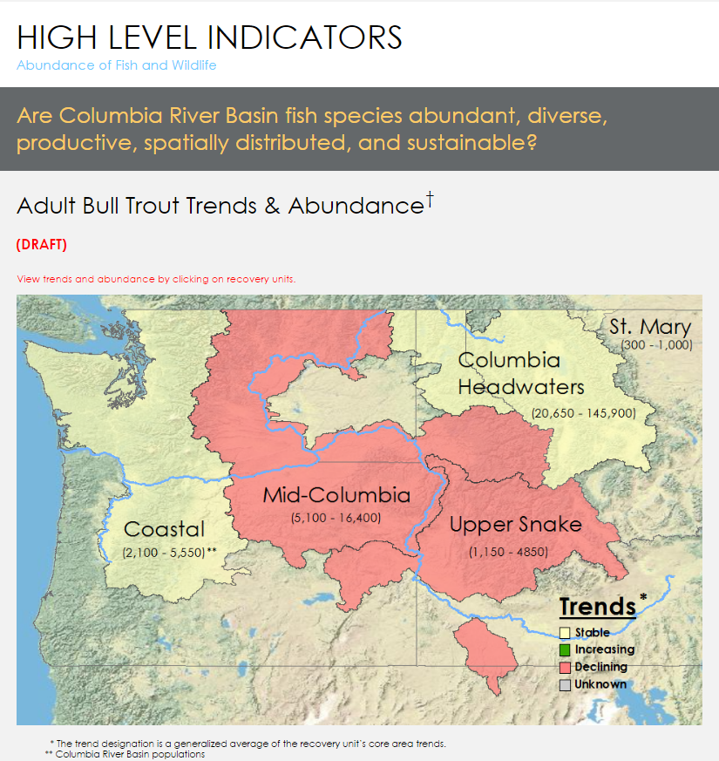
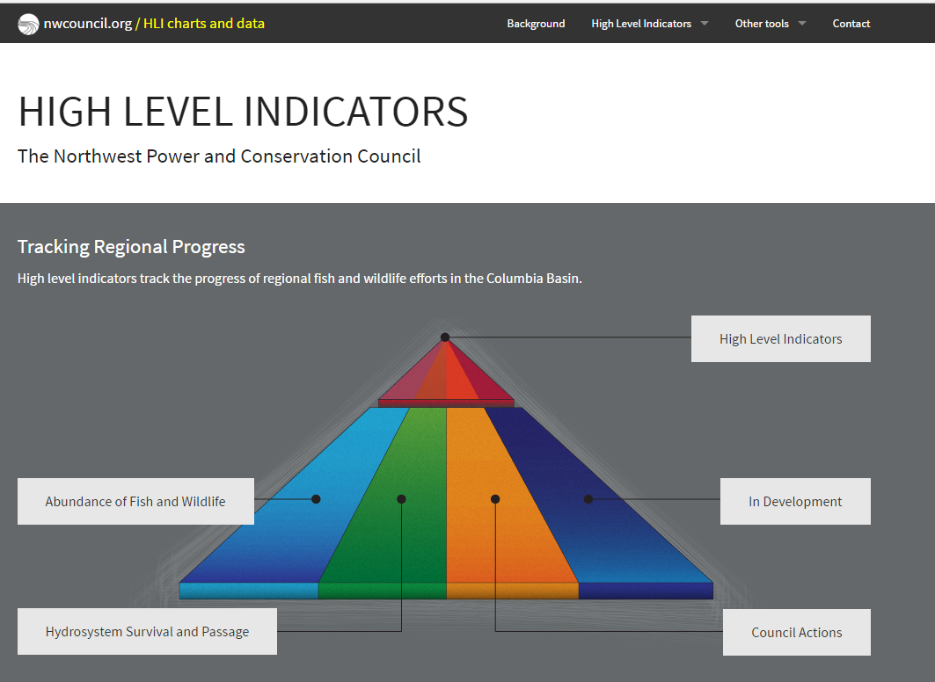
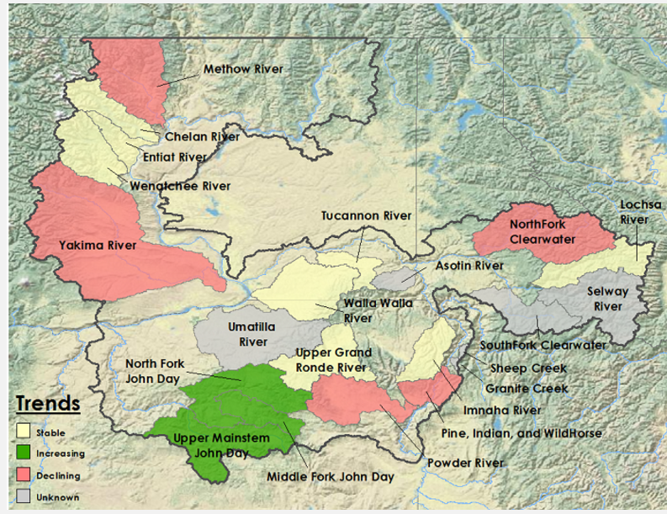
What is the value of coordinated data sharing?
To inform;
cross-jurisdictional management assessments
recovery progress
regional reporting requests (e.g. Council’s Bull Trout HLI and supporting graphics)

Slide 3
Coordinated Assessments – Historical Perspective
Coordinated Assessments Project started in 2010 with the goal of improving the timeliness, reliability and transparency of the Salmon and Steelhead data necessary for regional assessments and management decisions
At that time the project identified specific actions and activities for sharing Viable Salmonid Population (VSP) indicators in the Columbia River Basin. Important to note that sharing data was for a common goal: to provide data to NOAA for their 5 year status review
In 2015 – we started sharing data on first five VSP indicators;
Natural Origin Spawner Abundance
Recruits per Spawner
Smolt to Adult Ratio
Juvenile Abundance: Outmigrants
Presmolt Abundance

Slide 4
CA Focus: Getting Data for listed Salmon & Steelhead Populations for NOAA Status Reviews
BPA also requested assistance from StreamNet and the region’s fish managers to maximize data flow for certain populations identified as priorities by BPA for BiOp reporting in 2016. Continued interest from Bonneville in getting as much data as possible for these populations – remains a CA focus
If Data is not available at the population level, we work with the data providers to obtain the best available data for these populations into the database
Managing Data Exchange Standards (DES) and adopting changes thru a DES team approach
Hatchery Indicators, Bull Trout, other species as per a 5 year plan
A downloadable database not easy for the public and policy folks to access. Working on more user friendly displays of information, often map based

Slide 5
2016 Data Flow – all Populations
 | All Coordinated Assessments Populations |  | 200 TRT Populations
High Level Indicator | Reported with HLIs | Years with HLIs | Reported with HLIs | Years with HLIs | % of TRT Populations w/HLIs Submitted
Natural Origin Spawner Abundance | 155 | 3,908 | 112 | 3,290 | 56%
Recruits per Spawner | 86 | 2,652 | 65 | 2,295 | 33%
Smolt to Adult Ratios | 33 | 449 | 12 | 120 | 6%
Juvenile Outmigrants | 33 | 476 | 32 | 451 | 16%
Presmolt Abundance | 6 | 78 | 6 | 78 | 3%
All HLIs | 313 | 7,563 | 227 | 6,234
200 TRT Populations are in 'Interior Columbia' & 'Willamette/Lower Columbia' Recovery Domains, and exclude extirpated populations. March 30, 2017
*Publishable records are validated and have Publish=‘Yes’.

Slide 6
Lessons from Coordinated Assessments (CA)
Investment of time worth it if staff is repeatedly tasked with data requests
Investment in data structure and database management eases access
Standardizes data sets and avoids “conflicting” information
Focuses managers on information and resource gaps when available data is all shared in one place
Reduced time needed to provide data for NOAA ESA 5-yr status review
Facilitates action agency BiOp reporting needs, e.g. Bonneville need for data on BiOP populations
Provides data for Council indicators

Slide 7
CA Project Work Teams and Work Flow
CA Core Team
StreamNet Executive Committee
Coordinated Assessments
Work Group (CAWG)
StreamNet Steering
Committee
DES Development
Team (DDT)
StreamNet Technical
Team

Slide 8
“Core Team” - 4 or 5 key individuals that work to keep the project moving. Needs to be
a job function to get this done
“Executive Committee” - Policy/decision makers at agencies, tribes, etc. with
management responsibility (and/or funding). Need to recognize that data sharing
is useful, worth the effort, and helps agency mission and function
“DES Development Team” – the biologists/managers that know and analyze the data. Need
to recognize that data sharing makes their lives easier
“Steering Committee” – the data management staff in agencies/tribes that load and QC the
data. Need the technical ability and support to build and manage the agency database so that
it also shares data without the “sharing” becoming a major additional workload
“Coordinated Work Group” – periodic group meetings/workshops where everyone comes
together to work on the project

Slide 9
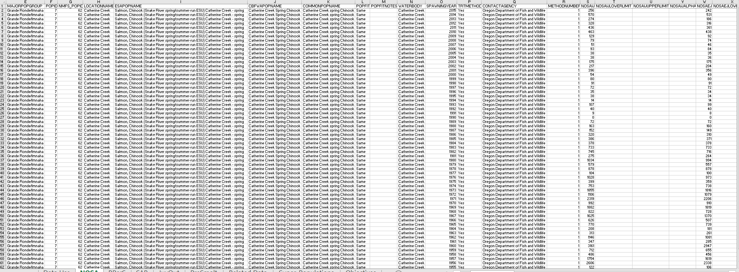
Just in case you think this is a really exciting topic – our
Downloadable Database…

Slide 10
“Traditional” website use is fairly stable, but automated sharing and consumption of data increasing rapidly

Slide 11
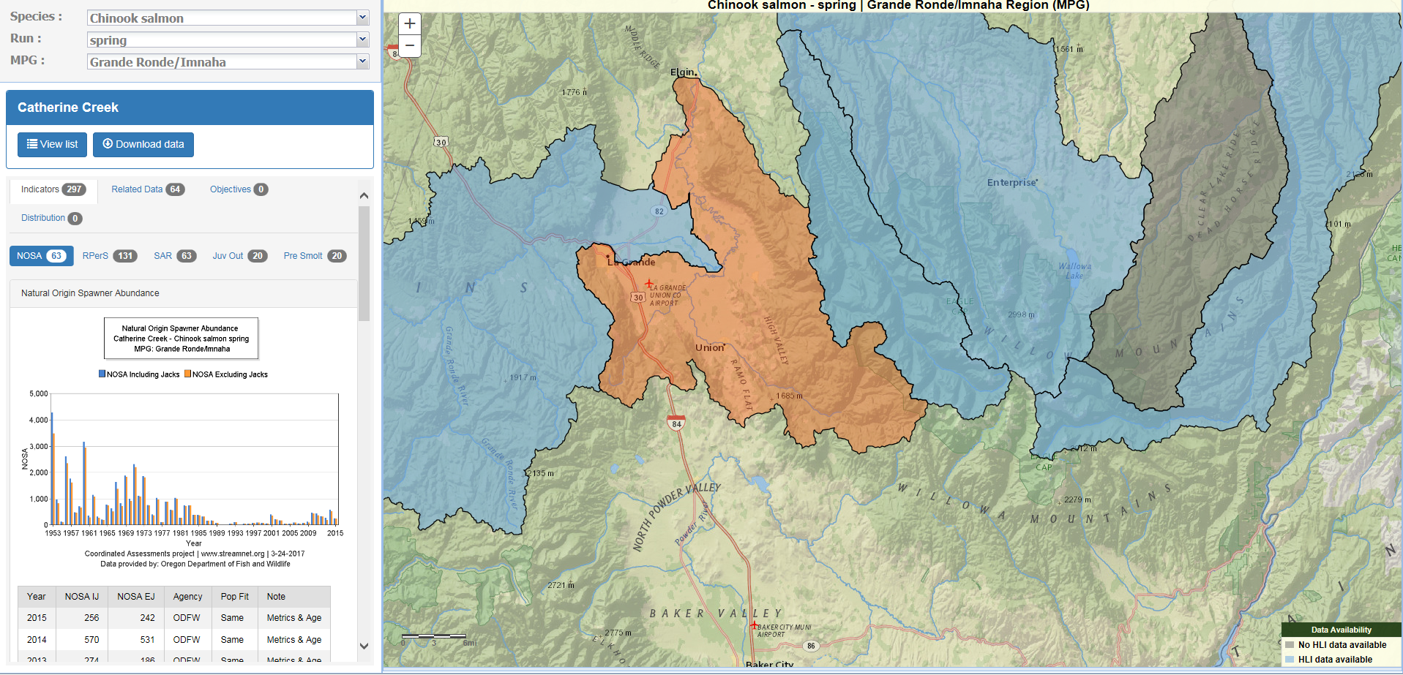
Will share Council Objectives here
Data/Graph is captured and exported to Council Objectives website

Slide 12
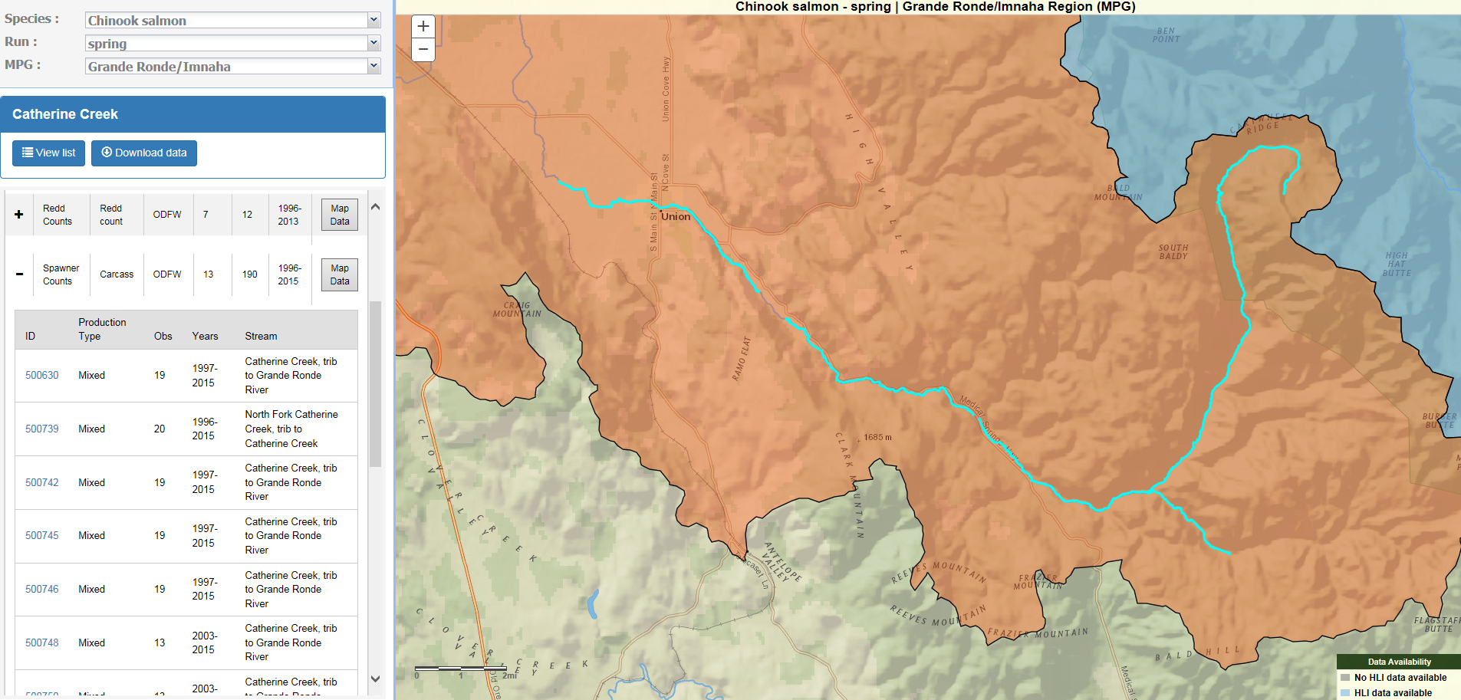
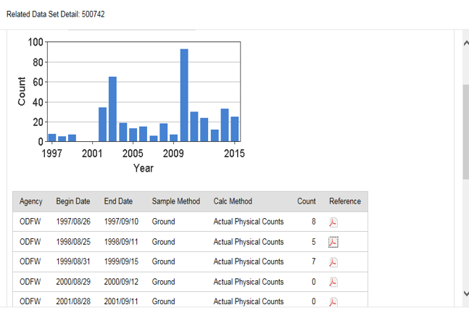
Traditional StreamNet “Abundance Trends” – now “Related Data” more granular understanding by placing data in the CA population indicator context

Slide 13
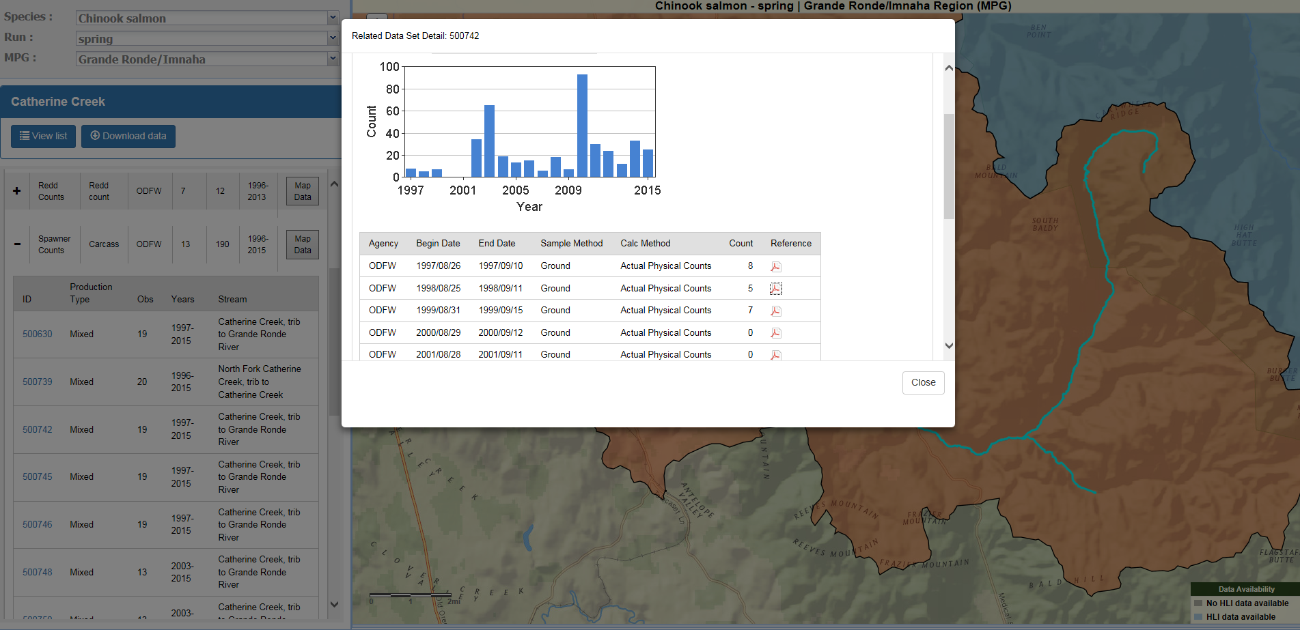
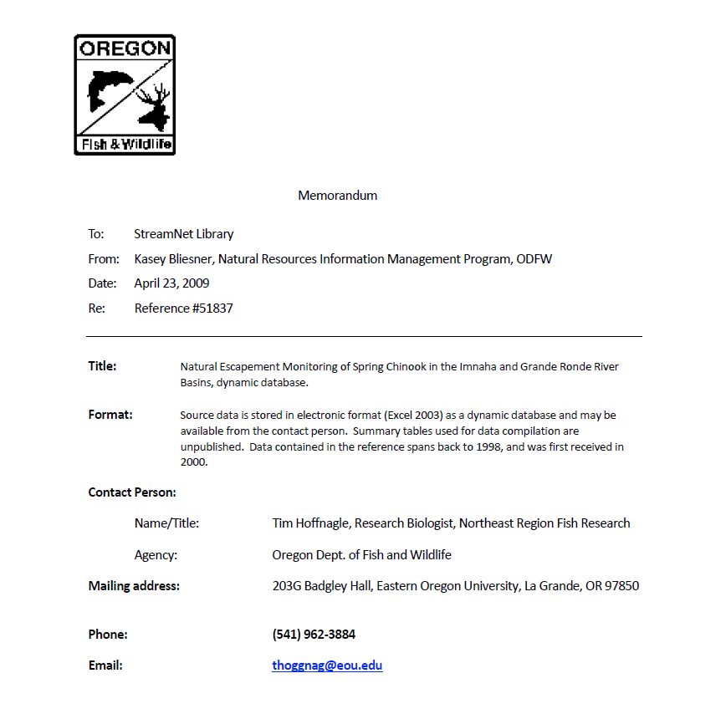
“Related Data” attribution is project by project, linked to pdf in StreamNet library – traditional bibliographic citation system (though more and more just a reference to data in a database)

Slide 14
Bottom Line
It takes a lot of coordination to get data reported in the same way across agency and state boundaries
There needs to be a data need “pull” to incentivize working across organizational boundaries. If each organization’s data needs are already met internally – why do extra work?
There needs to be structured data that is similar across Geographic and agency boundaries
Key participants are the biologists/data experts in each organization that collect data – they need to work together on the DES team to agree on the data exchange standards if this is going to work
It can be difficult to “automate” calculation of indicators, due to changing conditions and high level of analysis that goes into estimating parameters at the population scale

Slide 15
Why are we here ?/ What’s next?
The CA Five Year Plan:
Focus on data for Natural origin salmon & steelhead indicators
Hatchery data
bull trout – Missoula workshop with NPCC
Lamprey, sturgeon, Resident trout
For Bull Trout, we want to Explore interest
Determine if Data needs support continued discussion
Make sure Bull trout fisheries managers lead any discussion

Slide 16
Questions?

Slide 17
Extra Slides

Slide 18
What’s next for CA?
Five Year Plan:
1. Focus on data for Natural origin salmon & steelhead indicators
2. Hatchery data
3. bull trout – Missoula workshop with NPCC
4. Lamprey, sturgeon, Resident trout

Slide 19
