Slide 1
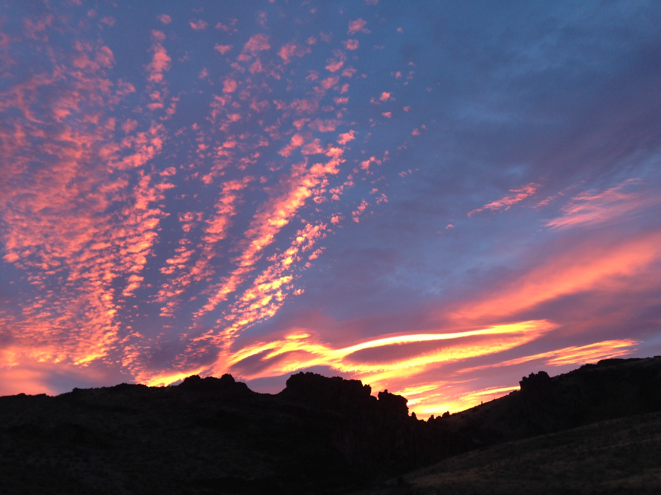
StreamNet Steering Committee Meeting Nov. 10, 2016 Agenda
Quick Review of FY 17 Budgets and FY 16 Spending 9:00 AM
Lessons Learned from BPA Priority Population Exercise 9:30 AM
Review Coordinated Assessments 5 Year Plan and Set Priorities 10:30 AM
  For current FY – Including Bull Trout Discussion
Roundtable Discussion: Issues with Gathering, Validating, 11:00 AM
  And QA/QC’ing CA HLI Data
LUNCH (NOTE: we will collect from each attendee and get pizza or sandwiches – or feel free to bring your own)
Update from CRITFC on Tribal EPA Grant & CA-Tribal Futuring Discussion 1:00 PM
Updating “Related Data” Expectations and Concerns 1:30 PM
Roundtable Discussion 2:30 PM
Adjourn 4:00 pm

Slide 2
Quick Review of FY 17 Budgets & Spending
FY 2016 Spending – target was $49,758 in savings to “roll” into 17
Total was actually $142,265. As of 11/2/16;
  PSMFC $51,565
  WDFW $19,387
  ODFW $23,320
  MFWP $35,521
  CCT $0
  USFWS $0
  IDFG $16,472
FY 2017 – With rollover savings from 2016 and cuts at PSMFC returned everyone to “base”

Slide 3
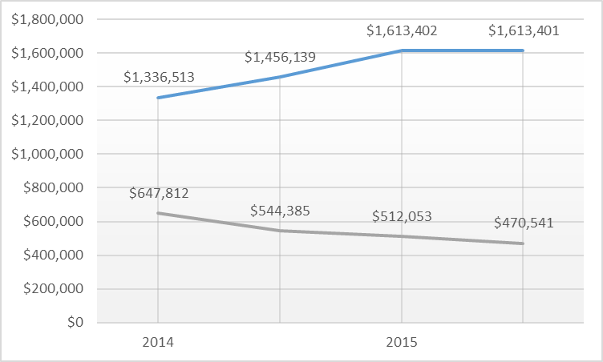
FY 17 Partner Budgets:
 | 2014 |  | 2015 |  | 2016 |  | 2017
Partners | $1,336,513 |  | $1,456,139 |  | $1,613,402 |  | $1,613,401
PSMFC | $647,812 |  | $544,385 |  | $512,053 |  | $470,541
Indirect | $100,251 |  | $84,052 |  | $83,596 |  | $111,299 | * includes
 |  |  |  |  |  |  |  | Iverson Contract
Total | $2,084,576 |  | $2,084,576 |  | $2,209,051 |  | $2,195,241
CCT |  | $90,000
IDFG |  | $331,288
MFWP |  | $168,877
ODFW |  | $474,458
USFWS |  | $78,248
WDFW |  | $470,530

Slide 4
PSMFC & StreamNet 2017 Budget
We have reprogrammed BPA funding for Streamnet (Direct only) away from PSMFC about 27.4% (-$177,271) in the last 4 years and allocated that to partners
Have eliminated most travel, device purchases, other extras (did add a $24,000 subcontract for Tom Iverson to continue tribal support)
For 2017 the cuts and shifting PSMFC staff to Klamath project were used to balance the budget. should work for 2017, 2018 will have a significant budget problem at PSMFC if no increase or change

Slide 5
2017 StreamNet Budget Executive Committee Discussion
BPA requested more transparency in the subcontract budgets. Expectation is no additional funding in 2018
Will schedule a budget meeting this winter with ExComm
Partners will need to describe how your allocation of resources supports the current priorities of streamnet
  CA Project
  Distribution
  Facilities dataset

Slide 6
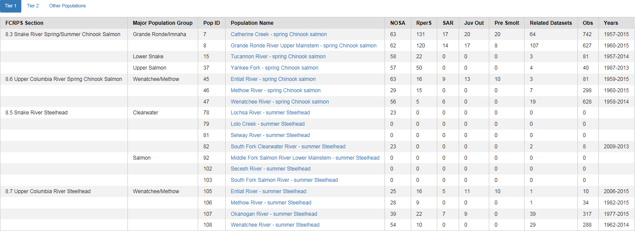
BPA Priority Population Exercise: Lessons Learned

Slide 7
BPA Priority Population Exercise: Lessons Learned
Coordinated Assessments Data through FY 2016
Number of Populations and Years of Information Reported as of November 3, 2016
Indicator | All Reported Populations / Years of Info. | ODFW Populations / Years | IDFG^{Ӿ} Populations / Years | WDFW Populations / Years | CCT Populations / Years | CRITFC Populations / Years
Natural Origin Spawner Abundance | 151 / 4,864 | 72 / 2,027 | 20 / 1,070 | 64 / 1,756 | 1 / 11
Recruits per Spawner | 75 / 2,783 | 42 / 1,642 | 18 / 931 | 15 / 208 | 1 / 2
Smolt to Adult Ratio | 33 / 459 | 4 / 62 |  | 3 / 24 | 1 / 7 | 25 / 366
Juvenile Abundance | 25 / 389 | 5 / 91 | 1 / 21 | 18 / 268 | 1 / 9
Presmolt Abundance | 6 / 93 | 4 / 73 |  | 2 / 20
^{Ӿ}Includes estimates coordinated with ISEMP, NPT or SBT. Includes TRT, non-TRT Populations and SuperPopulations.
Note: Some numbers don’t add up across Indicators Reported due to portions of Populations shared by agencies or multiple RperSTypes reported per Population, etc.

Slide 8
Our (PSMFC) Priority List for FY 16:
HLIs for 18 Tier 1 Populations
HLIs for 51 Tier 2 Populations
HLIs for other populations
Trends for both Tier 1 and Tier 2 Populations
Fish Distribution Updates
Facilities dataset maintenance
NPCC dashboard trends
Other (i.e. resident fish data, etc.)

Slide 9
What Did We Learn From This Effort?
How Does This Effect Priorities for 2017?
Do We Want to Pursue Any Recommendations to Regional Fish & Wildlife Managers?
PSMFC Recommendation: Clear direction to your StreamNet-funded staff on priorities is essential

Slide 10
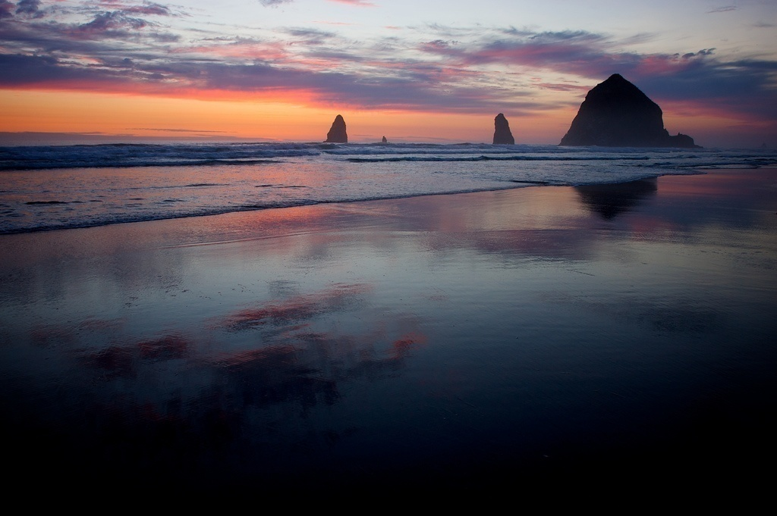
Next Priorities Discussion
From the CA 5 Year Plan Year 2 (Oct, 2016 – Sep, 2017);
Maintain, update, and automate existing data flow. Fully populate all Natural Origin Indicators with data
Finalize DES for hatchery indicators, begin to populate with data
Coordinate closely with hatchery database managers, expand hatchery DES team
Align hatchery DES development with needs of regional fish and wildlife managers
Notes:
Faded background picture
(Basic)
To reproduce the background effects on this slide, do the following:
On the Home tab, in the Slides group, click Layout and then click Blank.
Right-click the slide and click Format Background.
In the Format Background dialog box, click Fill in the left pane. In the Fill pane, select Picture or texture fill, and then under Insert from, click File.
In the Insert Picture dialog box, select a picture, and then click Insert.
Also in the Format Background dialog box, in the Fill pane, in the Transparency box, enter 85%.

Slide 11
2017 StreamNet Executive Committee Discussion
Clear direction on priorities to StreamNet-funded staff is essential
Ask partners for report on expected data flow again this year
In report, clearly indicate where population level indicator data will not be forthcoming

Slide 12
Review of CA 5 Year Plan – Set Priorities for FY 17
Add PNI as indicator? Is currently a metric and data is present in many cases (instruct partner staff to report, validate, and publish?)
Hatchery Indicators: A policy-level discussion is needed to define what is needed and useful. StreamNet will try to facilitate a work group that will define what hatchery information should be pursued -- DES work can follow if needed. StreamNet Executive Committee participants will provide names of correct people to invite to this work group (May, 2016 notes).
CAPG discussion (primarily your data compilers); CA project is still very labor intensive, consensus appeared to be retain focus on populating, automating, and updating existing NO indicators in FY 17

Slide 13
Bull Trout Discussion
EPA Grant application was dropped, as we were told directly that our ideas for a distribution update and GIS dataset would not qualify as a partnership grant
Generally a moderate to high level of interest (depending on agency/individual contacted) in collaboration on bull trout data management in region
Did not identify a management/leadership “pull” for bull trout data (like NOAA 5 year status review) – Is there one that we missed?
Current CA 5 year plan is to review data on lamprey, sturgeon, and bull trout starting next year (Oct., 2017). Change or update????

Slide 14
Streamnet Executive Committee Decision
Make populating the existing natural origin indicators the priority for FY 2016
Include discussions with FPC & CRITFC about sharing and displaying SARs for superpopulations
Survey partners to get information on predicted dataflow for the year, including information on “predicted” data, which shows where population level data is not/won’t be available
Continue to work with CRITFC tribes to include them in data flow to the extent that resources allow them to do so.
Nancy Leonard (NPCC), with Chris’s help (StreamNet) will convene a Bull trout workshop to identify players, discuss data needs, and identify future paths forward for regional data sharing for this species. Montana will be asked to play an important role (Host?).

Slide 15
Roundtable Discussion: Issues with Gathering, Validating, and QA/QC’ing CA HLI Data

Slide 16
Update on Tribal EPA Grant & Discussion of Tribal Involvement in CA Project in Future

Slide 17

Updating “Related Data” Expectations & Concerns
November 4, 2016
Following Table Shows BPA Tier 1 Populations Only

Slide 18
Tier 1 Population Name | Agency | Related Data Category | Observations | Years of Data
Catherine Creek - spring Chinook salmon | ODFW | Redd Counts | 300 | 1957-2015
Catherine Creek - spring Chinook salmon | ODFW | Spawner Counts | 404 | 1996-2015
Catherine Creek - spring Chinook salmon | ODFW | Fish Counts | 38 | 1996-2015
Grande Ronde River Upper Mainstem - spring Chinook salmon | ODFW | Redd Counts | 248 | 1960-2015
Grande Ronde River Upper Mainstem - spring Chinook salmon | ODFW | Spawner Counts | 341 | 1996-2015
Grande Ronde River Upper Mainstem - spring Chinook salmon | ODFW | Fish Counts | 38 | 1996-2015
Tucannon River - spring Chinook salmon | WDFW | Redd Counts | 58 | 1957-2014
Tucannon River - spring Chinook salmon | WDFW | Hatchery Returns | 23 | 1996-2009
Yankee Fork - spring Chinook salmon | IDFG | Redd Counts | 40 | 1987-2013
Entiat River - spring Chinook salmon | WDFW | Redd Counts | 57 | 1959-2015
Entiat River - spring Chinook salmon | WDFW | Spawner Abundance Est. | 14 | 2002-2015
Entiat River - spring Chinook salmon | WDFW | Fish Counts | 10 | 2006-2015
Methow River - spring Chinook salmon | USFWS | Hatchery Returns | 40 | 1978-2015
Methow River - spring Chinook salmon | WDFW | Redd Counts | 219 | 1960-2014
Methow River - spring Chinook salmon | WDFW | Spawner Abundance Est. | 39 | 1977-2015
Wenatchee River - spring Chinook salmon | WDFW | Redd Counts | 279 | 1958-2014
Wenatchee River - spring Chinook salmon | WDFW | Spawner Counts | 133 | 1996-2014
Wenatchee River - spring Chinook salmon | WDFW | Spawner Abundance Est. | 216 | 1958-2014
South Fork Clearwater River - summer Steelhead | IDFG | Hatchery Returns | 8 | 2009-2013
Lolo Creek - summer Steelhead
Selway River - summer Steelhead
Middle Fork Salmon River Lower Mainstem - summer Steelhead
Secesh River - summer Steelhead
South Fork Salmon River - summer Steelhead
Lolo Creek - summer Steelhead
Entiat River - summer Steelhead | WDFW | Redd Counts | 10 | 2006-2015
Methow River - summer Steelhead | WDFW | Spawner Abundance Est. | 34 | 1982-2015
Okanogan River - summer Steelhead | WDFW | Redd Counts | 130 | 2002-2015
Okanogan River - summer Steelhead | WDFW | Dam / Weir Counts | 10 | 2005-2015
Okanogan River - summer Steelhead | WDFW | Spawner Abundance Est. | 162 | 1977-2015
Okanogan River - summer Steelhead | WDFW | Fish Abundance Est. | 15 | 2004-2011
Wenatchee River - summer Steelhead | WDFW | Redd Counts | 235 | 2001-2014
Wenatchee River - summer Steelhead | WDFW | Spawner Abundance Est. | 53 | 1962-2014
November 4, 2016

Slide 19
November 4, 2016
Population Related StreamNet Data by Category & Agency |  |  |  |  | All Agencies
Data Category | IDFG | ODFW | USFWS | WDFW | Total Datasets | Total Observations
Redd Counts | 2,406 | 8,292 |  | 1,445 | 1,048 | 12,143
Spawner Counts |  | 6,090 |  | 529 | 663 | 6,619
Dam / Weir Counts |  | 1,635 |  | 109 | 79 | 1,744
Spawner Abundance Estimates |  | 235 |  | 2,022 | 77 | 2,257
Hatchery Returns | 120 |  | 41 | 220 | 58 | 381
Fish Counts |  | 348 |  | 10 | 21 | 358
Fish Abundance Estimates |  | 116 |  | 15 | 18 | 131
Freshwater Harvest |  |  |  | 165 | 18 | 165
All Related Datasets | 2,526 | 16,716 | 41 | 4,515 | 1,982 | 23,798

Slide 20
May, 2016 Excom Discussion;
Rename “Trends” for the CA Database – Recommendation to Executive committee – “related data”
Identify categories to carry forward
  Redd counts; spawner counts; estimates of spawning population; estimates of juvenile population; hatchery returns, etc.
Define and adopt des standards for each category of related data
Look at populations and try to get consistency in related data reported, where possible
Id legacy (i.e. no longer done) and ongoing related data in ca Database
Display related data on ca web interface
Lower priority; updating traditional “trends” (keep name?) in streamnet that are not associated with ca

Slide 21
Updating “Related Data” Expectations & Concerns
Issues; significant differences in how partners are updating; data types, amount of data, timelines
As we move more into displaying information, discrepancies stand out
Legacy datasets that are no longer updated
Related data = “building blocks” that go into HLIs, NOT CA metrics (?) Using existing StreamNet DES standards
PSMFC Recommendation: Clear direction to your StreamNet-funded staff on priorities is essential

Slide 22
Updating “Related Data” Expectations & Concerns
Issues; significant differences in how partners are updating; data types, amount of data, timelines
As we move more into displaying information, discrepancies stand out
Legacy datasets that are no longer updated
ExCom Decision: Continue collecting and displaying this data as long as it’s not impeding work on higher priority tasks
Discuss with partners at Steering Committee to make sure there is common understanding of what we are asking for.

Slide 23

Roundtable

Slide 25
Extra Slides

Slide 26
BPA Priority Population Exercise: Lessons Learned
All Publishable* Coordinated Assessments Data as of November 3, 2016
CA table | Agency | Populations | Years Validated | HLIs | Years of data related to FCRPS/BPA Priority # 1 2 3 |  |  | Null Records | Last Updated
NOSA | ODFW | 72 | 2,027 | 2,353 | 126 | 744 | 1,157 | 35 | Oct 20 2016 9:26
 | CCT | 1 | 11 | 11 | 11 |  |  |  | Aug 12 2016 5:07
 | WDFW | 64 | 1,756 | 728 | 345 | 125 | 1,286 | 1,028 | Sep 23 2016 2:28
 | IDFG | 20 | 1,070 | 1,989 | 104 | 502 | 464 | 75 | Oct 19 2016 6:55
NOSA | All Agencies | 151 | 4,864 | 5,081 | 586 | 1,371 | 2,907 | 1,138 | Oct 20 2016 9:26
RperS | IDFG | 18 | 931 | 820 | 53 | 454 | 424 | 111 | Sep 23 2016 1:37
 | WDFW | 15 | 208 | 207 | 114 | 60 | 34 | 1 | Sep 23 2016 2:39
 | CCT | 1 | 2 | 2 | 2 |  |  |  | Aug 24 2016 4:47
 | ODFW | 42 | 1,642 | 1,559 | 263 | 785 | 594 | 83 | Oct 13 2016 2:42
RperS | All Agencies | 75 | 2,783 | 2,588 | 432 | 1,299 | 1,052 | 195 | Oct 13 2016 2:42
SAR | CCT | 1 | 7 | 7 | 7 |  |  |  | Sep 23 2016 2:42
 | ODFW | 4 | 62 | 56 | 35 | 11 | 16 | 6 | Oct 10 2016 6:55
 | CRITFC | 25 | 366 | 362 | 6 | 27 | 333 | 4 | Sep 7 2016 12:14
 | WDFW | 3 | 24 | 24 | 14 | 10 |  |  | Sep 23 2016 2:42
SAR | All Agencies | 33 | 459 | 449 | 62 | 48 | 349 | 10 | Oct 10 2016 6:55
Juvenile Outmigrants | ODFW | 5 | 91 | 84 | 41 | 32 | 18 | 7 | Oct 10 2016 6:55
 | CCT | 1 | 9 | 9 | 9 |  |  |  | Sep 23 2016 2:47
 | WDFW | 18 | 268 | 261 | 115 | 56 | 97 | 7 | Sep 23 2016 2:47
 | IDFG | 1 | 21 | 19 |  |  | 21 | 2 | Sep 27 2016 4:02
Juvenile Outmigrants | All Agencies | 25 | 389 | 373 | 165 | 88 | 136 | 16 | Oct 10 2016 6:55
Presmolt Abundance | ODFW | 4 | 73 | 58 | 41 | 32 |  | 15 | Aug 24 2016 4:48
 | WDFW | 2 | 20 | 20 | 20 |  |  |  | Sep 23 2016 3:20
Presmolt Abundance | All Agencies | 6 | 93 | 78 | 61 | 32 |  | 15 | Sep 23 2016 3:20
PNI | All Agencies
All Tables | All Agencies | 290 | 8,588 | 8,569 | 1,306 | 2,838 | 4,444 | 1,374 | Oct 20 2016 9:26

Slide 27
Data Store: Data Sets by Fiscal Year (all years)
Fiscal Year | Total data sets | BPA-funded
2016 | 10 | 6
2015 | 12 | 6
2014 | 6 | 4
2013 | 9 | 8
2012 | 5 | 3
2011 | 13 | 7
2010 | 7 | 3
2009 | 4 | 2
2008 | 6 | 4
2007 | 7 | 5
2006 | 6 | 3
2005 | 26 | 8
TOTAL | 111 | 59

Slide 28
Data Store: Last 5 Fiscal Years by Agency
 | Fiscal Year
Agency | 2012 | 2013 | 2014 | 2015 | 2016 | TOTAL
Columbia River Estuary Study Taskforce |  | 1 |  |  |  | 1
IDFG |  |  |  | 4 |  | 4
MFW&P | 2 | 1 | 2 | 6 | 3 | 14
Nez Perce S&W Cons. Dist. | 1 | 1 | 1 |  | 1 | 4
NPT |  | 1 |  | 1 |  | 2
PNNL |  |  |  | 1 |  | 1
SBT | 2 | 3 | 3 |  | 1 | 9
StreamNet |  | 1 |  |  |  | 1
USFWS |  | 1 |  |  | 1 | 2
USGS |  |  |  |  | 2 | 2
YIN |  |  |  |  | 1 | 1
TOTAL | 5 | 9 | 6 | 12 | 9 | 41

