Slide 1
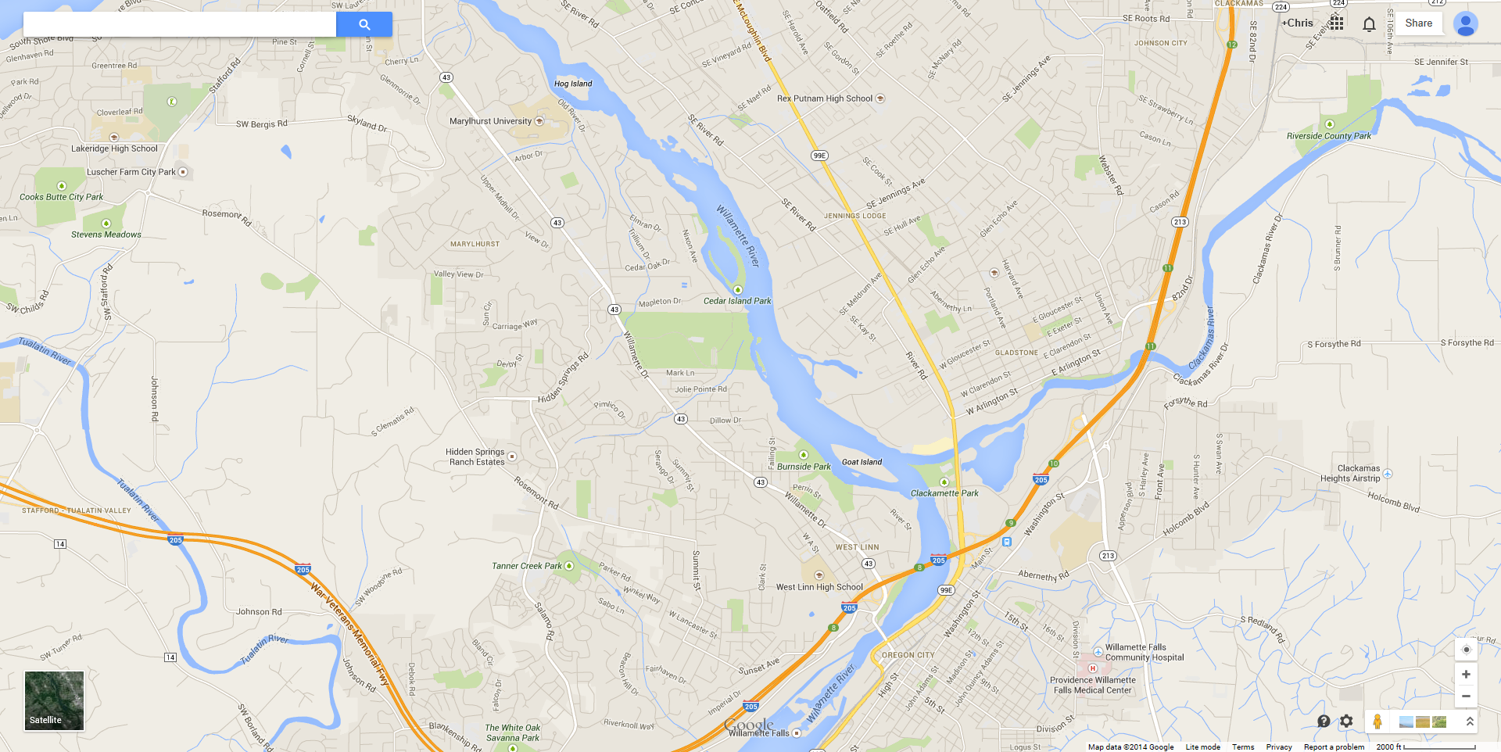
Roundtable
SNSC July 1, 2015

Slide 2
FY 15 Spending Snapshot (as of 6/17/15)
 | Percent of Funds Remaining | Billed thru | Percent of Year Remaining
CCT | 87.0% | March | 50.0%
IDFG | 67.1% | May | 33.0%
MFWP | 58.5% | March | 50.0%
ODFW | 44.5% | May | 33.0%
PSMFC | 43.7% | May | 33.0%
USFWS | 0.0% | Year | 0.0%
WDFW | 56.8% | April | 42.0%
Total | 48.9%

Slide 3

Emerging Technologies
Summary Report completed by Mike last month
Second Workshop co-sponsored with Sitka, PNAMP, and the Western Forestry and Conservation Association; Nov. 18 & 19 in Portland
Additional Device Purchases?
  $25,000 +/- could be available
  Interest expressed by;
    IDFG = $4,000
    WDFW = $15,000
    CCT = $3,800

Slide 4
FY 2015 Device Purchase Requests (with bids)
WDFW |  | $15,063 |  | 5 Toughpads
IDFG |  | $2,940 |  | 6 Sony Xperia™ Z3 compact Tablets
ODFW |  |  |  | no request
CCT |  | $3,695 |  | 1 SX Blue II-B GPS
MFWP |  |  |  | no request
USFWS |  |  |  | no request
PSMFC |  |  |  | no request
Total |  | $21,698 |  | PSMFC savings should be able to cover

Slide 5
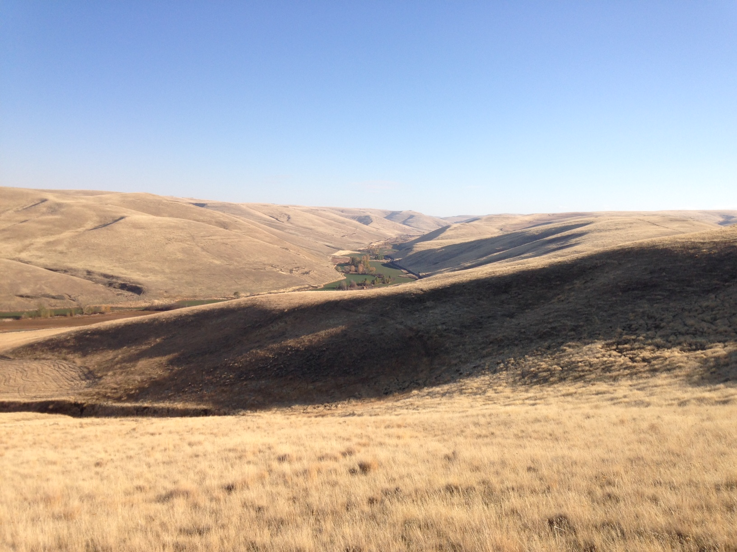
Other items…
Pisces Quarterly Update due July 15th

Slide 6
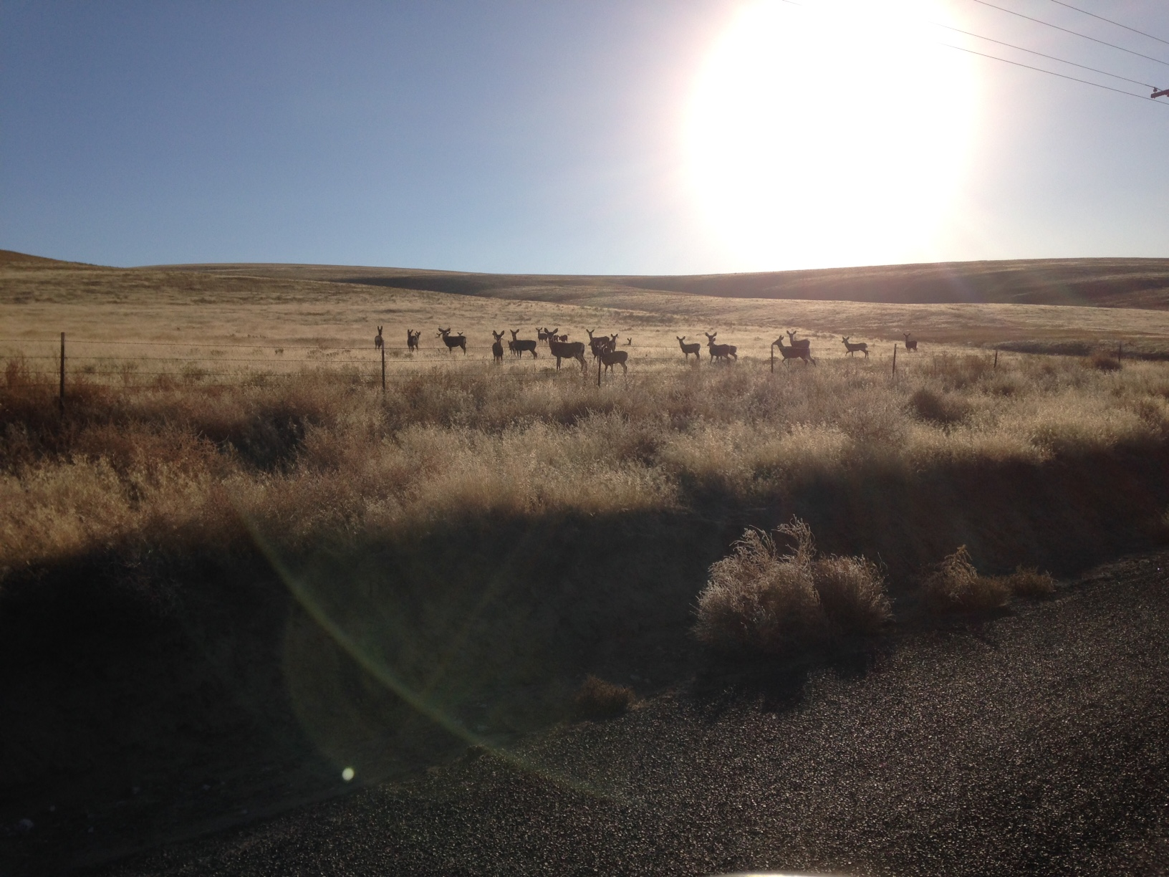
Update on CA Dataflow vs. Predictions
SNSC July 1, 2015

Slide 8
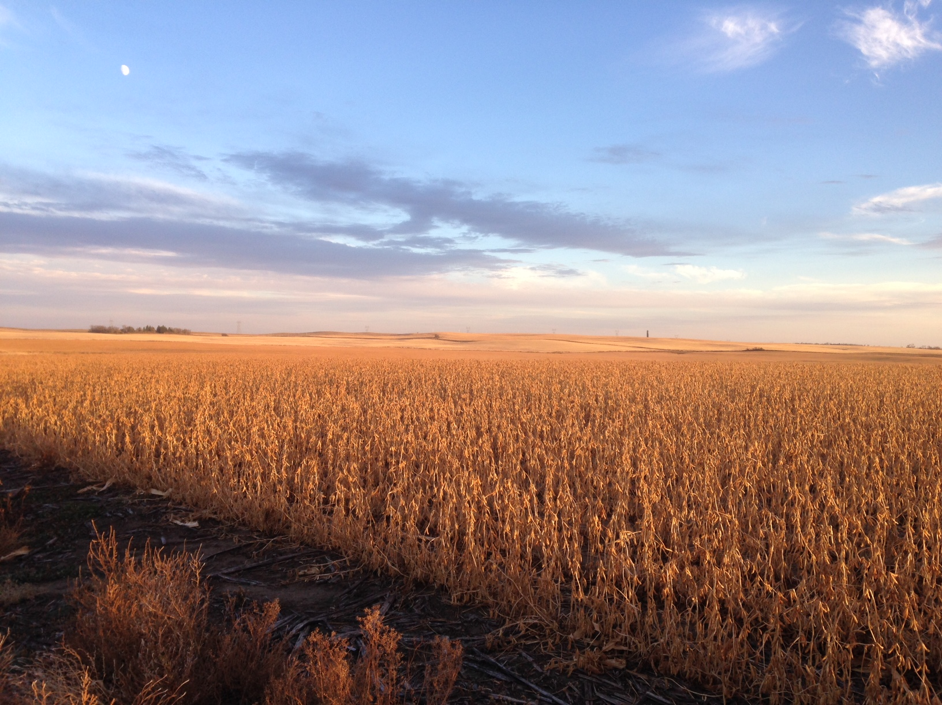
Next FY Statement of Work and Budget
SNSC July 1, 2015

Slide 9
Current Direction for 2016
Renew Updating Priority Traditional Data
  Proposed simple and consistent Milestone language
CA remains priority
  5 Year Plan for CA
Continue Simplification of SOW – 17 WE (20 in 2015)
  Other SOW themes;
    Secure Data Repositories
    Dissemination of Data (website, display, query system…)
    Field Device Trials and Workshop

Slide 10
Flat Budget
  Placeholder for USACE website management
  Any new developments from BPA?
  Issues, problems, discussion?

